Slide 1
On the Right Track: RAILS in 2026 & Beyond
RSA Director’s Day
September 30, 2026
Notes:
Monica/Joe

Slide 2

Notes:
Monica

Slide 3
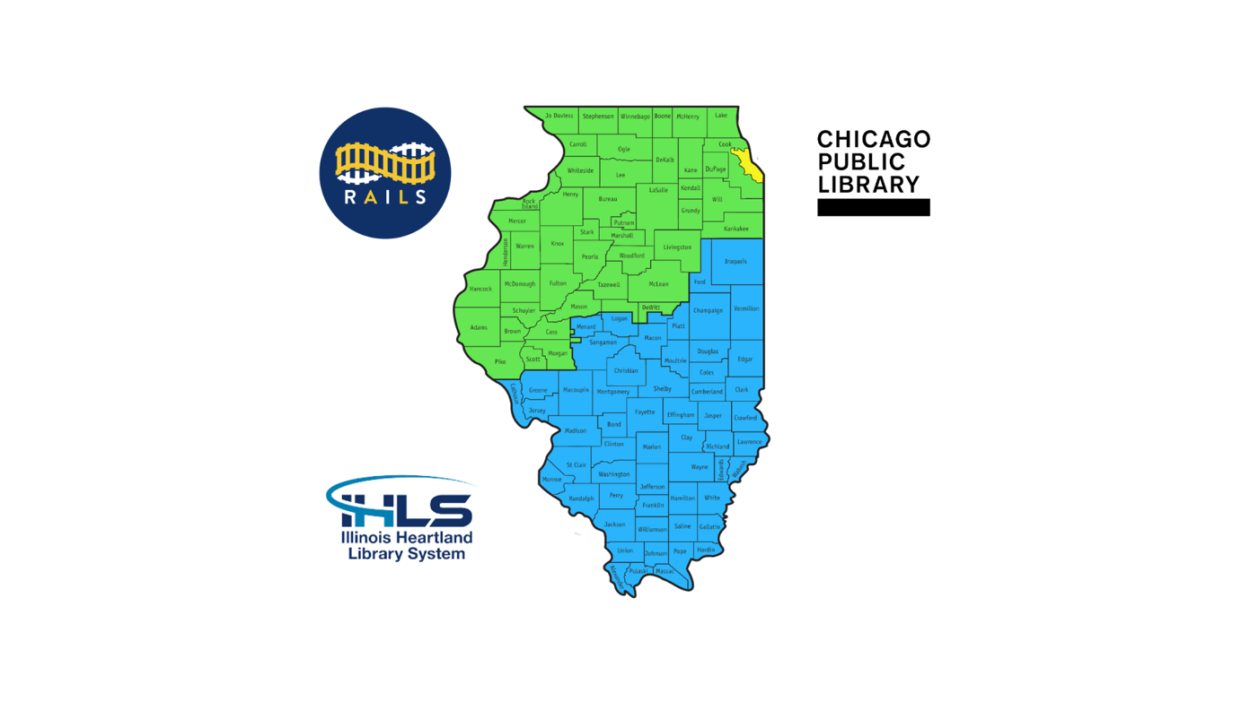
Notes:
Joe

Slide 4
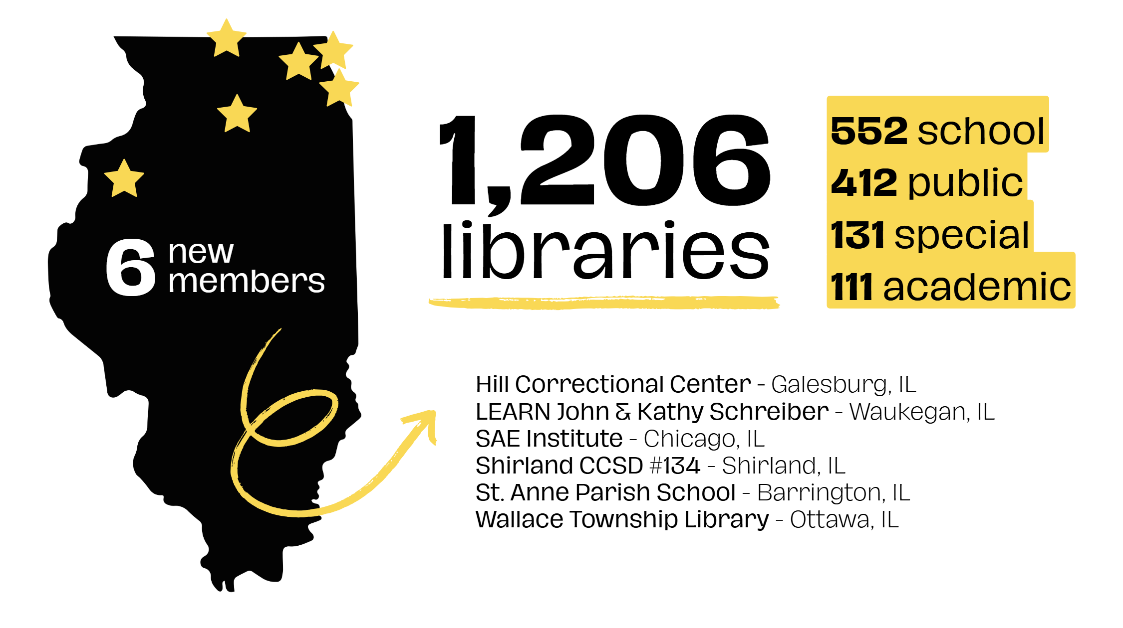
Notes:
Joe

Slide 5
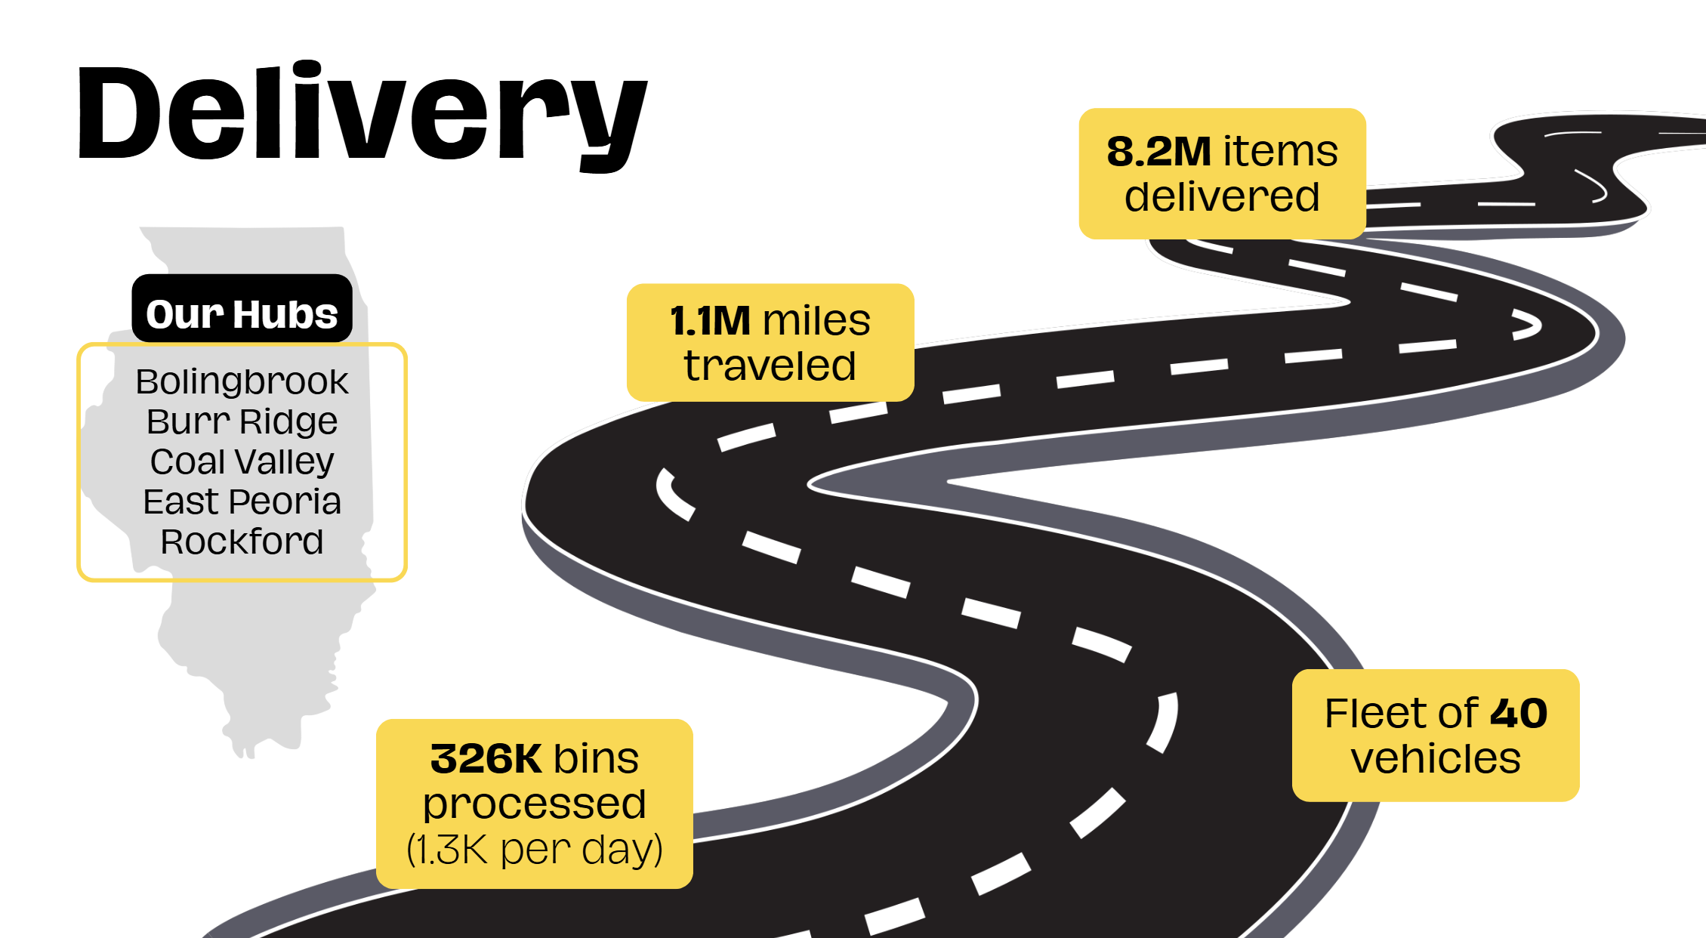
Notes:
Joe

Slide 6
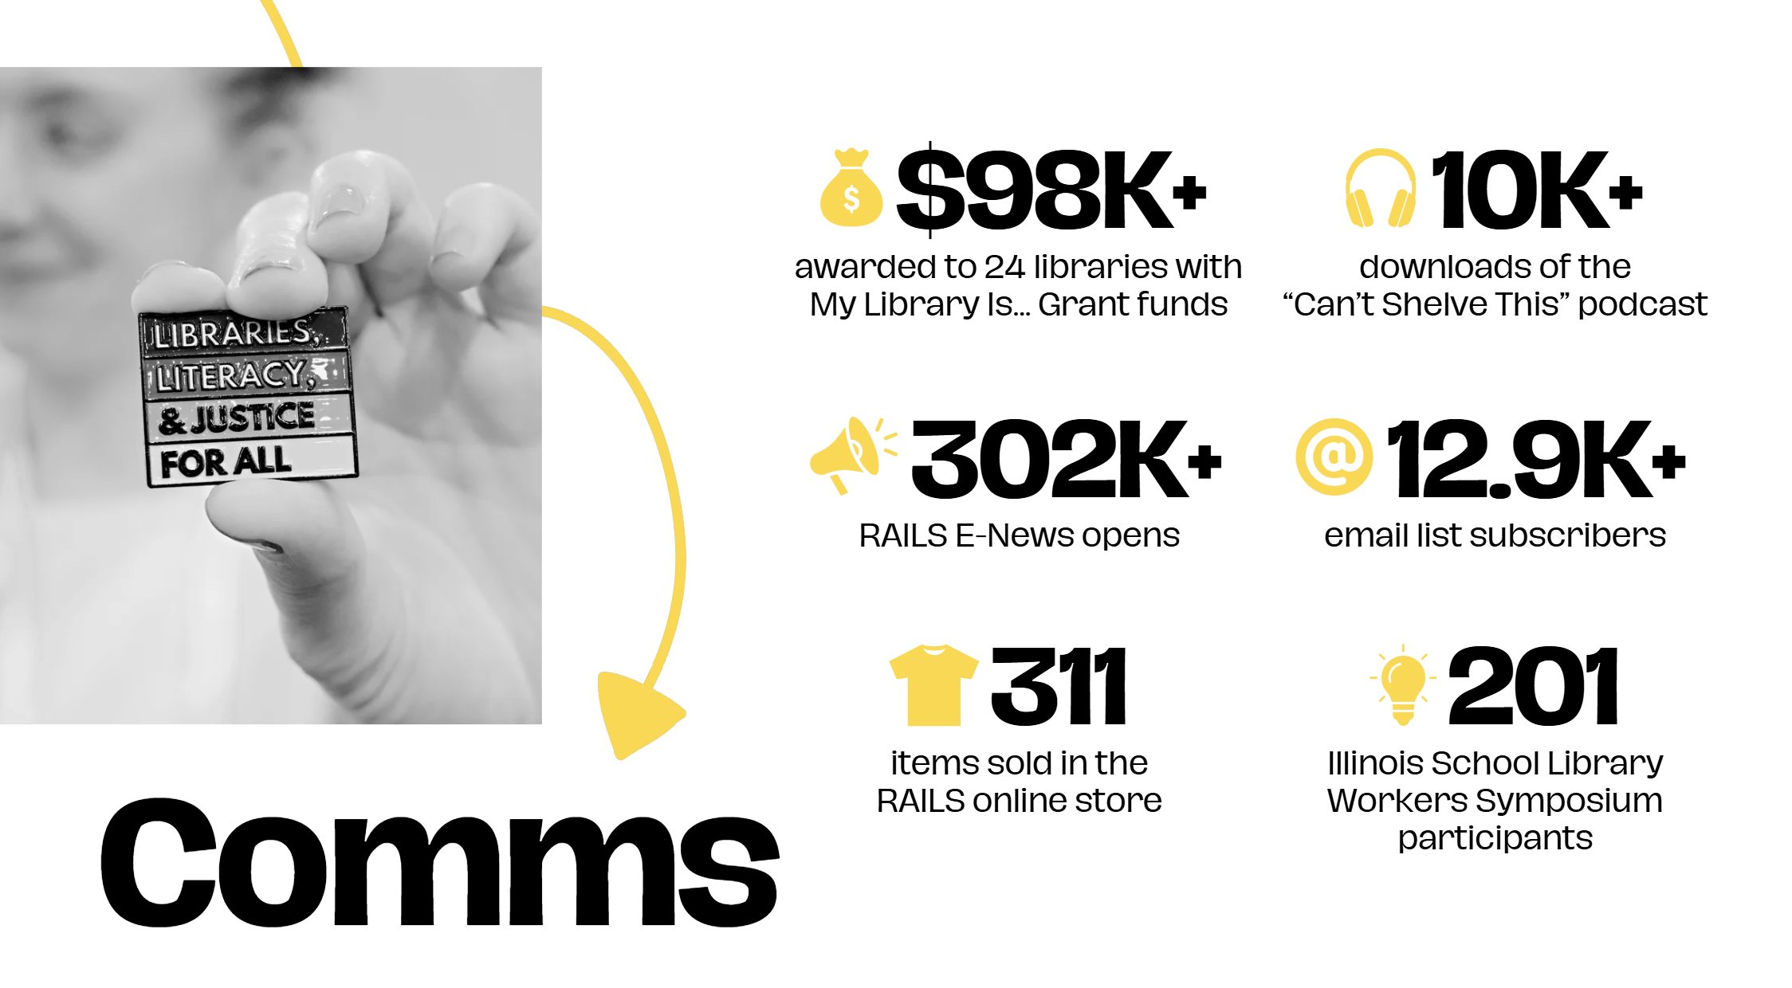
Notes:
Monica

Slide 7
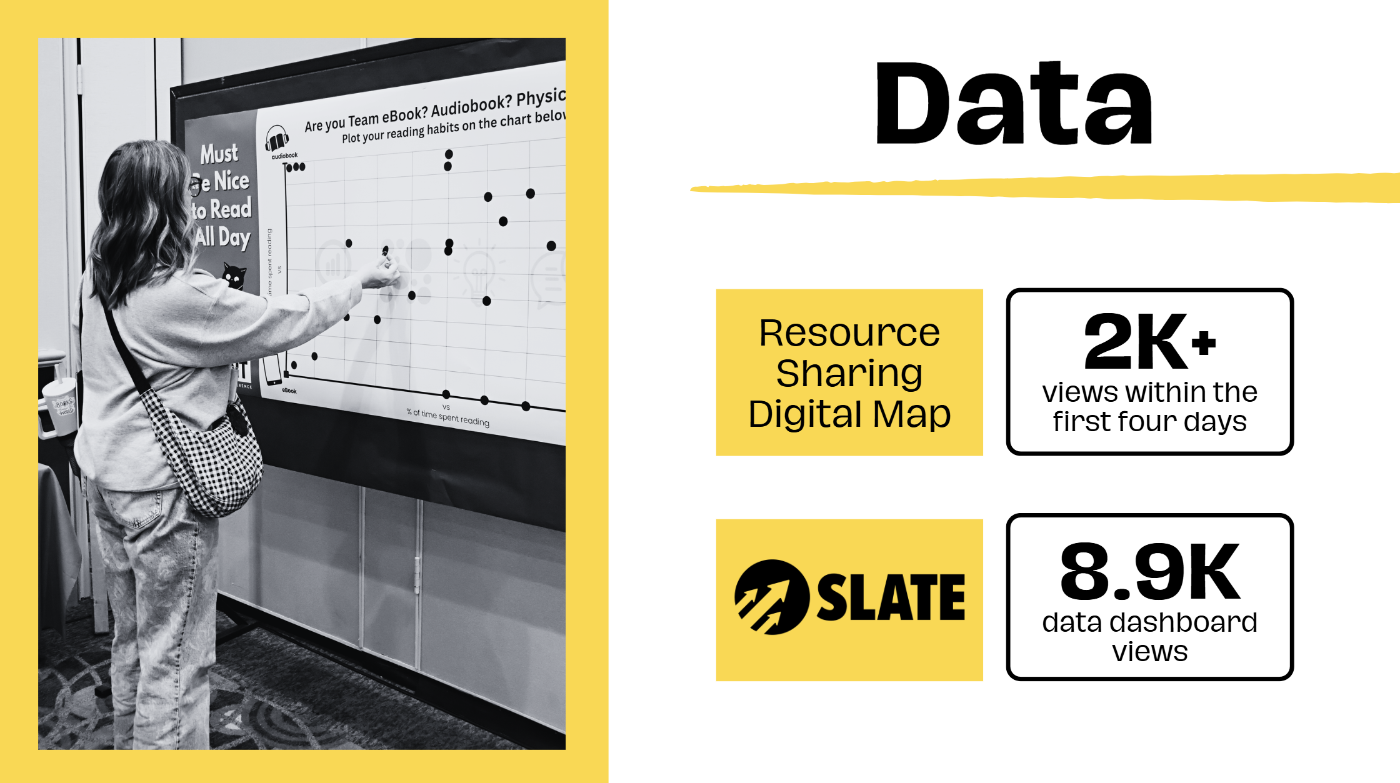
Notes:
Monica

Slide 8
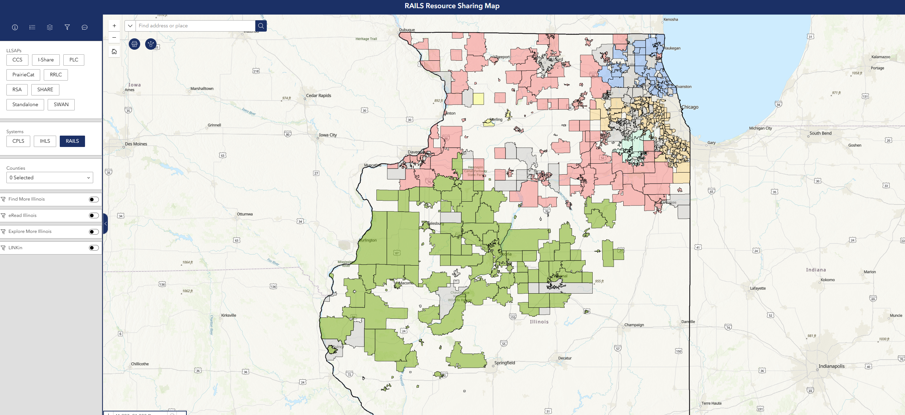
Notes:
Monica/Joe - How we support LLSAPs like RSA and others

Slide 9
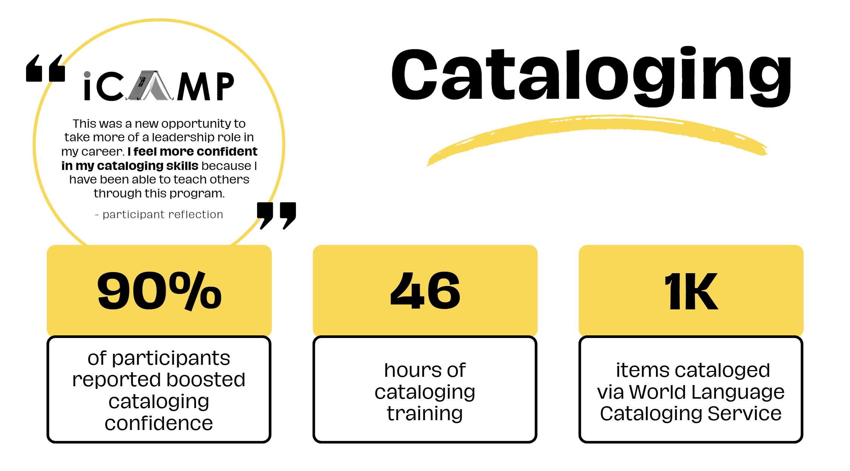
Notes:
Monica

Slide 10

Notes:
Joe

Slide 11

Notes:
Joe

Slide 12
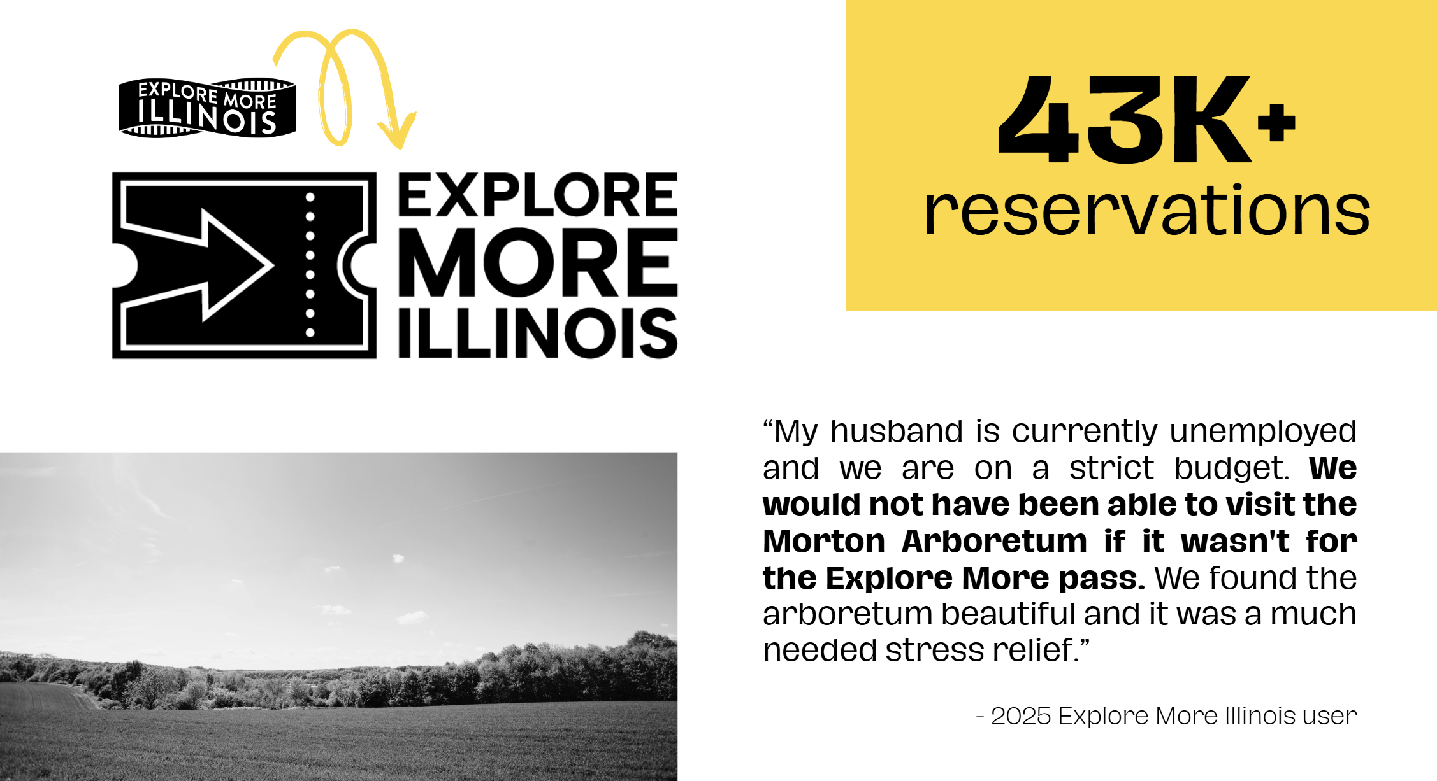
Notes:
Joe

Slide 13
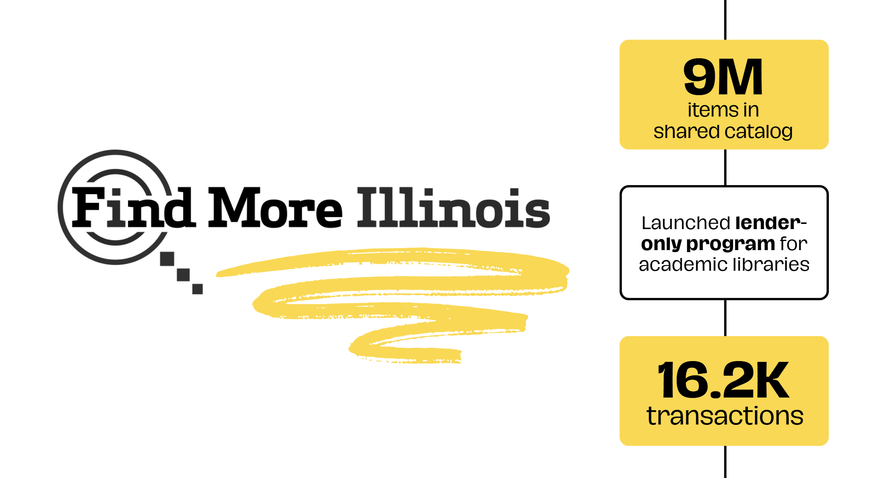
Notes:
Joe

Slide 14
New in 2026
Notes:
Joe

Slide 15
RAILS Strategic Plan Refresh
Strategic Goal 1: RAILS provides leadership in ensuring sustainable, equitable resource sharing for all member libraries.
Strategic Goal 2: RAILS models best practices in equity, diversity, accessibility, and inclusion.
Strategic Goal 3: RAILS assists member libraries in preparing for the future.
Strategic Goal 4: RAILS leads alongside member libraries to develop and strengthen the Illinois library community and expand services to all.
Notes:
Joe

Slide 16
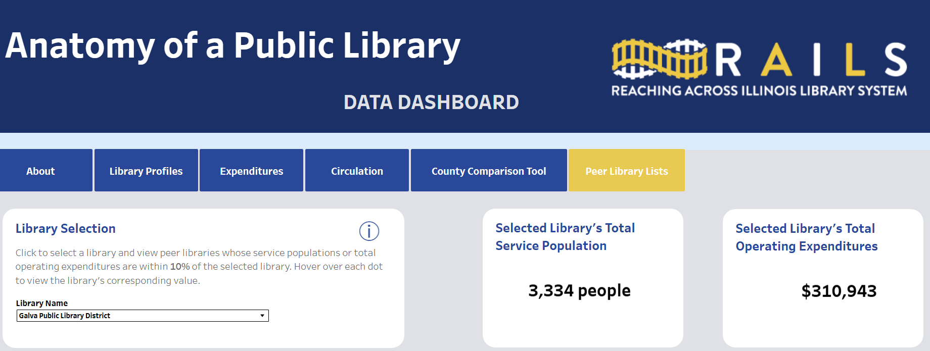
Notes:
Monica

Slide 17
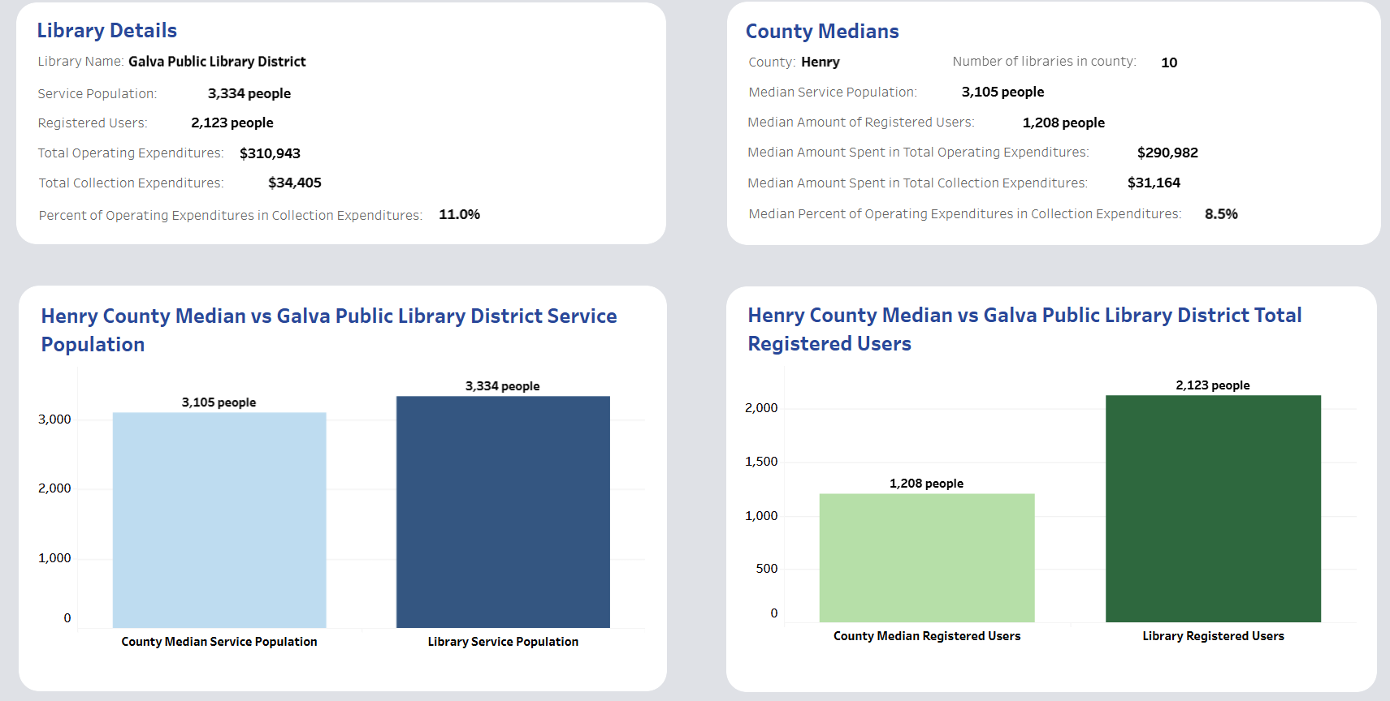
Notes:
Monica

Slide 18
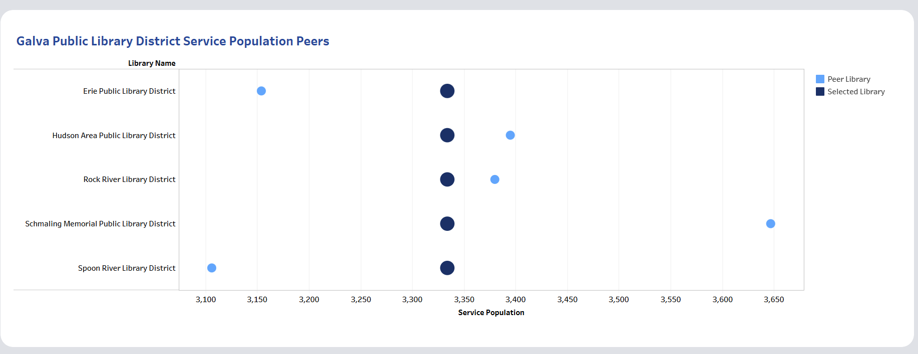
Notes:
Monica

Slide 19
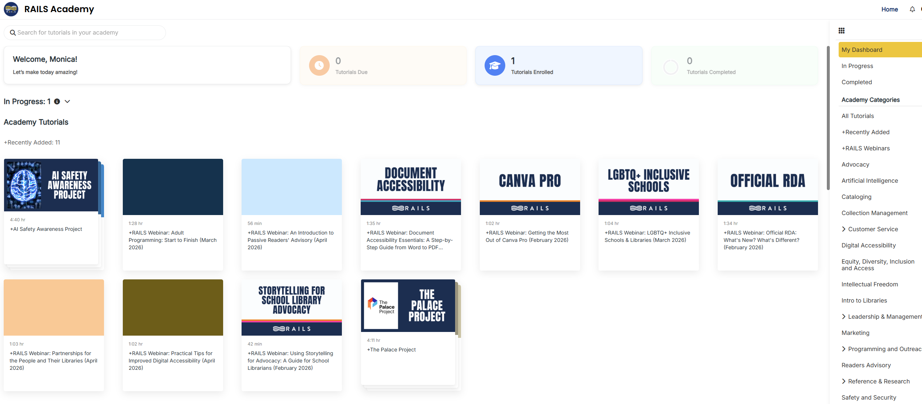
Notes:
Joe

Slide 20
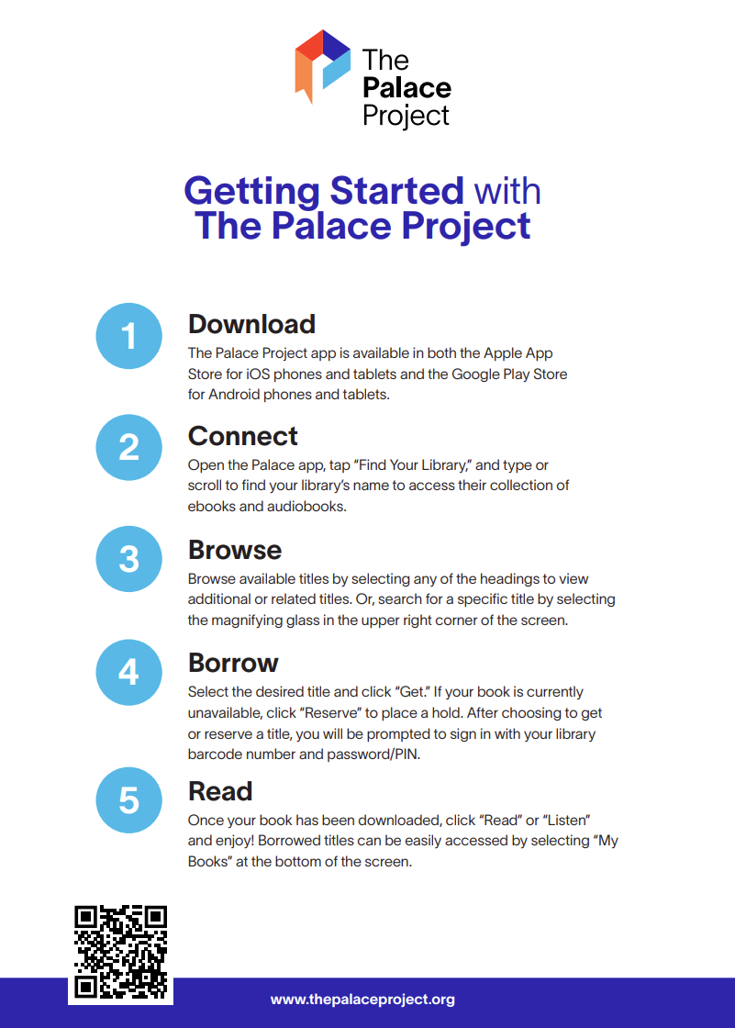
Notes:
Joe

Slide 21
Stay Informed with RAILS
Notes:
Monica

Slide 22
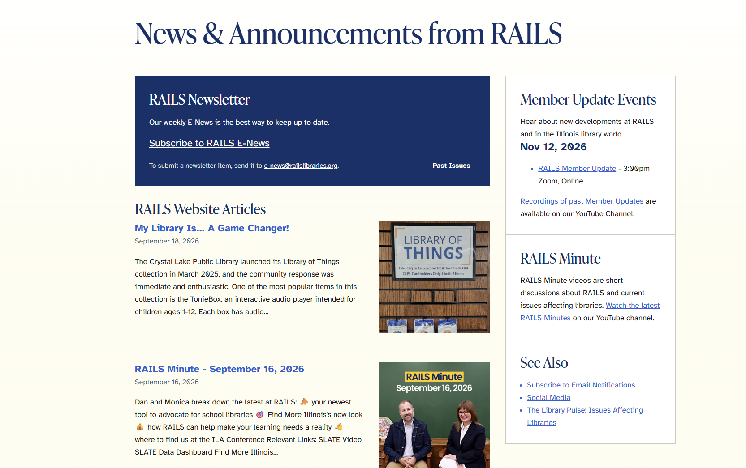
Notes:
Monica

Slide 23
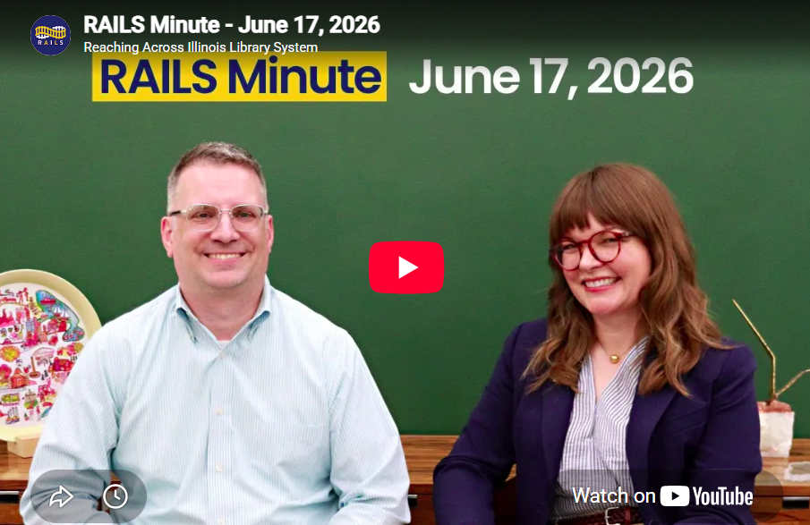

Slide 24
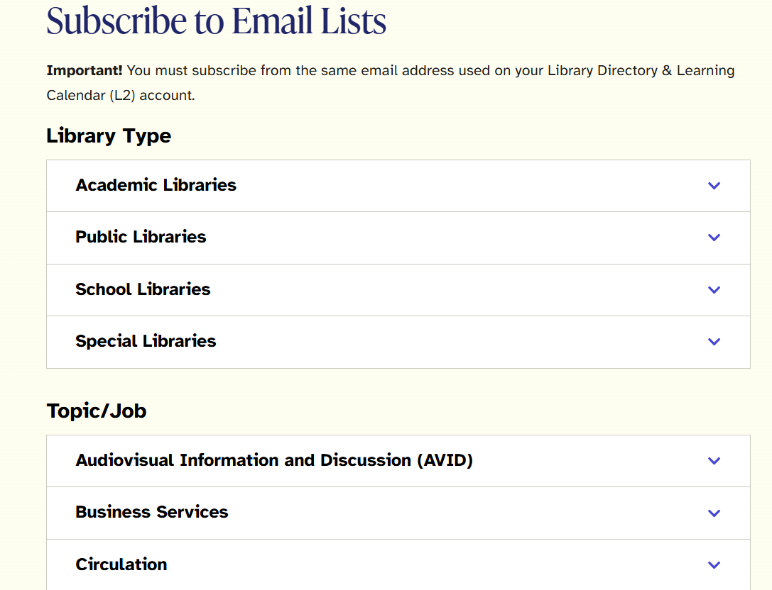
Notes:
Monica

Slide 25
Questions?
Joe Filapek
Associate Executive Director
Joe.Filapek@railslibraries.org
Monica Harris
Executive Director
Monica.Harris@railslibraries.org
Notes:
Joe/Monica

