Slide 1
RAILS Delivery Q&A
Robert Morgan
XEP Hub-Delivery Services Manager

Slide 2
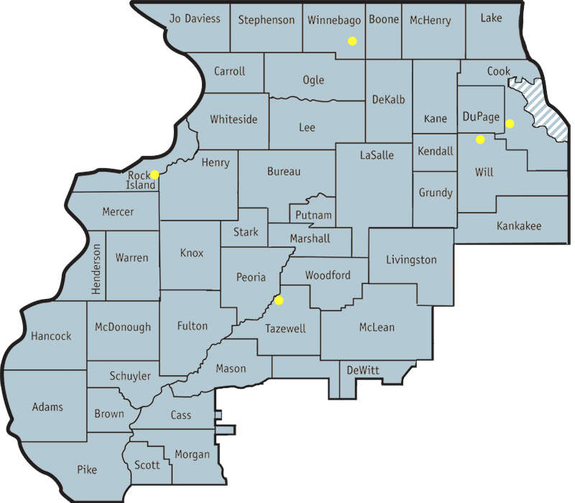
RAILS Delivery Department Overview
5 buildings Total- 4 delivery hubs
East Peoria, Rockford, Coal Valley, and Bolingbrook

Slide 3
Fun Data….we like numbers
8,260,163 items/316,213 containers for FY25
Avg. of 28,530 miles per week-1.4M total
Avg. of 2,348 stops per week-122K+ total
27,000 square miles.
29 delivery routes + 8(outsourced) - CTS
Serve nearly 1300 private, public, school, and university library members which have a total of more than 4000 library facilities
Type | Count
Academic | 110
Public | 413
School | 555
Special | 132

Slide 4
Your Delivery Hub- XEP (Like I said, we like numbers)
11 RAILS delivery staff
Processed in FY25- 946,038 items & 35,438 bins
33 separate routes all together
(6) M-F (1) T, W, & Th
Avg. 14 stops per route
Avg. of 4.82 driving hours
Avg 238.39 miles per day/Total of 7867p/w = 409k+ total
Longest: 1563 mi. p/w
Shortest: 784 mi. p/w

Slide 5
RSA vs RAILS- What’s the difference?
See your handouts
RSA does NOT manage/facilitate delivery
RAILS provides intra-library delivery.
95% of items moving between RSA members are from other RSA member libraries.
All RSA members must be RAILS members. Many RAILS members are not RSA members.
Without RSA’s membership/Benefits of RSA
Holds/ILL, Cataloging, Data

Slide 6
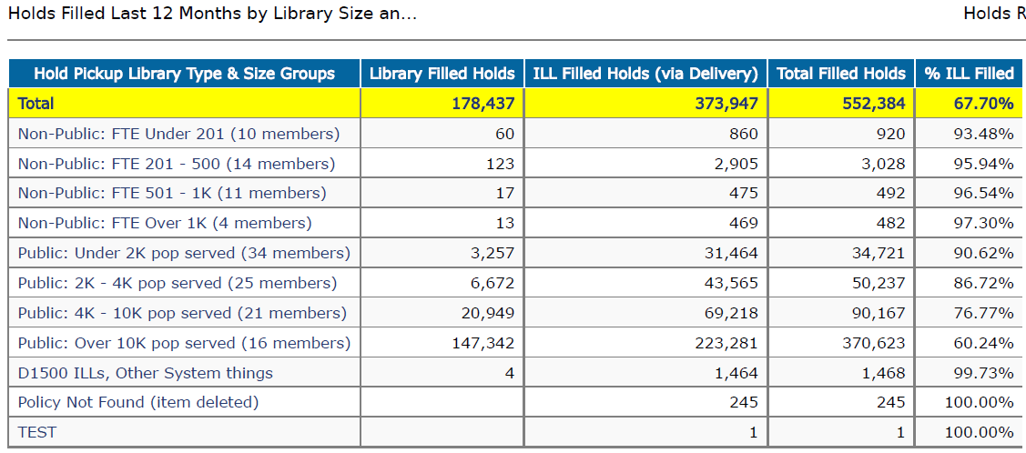

Slide 7
Check Out Our Website
Take time to explore the whole website
Delivery Count
Email List
Training Videos
Best Practices
What We Deliver
Delivery Frequency Table
Delivery Types
Labeling Instructions
L2, Delivery Labels, ILDS, Help Desk

Slide 8
Label Types and Helpful Tips
See your handouts
RAILS, ILDS, FMI, and ILS generated label types
Write BIG and BOLD
Write Clearly
No rule saying you can’t take up both TO field lines
Include Branch or CDP info on FOR line
NO Patron Info
Transit/Hold Slips- not required by RAILS or RSA for delivery

Slide 9
ILDS Shuttle Changes
What is ILDS?
ILDS is an interlibrary loan delivery service for academic and research libraries in Illinois. CARLI manages the program under a grant from the Illinois State Library and enlists the regional library systems for logistical support. That is, IHLS and RAILS serve as contracted couriers for ILDS.
What is changing about ILDS?
We are moving the RAILS and IHLS delivery vans’ regular meetup time. Currently, RAILS and IHLS shuttles meet every weeknight in Champaign to exchange materials. These shuttles will now meet during the day, rather than at night.

Slide 10
Delivery Help Desk
Send an email to railsdelivery@railslibraries.org.
Send your message from the email address used for your Library Learning (L2) account, so the ticketing system will recognize your library and route your message to the correct RAILS service center.
You should attach photos or documents to your help desk ticket.

