Slide 1
Senior Programming & Outreach
RSA Day – April 8, 2026

Slide 2

Madison Benson
Morton Public Library
Adult Services Coordinator

Slide 3
THE FUTURE OF OUTREACH SERVICES
Presented by Madison Benson
Morton Public Library Adult Services Coordinator

Slide 4

INTRODUCTION
A new wave of outreach and homebound patrons are coming our way. As a result, new interests are appearing and familiarity with technology is increasing. This means outreach will begin to change in the coming years.

Slide 5
DELIVERY PROCEDURE
CHANGES

Slide 6
LIBRARY TIME VS. BAG EXCHANGE
Library Time: I bring 30-40 books for patrons to browse and holds for those with specific requests. Patrons come up to me and let me know what they would like to take.
Bag Exchange: Patrons receive a bag of books and it is traded for a new bag each delivery. Books are chosen based on genre or author lists created or from specific requests from previous delivery.

Slide 7
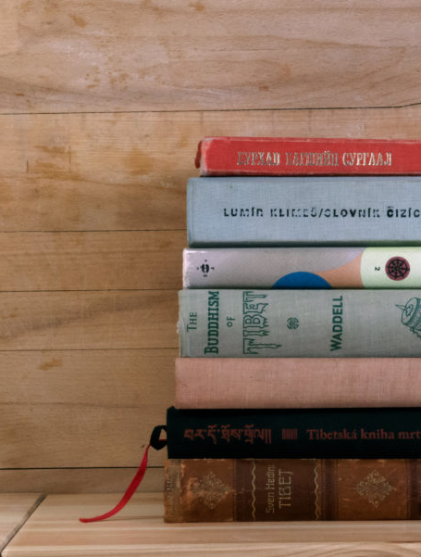

PROS TO EACH DELIVERY STYLE
Library Time:
Allows the feel of coming to the library where they can read the blurb and decide what to “checkout.”
Gives time for a connection (more conversational).
Bag Exchange:
Ensures you are bringing titles they are interested in each time.
Less chance for lost books since they have a “home” inside the delivery bag.
Smooth transition for those that will utilize RSAcat to place their own holds if they so desire.

Slide 8
CONS TO EACH DELIVERY STYLE
Library Time:
May not be the best use of time if only a couple of people are browsing.
Large amount of books to transport.
Bag Exchange:
Less conversational
Must launder bags if they get dirty.

Slide 9
INTRODUCTION/USE OF ONLINE TOOLS/APPS

Slide 10



INTRODUCING AUDIO & EBOOKS
Tech Programming at Outreach Facilities:
While some patrons may be accessing apps on their own, others may need help getting introduced.
You Can:
Provide tech programs, once a month to begin introducing apps to your patrons.
Each program would focus on one app, offering one on one help to get set up at the end.

Slide 11
HIGHER USE = CHANGE
Audio and Ebook usage will likely rise and has at several of my outreach locations.
  May alter how many physical checkouts occur.
  Will require time at facilities teaching patrons how to use apps.
Outreach/Homebound patrons may begin to start placing their own holds.
  In turn will change the process and potentially make outreach a less time intensive process.

Slide 12
COLLECTION DEVELOPMENT CHANGES

Slide 13
CATERING TO NEW LP USERS
MPL is transitioning from purchasing mostly Amish and Christian to more popular women’s and men’s fiction.
Previously, the focus was on purchasing titles that aligned with outreach interest. Now, focus is on large print readers as a whole.
New wave of large print readers means taking a look at what current interests are.

Slide 14

LOOKING AT THE STATS
My Process
Purchase a wide array of genres, popular men’s and women’s fiction, non-fic, etc.
Track genres/authors of books purchased on a spreadsheet.
Track how many checkouts each book has.
Year End Goal
I plan to utilize checkout numbers to determine which genres I should focus on purchasing next year.

Slide 15
OVERALL TRENDS
Currently, many outreach patrons know exactly what they want(genres/authors). I create a list in Excel for these patrons and place holds for them based on the list. Specific book requests are welcomed at any time.
Three out of the four facilities I deliver to are bag exchange only.
The facility I deliver to where I provide library time most residents browse and there are few I place holds for each time.
Bottom line:
Determining which facilities need library time vs bag exchange starts with taking note of how many people are actually browsing every time.
  Is it two people out of 20? Is it majority and only a few people you place holds for?

Slide 16
CONCLUSION
Senior outreach will continuously change as people that are more familiar with technology require the service. Assessing and planning what we can do on our end to cater to patron's needs is important.

Slide 17

Cindy Wright
Peoria Public Library
Reference & Adult Services Librarian

Slide 18
Prevalence of Dementia
According to the Alzheimer’s Association, “over 7 million Americans are living with dementia”¹
That figure will grow significantly as the baby boom population continues to age
Many people with dementia live at home, with family members assuming the role of primary caregivers
People with dementia can still participate and enjoy books, art, and music into the later stages of dementia
¹Alzheimer’s Association. 2025 Alzheimer’s Disease Facts and Figures. Alzheimers Dement 2025;21(5). https://www.alz.org/getmedia/ef8f48f9-ad36-48ea-87f9-b74034635c1e/alzheimers-facts-and-figures.pdf.

Slide 19

Depression and Dementia
According to Zenebe (et al), the prevalence of depression in older adults is, on average, 31.74%.¹
Kitching states that “people with dementia of any type have a high incidence of major depression.” ²
https://pixabay.com/vectors/elderly-senior-man-thought-9792507/
¹ Zenebe, Y., Akele, B., W/Selassie, M., & Necho, M. (2021). Prevalence and determinants of depression among old age: a systematic review and meta-analysis. Annals of general psychiatry, 20(1), 55. https://annals-general-psychiatry.biomedcentral.com/articles/10.1186/s12991-021-00375-x
² Kitching D. (2015). Depression in dementia. Australian prescriber, 38(6), 209–2011. https://doi.org/10.18773/austprescr.2015.071

Slide 20

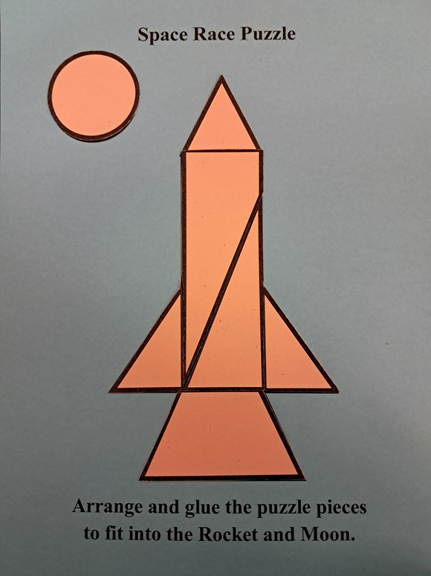
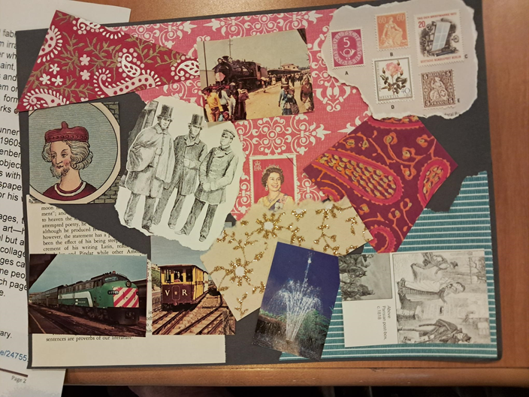
Ensuring the person has the chance to try new things or take part in activities they enjoy.
Notes:
Tales and Travel Memories, along with other programs of interest, ensures that the person has experiences that bring back memories, try something new, or spark their creativity.

Slide 21
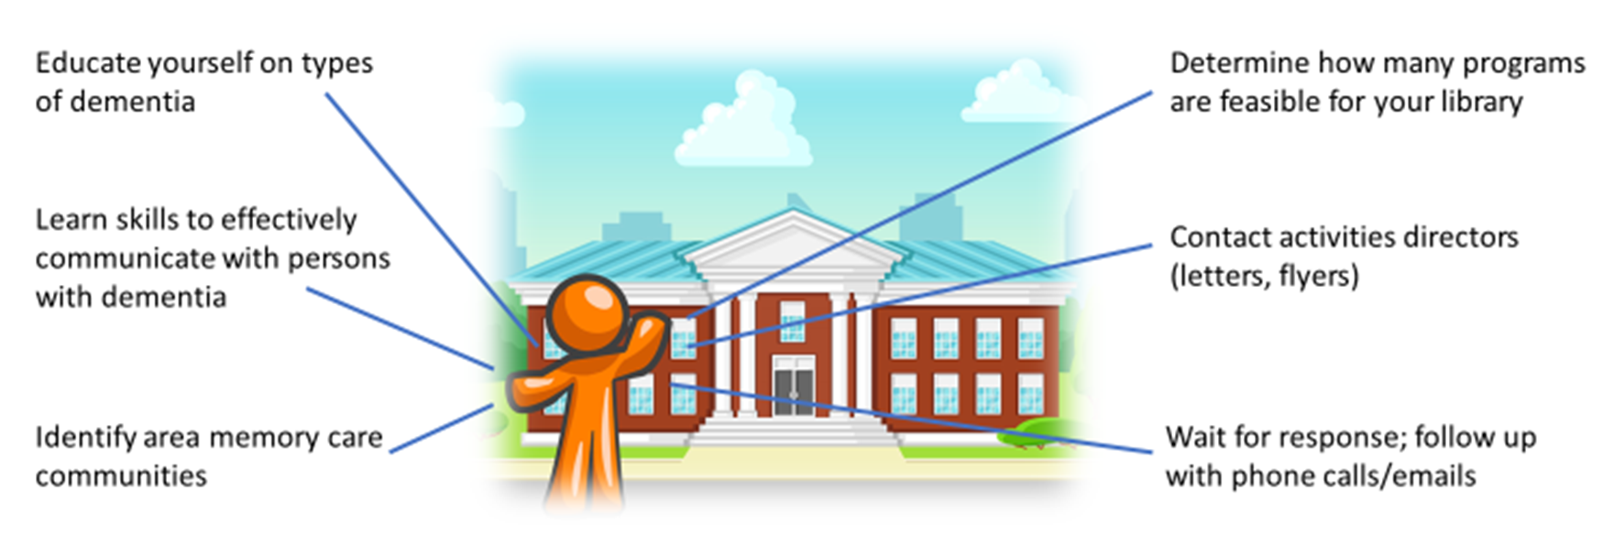
It only takes one…
Notes:
It is not necessary to have several staff members in order to bring programs to patrons with dementia. It can be done with only one, as I have been doing programs for at least six memory care communities a month for over eight years. Here you see the steps to start programs in your community. Once I familiarized myself with dementia and ways to communicate with these patrons, I contacted several memory care community activities directors. Amazingly, I had a 100% response. These places were eager to have something new and different for their residents.

Slide 22
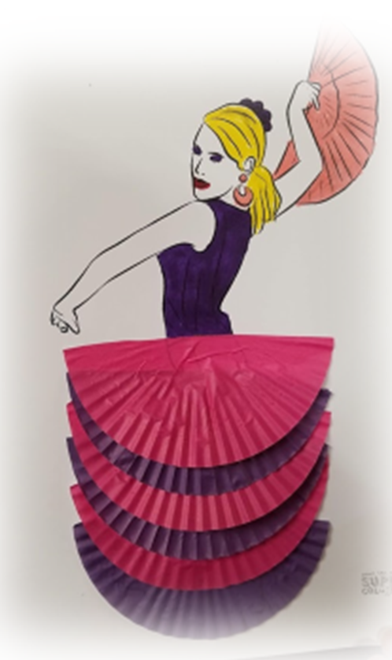
Setting Up Programs
Discuss residents’ needs and abilities with activities directors
Design programs based on residents’ abilities
Incorporate crafts, if appropriate
  Simple but not childish
  Low budget
  Paper crafts
Use everyday items
  Recycled catalogs
  Old Magazines
  Cupcake liners
Notes:
It is important to know the residents’ preferences and capabilities, so discuss it with the activities directors to determine the types of programs that best fit their residents, as well as the amount of time they prefer for each program. Also important is to make sure there is a memory care residence staff member present during the entire program. If incorporating crafts, make sure they are simple but not childish. Crafts can be done on a low budget; for the first few years, most if not all of my craft projects were using paper we had on hand. Everyday items also are great for crafts, such as old catalogs and magazines (I have a substantial collection of seed catalogs!), and have also done several projects with cupcake liners as you see here.

Slide 23
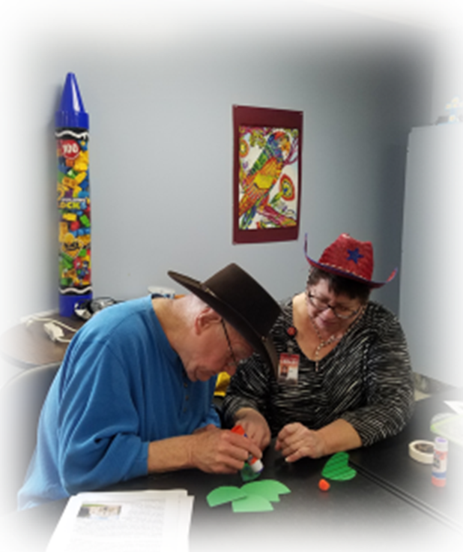
Presenting Your Program
Determine length of time for program based on residents’ tolerance
Bring name tags
Speak slowly and clearly
Copy of program for each resident
  Use large font size
Incorporate music, if appropriate
Create/send program evaluations annually to activities directors
Adjust programs based on evaluation feedback
Notes:
Part of the joy of doing these programs is getting up close and personal with the residents. It may not be possible to do this with every patron for large groups (my biggest is 25), but you can still go from person-to-person and spend a little bit of time conversing with them. Again, different groups may not be able to participate in a longer program, so you need to be able to adapt your program to their tolerance level. Name tags make the residents feel recognized and respected; calling them by name usually brings a smile to their face. Speak slowly and clearly, and use a portable speaker if you have a large group. Provide a copy of any handouts to each resident for them to read on their own, or invite them to read to the group. Be sure to use a large font size, at least 18 pt. Music can be appreciated into the later stages of dementia, so use it as much as possible. I’ve had patrons sing along or even get up and dance to music. Finally, allow for feedback on the programs from activities directors. Create and send program evaluations so you can modify your programs as needed.

Slide 24
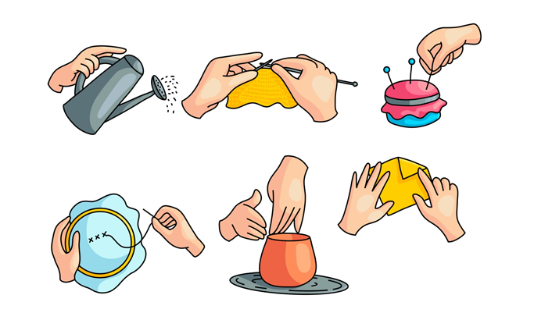
Other Topics of Interest for Patrons
Get to know your patrons’ background and interests
Topics can be
  Nostalgia (old movies, TV shows, radio shows, music)
  Childhood memories (zoo, circus, toys)
  Familiar subjects (gardening, backyard birds, insects)
  Historical events (World War II, Space Race, Olympics)
  Holidays
  Biographies
Bring books about each subject
Incorporate music if appropriate to subject
Bring a simple craft, puzzle, or game
Try to tie the craft or game to the program topic
Encourage discussion before, during, and after programs
Notes:
Tales and Travel Memories are one type of popular programs for patrons with dementia. You can also create programs on other topics of interest such as old radio or TV shows, childhood memories (going to the zoo or old toys), familiar subjects (gardening, backyard birds, or even the history of Tupperware). Other ideas include historical events such as World War II, the Space Race, or World’s Fairs. You can do seasonal programs or biographies, particularly focusing on events that occurred or people who were popular during their younger years. You would be surprised how many stories come out of some of these topics. Engaging in meaningful discussion with these patrons relays to them that the stories they tell are valuable to us. As with Tales and Travel Memories, bring books about each subject and objects, if available. I did a program about the beach and brought seashells, sand, and driftwood to pass around. Finally, if time allows, a simple craft, puzzle, or game is not only entertaining but also gives the patron a sense of accomplishment.

Slide 25

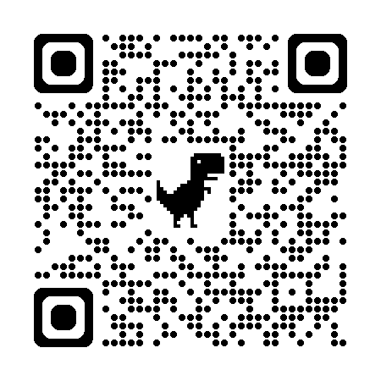
Tales and Travel Memories
Created by Mary Beth Riedner
Brings travel and world experiences to patrons
Program design is simple, yet informative
See a video of a program in action on the Tales and Travel Memories home page: https://talesandtravelmemories.com
Several excursion guides are available on the Tales and Travel Memories website: https://talesandtravelmemories.com/excursions
Uses books to allow patrons to experience the joy of reading
Notes:
Tales and Travel Memories was created by Mary Beth Riedner. The program allows patrons to virtually travel to faraway places while also learning about each country or region. The program design is simple, yet informative. You can see a video of an actual program on the Tales and Travel Memories home page. Also, you can download the excursion guides for several of her programs. In addition, bring books, as many dementia patrons can still read into the later stages of the disease.

Slide 26
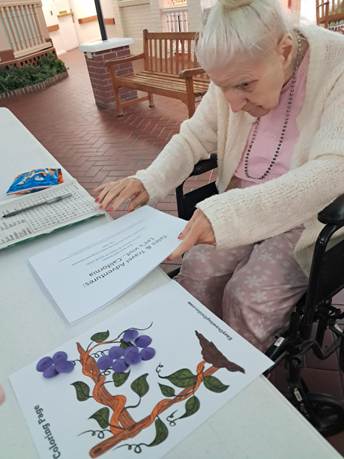
Presenting a Tales and Travel Memories Excursion
Select a country
Show the country on a globe or large map
List a few facts about the country
Bring props and/or food (if appropriate) that represent the country
Read a folk tale from the country
Provide a copy of the excursion guide to each patron
Bring books with large photographs for patrons to browse
  Use children’s nonfiction that is not too juvenile
  Check weeded items for appropriate books
Encourage discussion about the country
Notes:
To present a Tales and Travel Memories excursion, choose a country from the Tales and Travel website, or create your own. Select a country, and bring either a globe (blow up or plush) or a large map. Do a little research about the country and list a few interesting facts. You may bring props and, if appropriate, a small snack that represents the country and its cuisine. Read a folktale from the country, as many patrons enjoy being read to. Make sure you give a copy of the excursion guide to each patron so that they may read along with you, or even read it to the group. Bring brooks with large photographs for them to browse. Children’s nonfiction (if not too juvenile) are great books to bring due to large pictures and font size. Also check weeded items for books you can use, especially if some of the patrons may accidentally tear pages. Finally, encourage discussion about the country. Ask questions such as, has anyone every visited that country, etc. Conversation with these patrons is key to recognizing and giving personal attention to them.

Slide 27

Catherine Barnett
Chillicothe Public Library
Programming & Outreach Supervisor

Slide 28


Remember When
Take a stroll down memory lane and reminisce about different topics each month.
Sample questions:
Notes:
Remember When
a. Open to the public, but hosted at Evergreen Senior Living. Most attendees are residents at Evergreen, though we’ve had a few other members of the public attend. Occasionally visiting family members, too.
b. Topics chosen ahead of time; staff at Evergreen remind residents.
c. I prepare questions, but encourage an informal conversation. Tangents are okay, but I try to get us back on track with the original topic if we stray too far and others have topic-related stories they want to tell.
d. Try to ask questions that draw on multiple senses. “What scents remind you of summer?” “What was your favorite flavor of ice cream?”
e. Like any discussion/book group, try to facilitate in such a way that conversation isn’t dominated by anyone, and that all who want to talk have the chance. Watch and listen for hints. Find places to jump in and prompt. “Thanks for that story, Paula; Chuck, did you have something you wanted to say?”
f. Follow up questions to individual, or bounce back to the group. “Does anyone else remember ___?”
g. Allow space for participants to ask each other questions or respond to each other’s stories.
h. Share your own memories, now and then!
i. Keep record of topics & questions, can revisit every couple of years. (Share QR code to Google Doc). Seasonal topics, gather ideas from participants, etc.
j. Feel free to borrow from my stash of questions, available at this QR code (includes a list of questions for “Plant a Seed: Read!”). Document tabs help navigate, see topics at a glance. https://docs.google.com/document/d/1AqtaIharax5JU-WecAjah-yQo3ggFNzatllvtKXix3Y/edit?usp=sharing

Slide 29

Dementia Caregivers Support Group
Led by trained volunteers
Informal, mutual support
Dementia education
Problem-solving skills
Alzheimer’s Association Illinois Chapter offices
Notes:
Dementia Caregivers group (who is the contact, how does it grow, how did it start?)
a. What is it? This support group, led by a volunteer trained with the Alzheimer's Association, offers a safe, confidential, supportive environment and a chance for caregivers to develop informal mutual support, learn about dementia, and build problem-solving methods and skills. Meets monthly on 3rd Tuesdays, and is open to caregivers and others who have loved ones with dementia.
b. How did it start? An employee at Evergreen Senior Living went through the training as an Alzheimer’s Association Dementia Caregivers support group facilitator, and reached out to the library to see if we were interested in collaborating as a host and promoting to our community. The facilitators have changed since its beginning. Currently have another Evergreen employee, as well as someone from Traditions Health.
c. How does it grow? We include the group in our library events, which we promote through our newsletter & e-news, Facebook, etc. The facilitators also promote it to their own networks, and it’s listed on the Alzheimer’s Association website, where you can search for a support group in your area (https://www.alz.org/help-support/community/support-groups). Attendance has been steady ever since we began hosting, quickly growing from # to a dozen or more.
d. Who is the contact? If a library was interested in hosting a group, they would need to contact the Alzheimer’s Association, as all the facilitators are volunteers through them. Illinois Chapter office locations: https://www.alz.org/illinois/about/contact-us/office-locations

Slide 30
Knots of Fun
Stitch, chat & create with us! Whether you’re a crochet pro, knitting newbie, or sewing enthusiast, all skill levels are welcome. Bring your project, share tips, and enjoy some creative camaraderie!
Notes:
Knots of Fun
a. Began as another collaboration with a staff member from Evergreen Senior Living, who reached out with the offer to facilitate a casual fiber arts group. We’d had some requests for a program like this, so decided to try it out!
b. People are invited to bring their project (crochet, knitting, sewing, cross stitch, quilting—whatever!) and work on it while enjoying each other’s company and sharing tips.
c. Started out as a one-hour thing, now has expanded by popular demand to 2 hours, twice a month (3:00-5:00 pm on 1st & 3rd Wednesdays)
d. Attendance averages about 8 people, mostly older adults, but also a few in their 40s or so. Occasionally a teen has joined in.
e. People seem to appreciate the chance to have company as they work on their projects, and real friendships have been developing. Several ladies who come are widows, and it seems like they’ve been able to find a special connection.
f. Set up is easy – we provide a room with tables and chairs.
g. Now and then our facilitator is unavailable, but the group is self-sufficient enough. In this case, I try to pop in at the beginning for a few minutes, and at the end.

Slide 31
Thank you! Questions?
Madison Benson
Morton Public Library
Adult Services Coordinator
madisonb@mortonlibrary.org
309-263-2200
Cindy Wright
Peoria Public Library
Reference & Adult Services Librarian
cindywright@peoriapubliclibrary.org
309-497-2000
Catherine Barnett
Chillicothe Public Library
Programming & Outreach Supervisor
cbarnett@chillipld.org
309-274-2719

