Slide 1
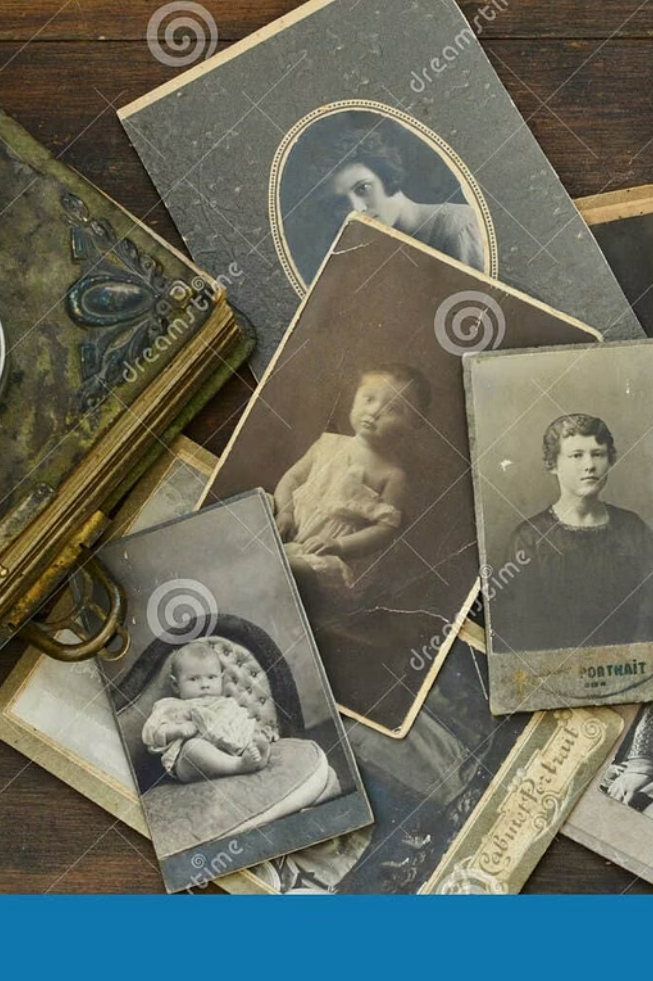
Helping Customers with Family History Research
A practical guide for librarians supporting genealogy researchers — no prior experience required.
Sue Kaufman | Local History and Genealogy Librarian | Historical Records Coordinator | Peoria Public Library | Peoria, IL | RSA Day 2026
Notes:
• Welcome everyone to this session on supporting family history research in your library •
This is a practical, hands-on guide—you don't need any genealogy background to help patrons •
Family history research is one of the most popular library services, and librarians are perfectly positioned to guide people through it •
Over the next [time], we'll cover practical strategies, resources, and tips you can use immediately with your patrons •
I'm Sue Kaufman, a genealogy librarian at Peoria Public Library, and I've worked with thousands of family history researchers •
Whether you're new to this or looking to expand your genealogy services, this guide will give you concrete ways to support your community's genealogy interests

Slide 2
About Me
Never did genealogy
3 size libraries
40 years later
Obituary Credits
Notes:
Never did genealogy
40 years later
3 size libraries
Obituary Credits
National Genealogical Society’s P. William Filby award for outstanding service as a Genealogical Librarian
Fellow of the Texas State Genealogical Society
Lloyd DeWitt Bockstruck Distinguished Service Award to the Genealogical Community, DallasGenealogical Society.
Cat mom

Slide 3
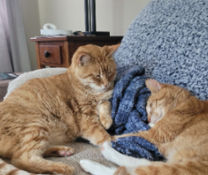
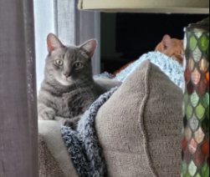
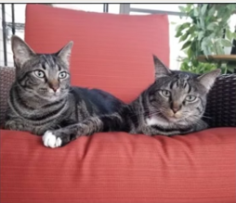
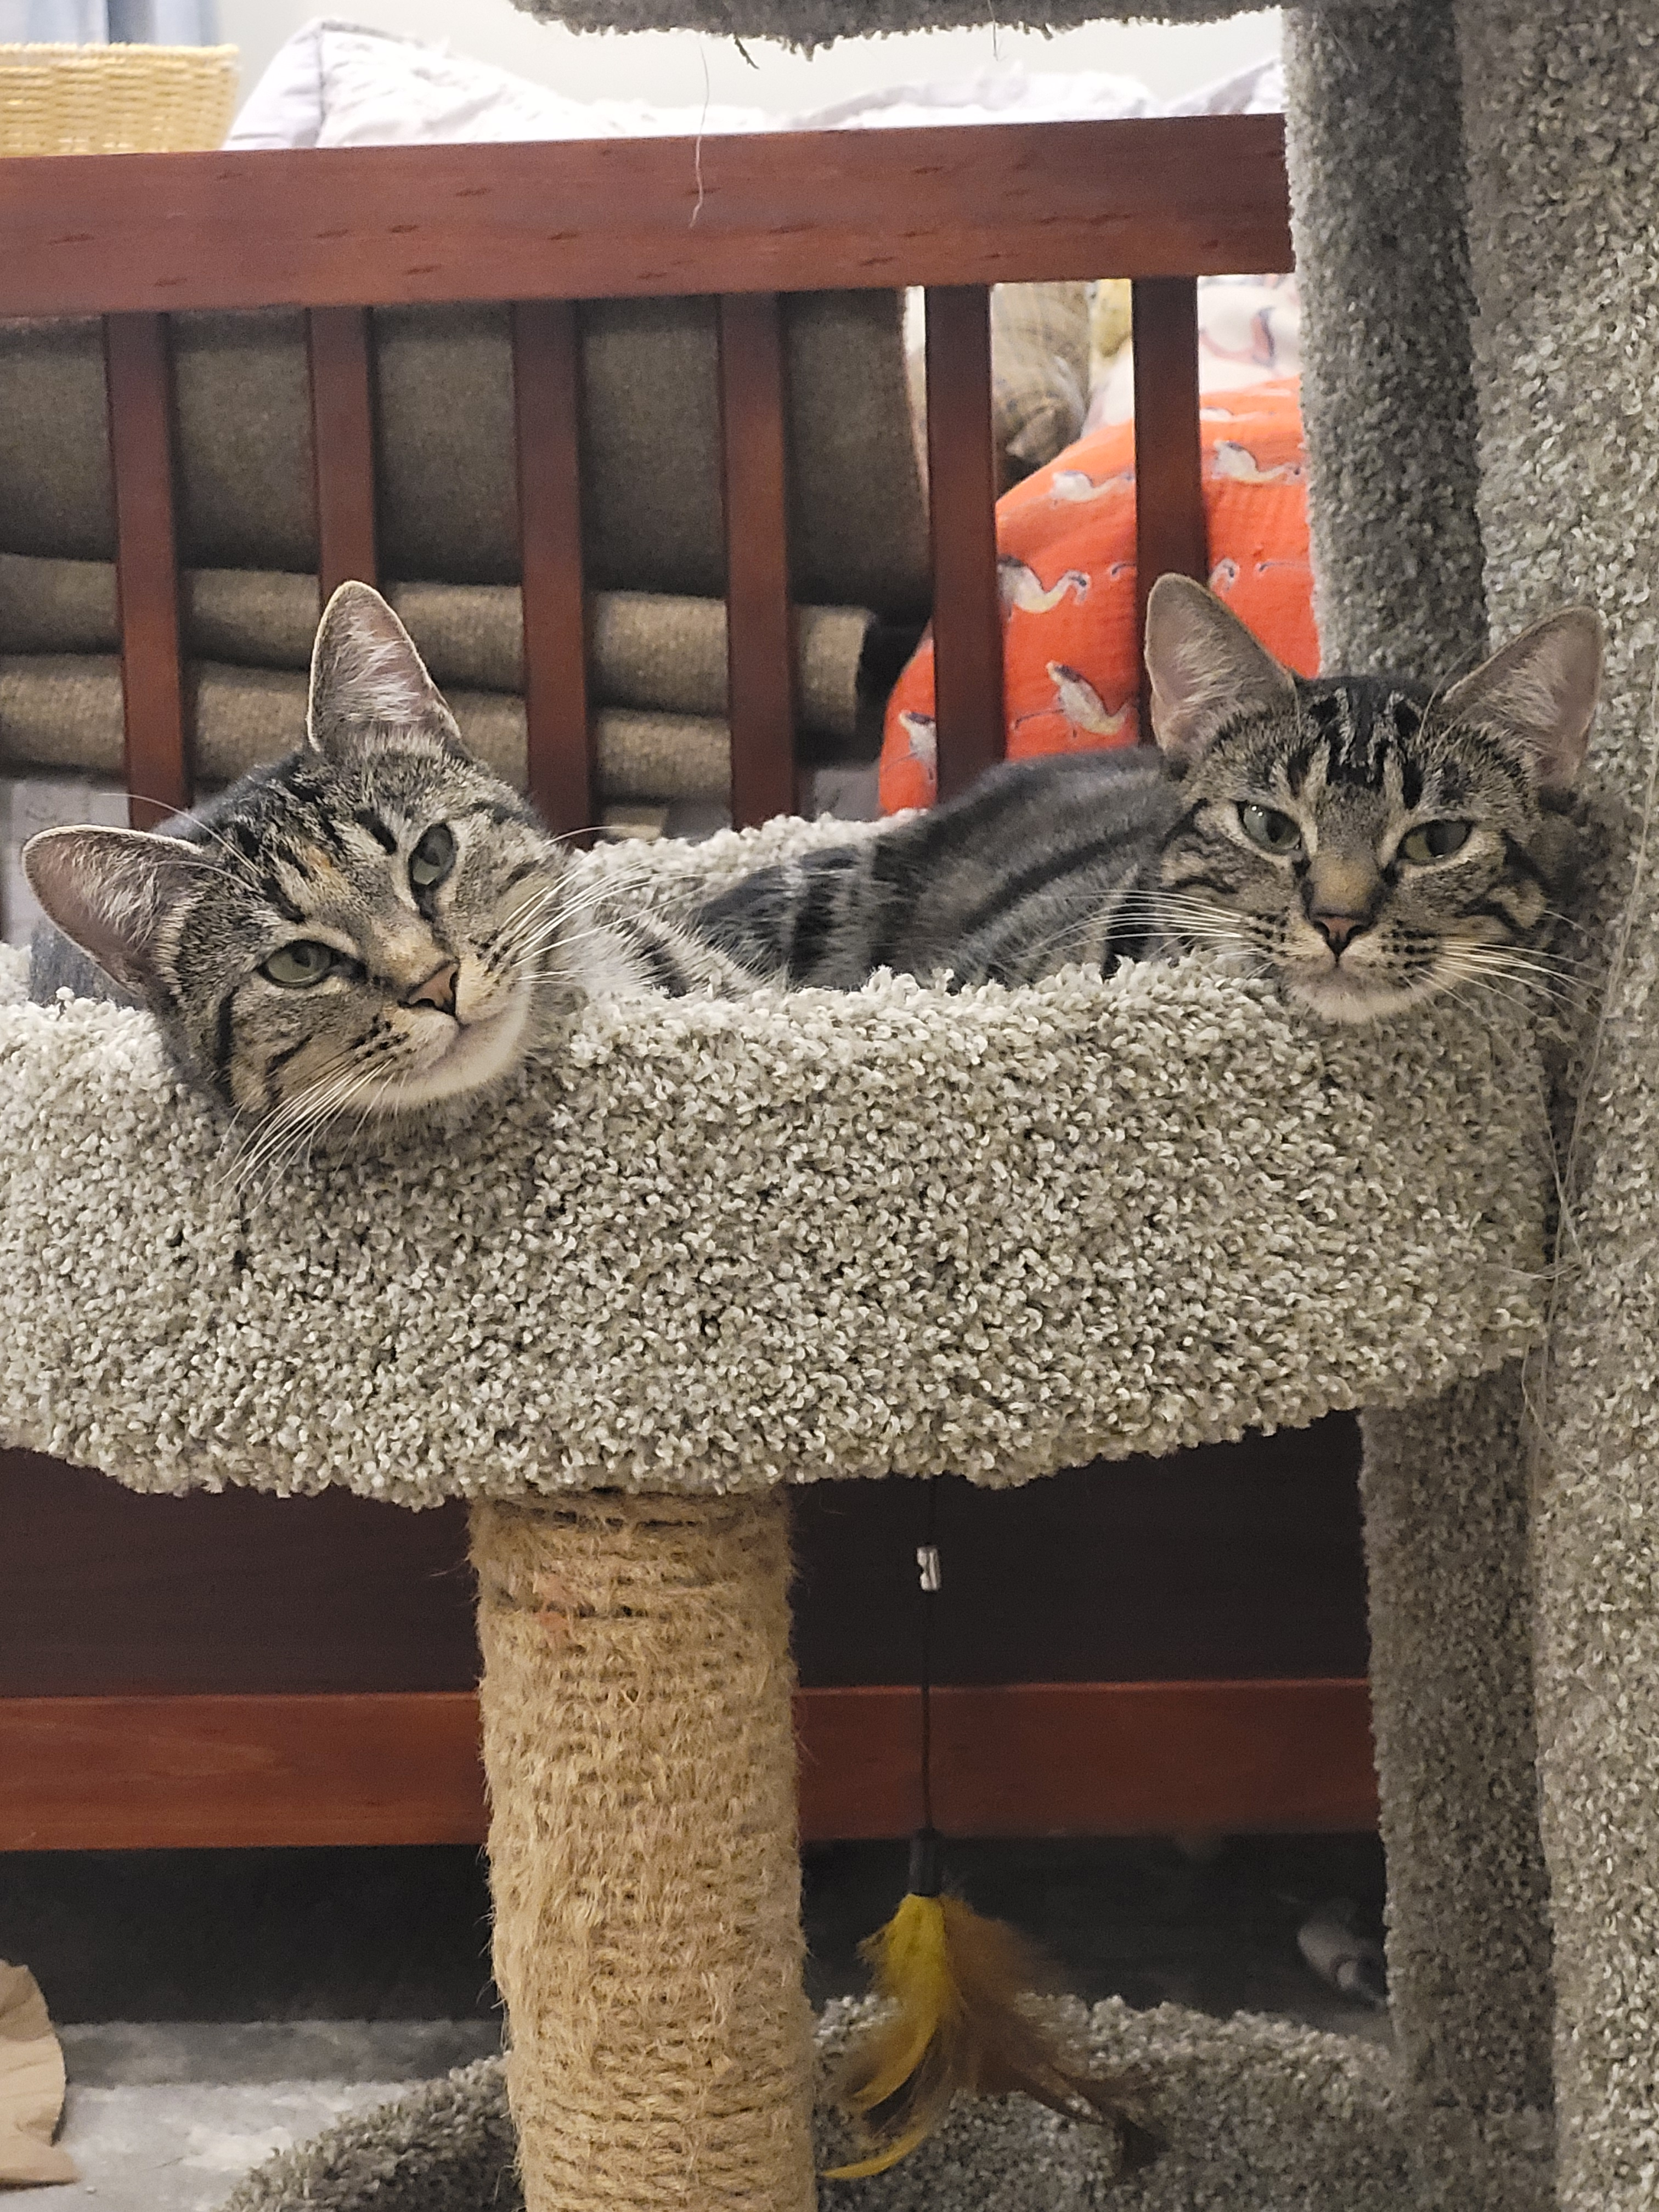
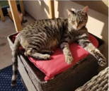
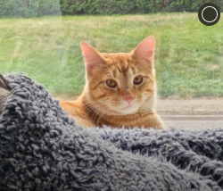

Slide 5
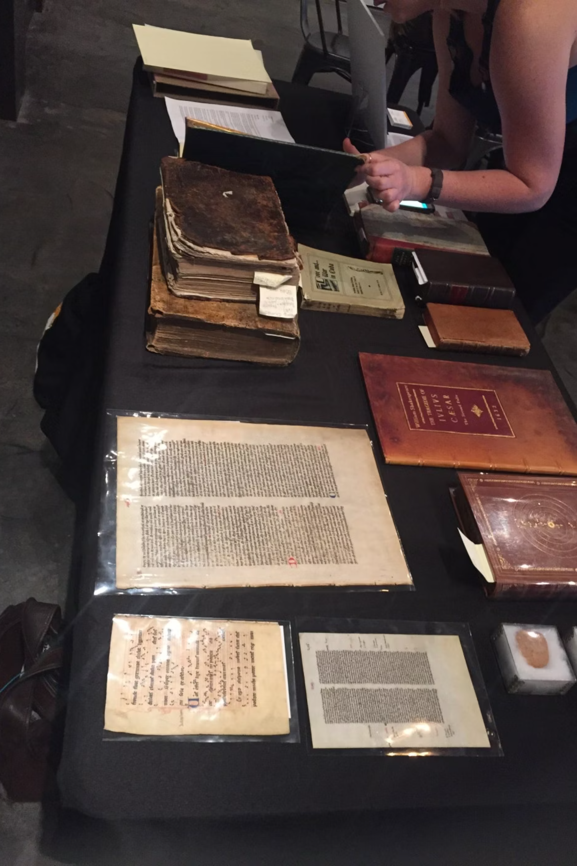
Why Family History Research Matters in Libraries
Fastest-Growing Service
Free, Trusted Access
Genealogy is among the most rapidly expanding library services worldwide, drawing new every year.
Patrons rely on libraries for free, expert guidance through complex and often costly family history resources.
Community Heritage Hub
Libraries are uniquely positioned as community anchors for preserving, exploring, and celebrating personal heritage.

Slide 6




Why the Genealogy Reference Interview is Crucial
A successful reference interview is the cornerstone of effective genealogy support, transforming a general inquiry into a targeted, productive research session.
Uncover True Needs
Guide to the Right Resources
Move beyond surface-level questions to understand the customer's specific research goals, current progress, and the "brick walls" they've encountered.
Direct customers to the most relevant specialized collections, online databases, microfilms, and local resources, saving them valuable time and effort.
Empower Research Skills
Manage Expectations & Build Rapport
Educate customers on effective search strategies, critical source evaluation, and efficient record organization, building their confidence as independent researchers.
Set realistic expectations about the genealogical process, while fostering a supportive relationship that encourages ongoing research and future library visits.
Notes:
True needs: Skills - listening, guiding, providing
Guide to right resources: Realistic expectation within resources
Empower Research Skills: teaching vs. doing - computer / mouse
Manage expectations: what resources/skills/interest but still build user relationships

Slide 7
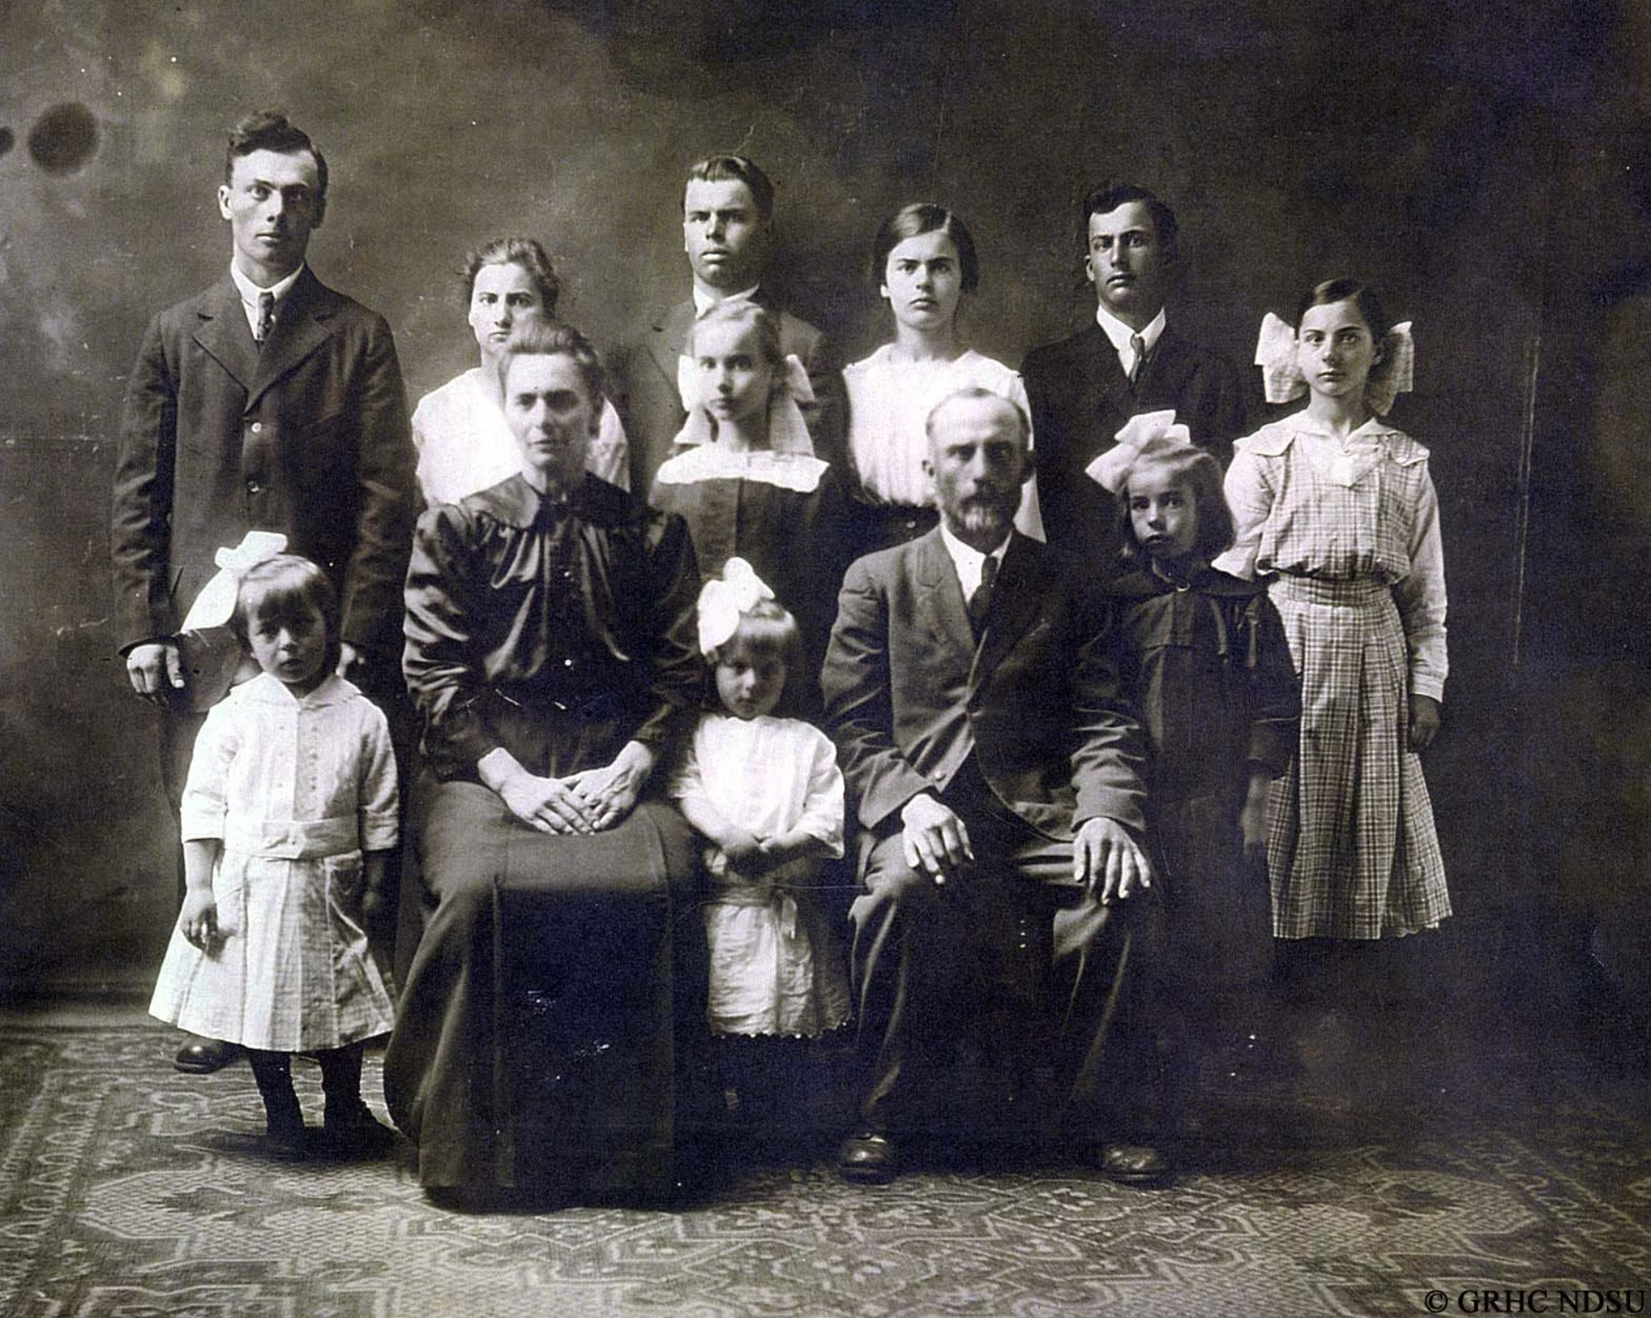


FOUNDATIONS
Understanding the Basics of Genealogy
Genealogy is the practice of tracing family lineage through historical records, connecting names, dates, places, and relationships across generations.
Gather
Verify
Document
Collect known family information from relatives and personal documents.
Cross-reference sources to confirm accuracy and resolve conflicts.
Record findings systematically with citations for future reference.

Slide 8
The Value of the Reference Interview
A successful reference interview is crucial for guiding patrons through complex genealogical research, ensuring they find the information they need efficiently and effectively.
Uncovers True Needs
Guides to the Right Resources
Empowers Research Skills
Move beyond surface-level questions to understand the patron's specific research goals, current progress, and the challenges (or "brick walls") they've encountered. This helps you understand what they're really looking for.
By understanding their situation, you can direct them to the most relevant specialized collections, online databases, microfilms, and local resources, saving them valuable time and effort.
A good interview educates patrons on effective search strategies, critical source evaluation, and efficient record organization, building their confidence as independent researchers.
Manages Expectations & Builds Rapport
It sets realistic expectations about the genealogical process while fostering a supportive relationship that encourages ongoing research and future library visits.

Slide 9

How to Conduct a Genealogy Reference Interview
A focused conversation at the start saves significant time and sets patrons up for success.
01
Assess Experience & Goals
Ask how far along they are and what they hope to discover.
02
Identify Key Ancestors
Focus on specific names, family lines, or geographic origins.
03
Clarify Existing Records
Find out what documents or information they already have in hand.
04
Guide to Next Steps
Direct them to the most relevant resources and a clear research path.

Slide 10
Researchers and Providers: Shared Responsibility
Successful genealogy research is a partnership where both parties have important roles to play.
Researcher (Customer) Responsibilities
Information Provider (Librarian) Responsibilities
Come prepared with what they already know
Ask clear questions about their research goals
Be open to guidance and new research strategies
Take notes and follow up on recommendations
Understand that genealogy takes time and patience
Listen actively during the reference interview
Ask clarifying questions to understand true needs
Guide them to appropriate resources and databases
Teach effective search strategies and source evaluation
Manage expectations about timelines and outcomes
Provide referrals when needed beyond library scope

Slide 11


COMMON CHALLENGES
Navigating Roadblocks in Family History Research
Record Gaps
Name Variations
Every genealogist hits a wall. Help patrons recognize and work through the most frequent obstacles so frustration doesn't stall their research.
Historical Context
Name variations — surnames were often spelled phonetically or changed at immigration.
Missing records — wars, floods, and fires destroyed countless archives.
Historical context — county boundaries, name changes, and social history all affect where records are held.

Slide 12


PROGRAMMING & OUTREACH
Developing Genealogy Programming
Structured programming builds patron skills and positions your library as the go-to genealogy resource in your community.
Workshops & Clubs
Curated Guides
Local Partnerships
Host beginner sessions and ongoing family history clubs to build a loyal research community.
Create resource lists and research guides tailored to your specific local community's heritage.
Collaborate with historical societies and county archives to co-host events and share expertise.

Slide 13

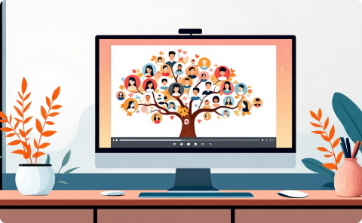

Continuing Your Genealogy Education as a Librarian
You don't need to be an expert to help — but growing your knowledge builds confidence and better service for every patron you assist.
eCourses & Certifications
Webinars & Workshops
Professional Networks
ALA's Genealogical Research for Librarians is a comprehensive starting point designed specifically for library professionals.
WebJunction's Genealogy Essentials and similar free online events keep your skills current without leaving the building.
Join groups like the Federation of Genealogical Societies to connect with colleagues and stay informed on emerging tools.

Slide 14
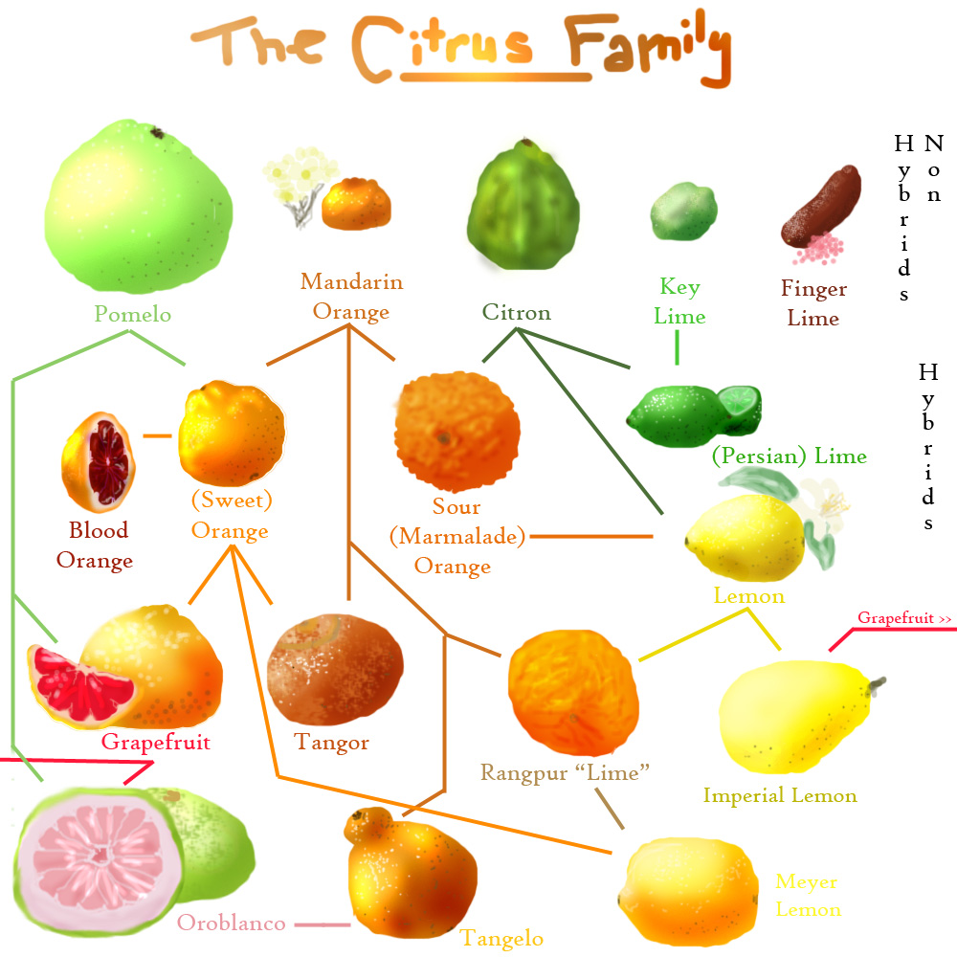
The Fruits of Helping Researchers
Every conversation you have, every resource you share, and every barrier you help break down transforms a family story into a lasting legacy.
Build Legacies
Strengthen Community
Your support turns scattered records into meaningful family narratives that span generations.
Every question answered deepens the trust between your library and the community it serves.
Unlock the Past
Together, we help patrons connect with who they are — and where they come from.
This Photo by Unknown Author is licensed under CC BY-NC-ND

Slide 15



Essential Genealogical Resources for Libraries
Knowing where to point patrons is half the battle. Familiarize yourself with these core tools.
Free Online Databases
Subscription Services
Local & Physical Records
FamilySearch.org — the world's largest free genealogy site. Also explore USGenWeb and state or local digital archives for regional records.
Ancestry.com and HeritageQuest Online (often available free through your library) offer billions of digitized historical records.
Census data, vital records (birth, death, marriage), historical newspapers, land deeds, and court records often hold irreplaceable local detail.

Slide 16
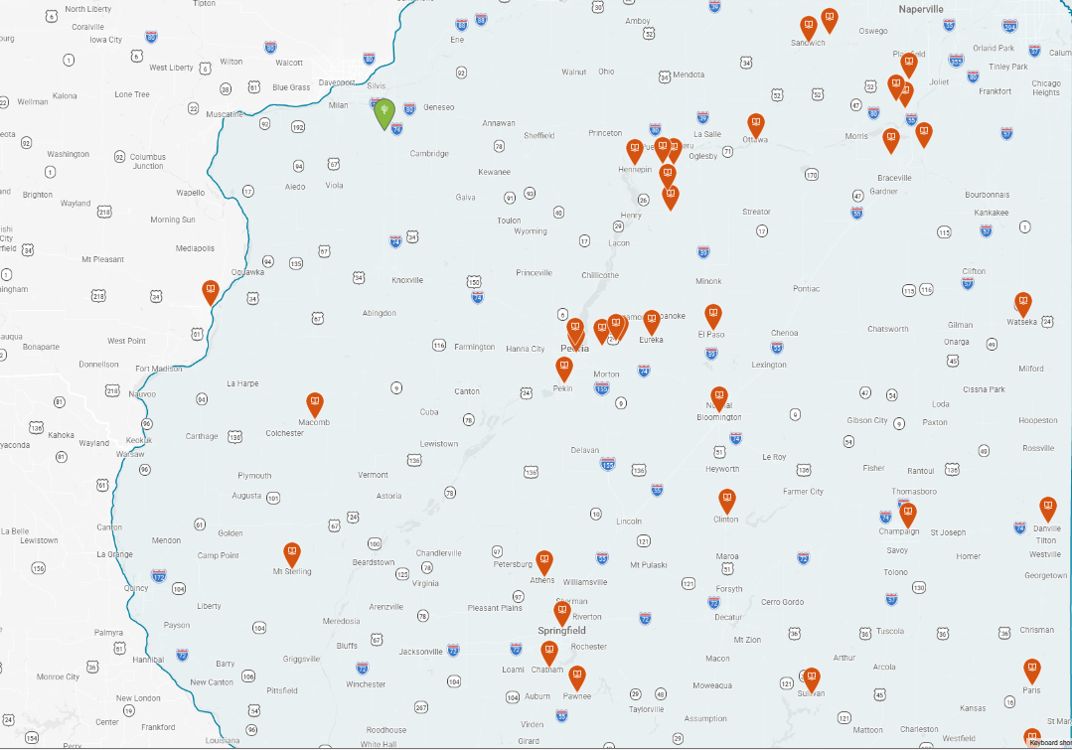
Notes:
Affiliate Libraries information about becoming one
Why?

Slide 17
FEATURE | Ancestry Library Edition | Heritage Quest | FamilySearch.org
Primary Access | On-site only at library | Remote with library card | Free personal account
Geographic Scope | Global: UK, Canada, Europe, Australia | Primarily U.S. focusing on American history, very limited international | Nearly every region of the world
Search Function | Global search | Targeted search – specific collections | Global and targeted
Unique Strengths | Extensive Vital Records, immigration, military worldwide | Full text books - 28,000k | Access from over 200 countries, 20 billion searchable records. FamilySearch Centers, affiliate libraries
Special Collections | Public member trees massive military databases (Fold3) | Freedman’s Bank records, U.S. Serial Set | Digital library over 600,000 books
Notes:
FamilySearch.org offers several specialized search functions designed to help you find historical information about ancestors, ranging from indexed records to handwritten documents and digitized books.
FamilySearch +1
Primary Search Functions
Records Search: This is the standard search for indexed records. It allows you to search by name, date, place, and relationships (like spouse or parents) across billions of records that have been transcribed by volunteers.
Full-Text Search: A newer feature powered by artificial intelligence (AI) that scans the actual text of unindexed historical documents. It can find names and details buried in handwritten paragraphs that traditional searches might miss, covering nearly 2 billion records including land deeds and probate files.
Images Search: Provides access to millions of digitized images that have not yet been indexed. Users can browse these collections image-by-image, often finding records that are not yet searchable by name.
Family Tree Search: Allows you to search the collaborative global tree to see if other users have already added profiles for your ancestors.
Catalog Search: A comprehensive database of all materials held by the FamilySearch Library. You can search by location, surname, or keyword to find specific record collections, microfilms, or books.
Digital Library Search: Focuses specifically on over 500,000 digitized books, including family histories, local maps, and genealogy magazines. These texts are fully searchable using keywords or phrases.

Slide 18
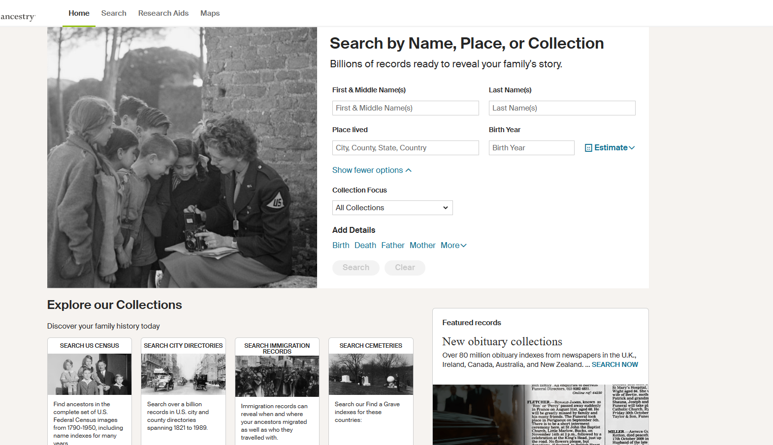
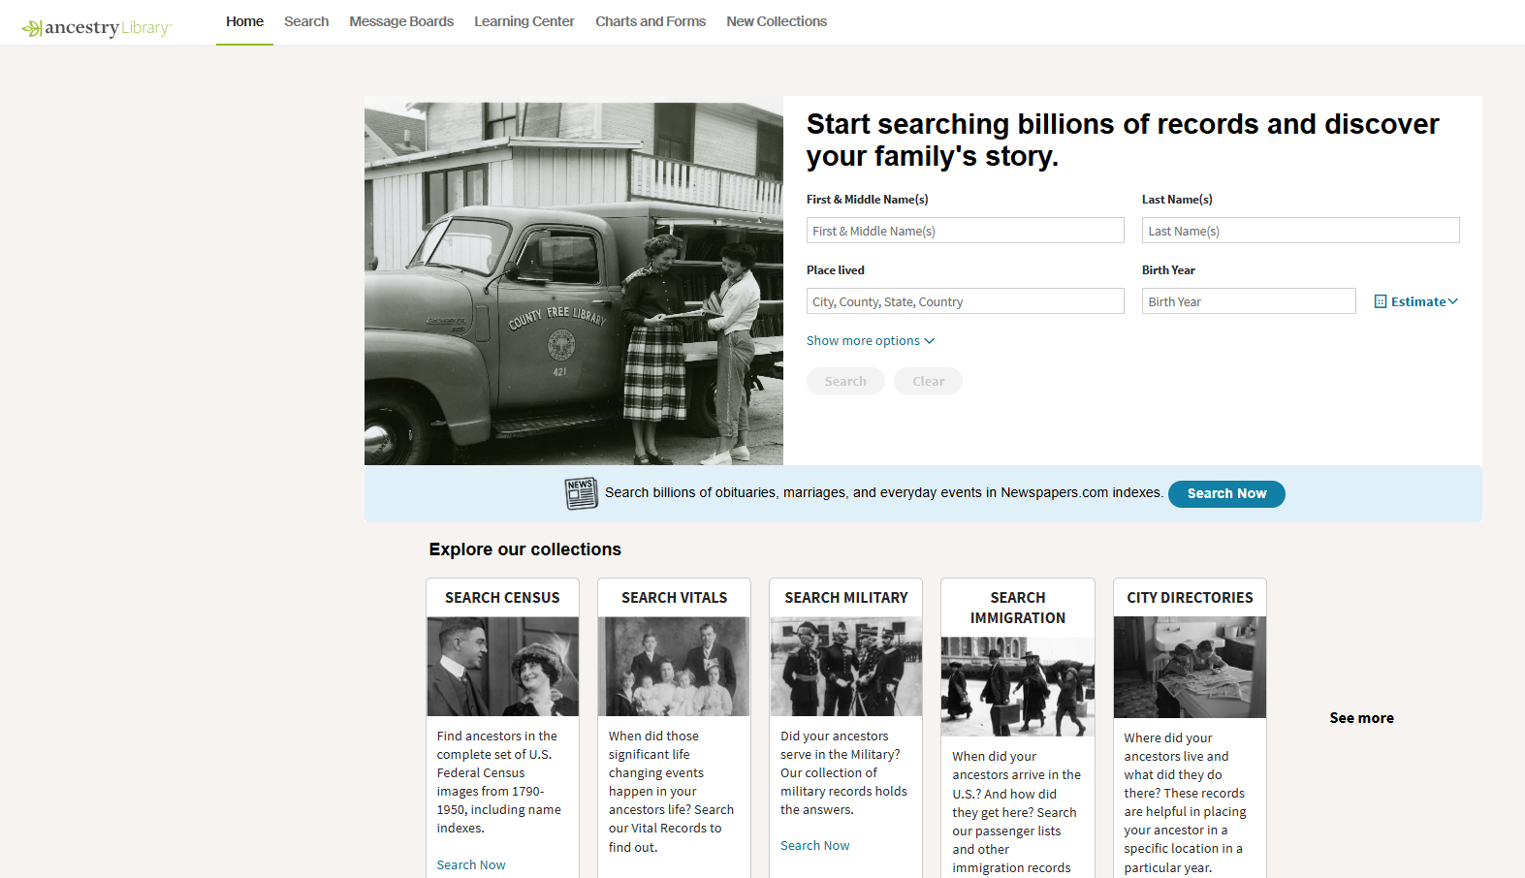
ALE and HQ
Basic Differences
Both powered by Ancestry
Where they can be accessed
Scope of international content
ALE / Ancestry powerhouse
HQ specialized tool
Notes:
he primary search functions of Ancestry Library Edition allow users to navigate billions of records through several specialized entry points. Unlike the personal version, the Library Edition is designed for in-library research and does not include private tree-building tools.
Cass County Public Library +2
Core Search Methods
All Categories (Basic Search): Accessible via the "Begin Searching" button or the "Search" tab, this broad tool queries the entire database simultaneously. It is best for initial research on an ancestor but can produce overwhelming results for common names.
Category-Specific Search: Users can narrow their focus by searching within specific record types, which provides customized search fields (e.g., ship name for immigration):
Census & Voter Lists: Includes all U.S. Federal Censuses (1790–1950) and various state and international voter lists.
Birth, Marriage & Death (Vital Records): Focused on certificates, church registers, and indexes.
Military: Covers draft cards, pension indexes, and service records.
Immigration & Travel: Specifically searches passenger lists, naturalization records, and border crossings.
Card Catalog: A database of all available record collections. Users can search by title or keyword to find specific datasets (e.g., "Missouri Marriages") rather than searching by an individual's name.
Map/Location Search: An interactive map on the search page allows users to click on a state or country to see all collections specifically related to that geographic area.
HeritageQuest Online, which is powered by Ancestry®, provides a simplified search interface primarily focused on U.S. genealogical records. Its primary search functions are organized into several core data sets:
Laurel County Public Library +1
U.S. Federal Census Search: This is the most popular function, allowing users to search every available federal census from 1790 through 1950. You can search by name, location, and other life events to view original digital images of census pages.
Genealogy & Local History Books Search: Users can perform a full-text search across more than 28,000 digitized family histories, local histories, and city directories. You can search by Person to find names mentioned within the text or by Publication to find specific book titles.
Revolutionary War Records: This specialized search accesses the complete NARA collection of pension and bounty-land warrant application files for over 80,000 officers and enlisted men.
Freedman’s Bank Records (1865–1874): A critical tool for African American research, this allows users to search names of bank applicants, their dependents, and heirs.
U.S. Congressional Serial Set: Users can search for memorials, petitions, and private relief actions made to the U.S. Congress dating back to 1789.
Interactive Census Maps: The "Maps" tab provides a visual search tool to view how U.S. state and county boundaries changed between 1790 and 1920, helping researchers identify where records might be located.
Tennessee Electronic Library +7
HeritageQuest also includes a Research Aids section that provides tips and guides for using these search functions effectively.

Slide 19
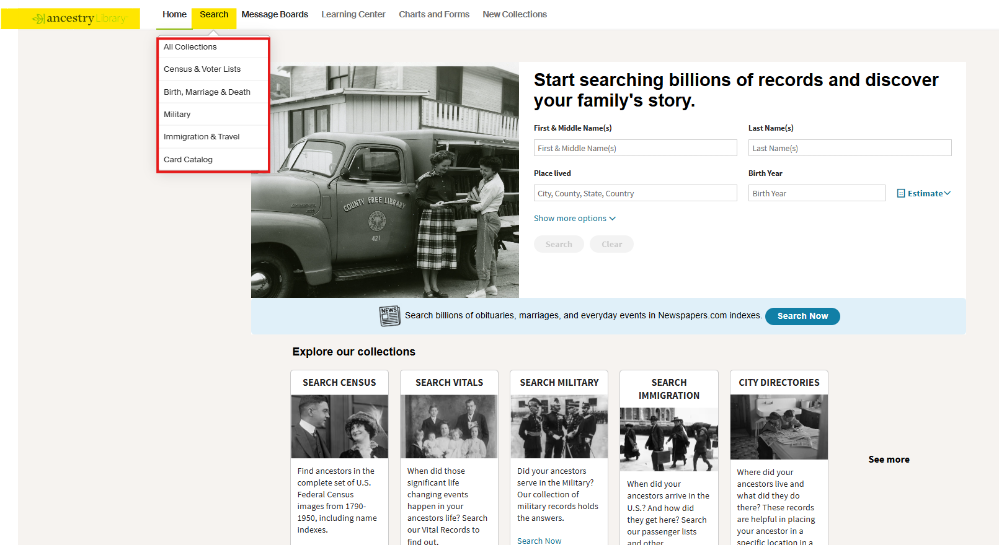
Notes:
The primary search functions of Ancestry Library Edition allow users to navigate billions of records through several specialized entry points. Unlike the personal version, the Library Edition is designed for in-library research and does not include private tree-building tools.
Cass County Public Library +2
Core Search Methods
All Categories (Basic Search): Accessible via the "Begin Searching" button or the "Search" tab, this broad tool queries the entire database simultaneously. It is best for initial research on an ancestor but can produce overwhelming results for common names.
Category-Specific Search: Users can narrow their focus by searching within specific record types, which provides customized search fields (e.g., ship name for immigration):
Census & Voter Lists: Includes all U.S. Federal Censuses (1790–1950) and various state and international voter lists.
Birth, Marriage & Death (Vital Records): Focused on certificates, church registers, and indexes.
Military: Covers draft cards, pension indexes, and service records.
Immigration & Travel: Specifically searches passenger lists, naturalization records, and border crossings.
Card Catalog: A database of all available record collections. Users can search by title or keyword to find specific datasets (e.g., "Missouri Marriages") rather than searching by an individual's name.
Map/Location Search: An interactive map on the search page allows users to click on a state or country to see all collections specifically related to that geographic area.

Slide 20
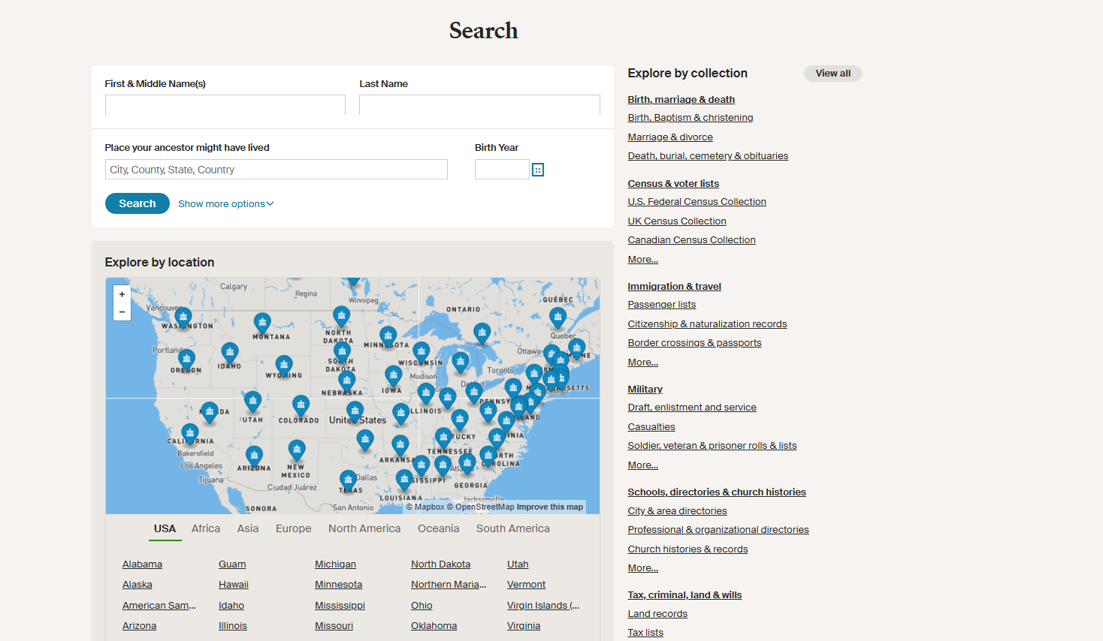

Slide 21
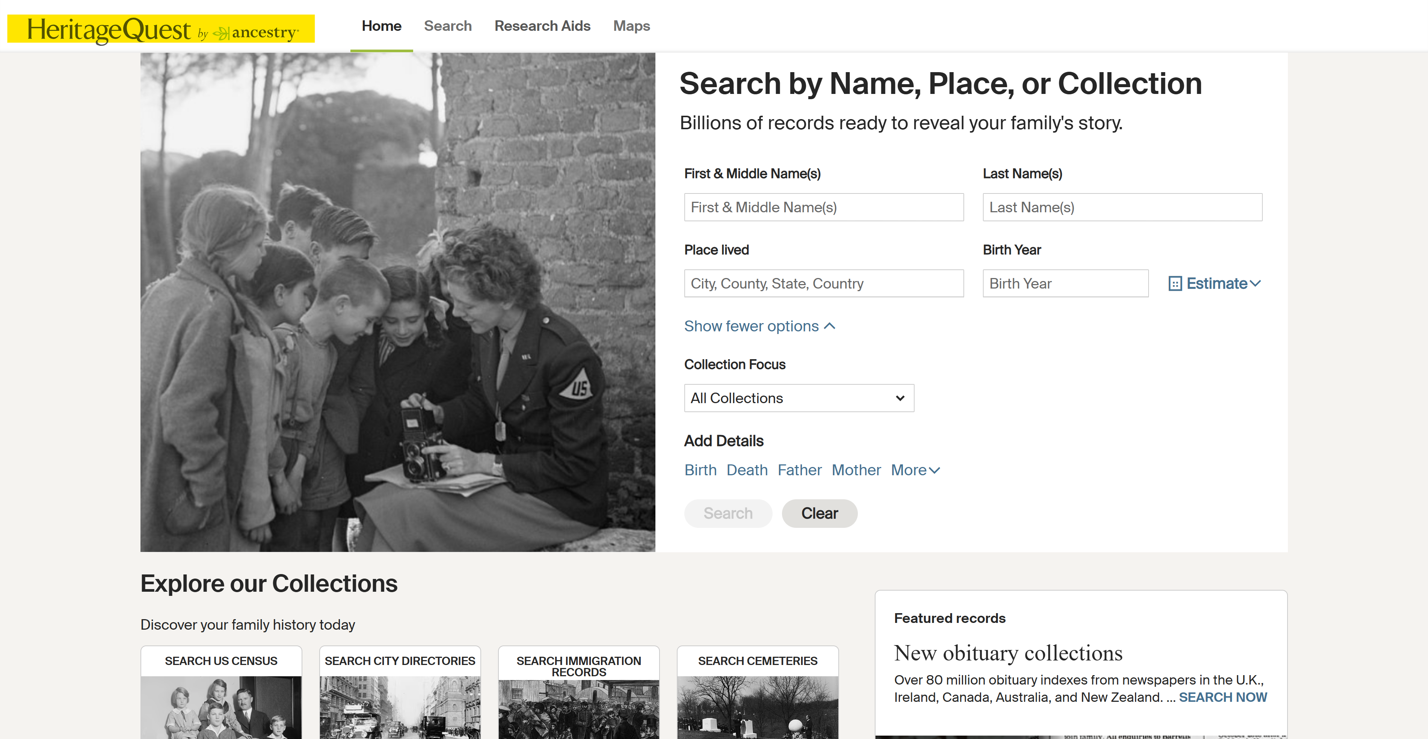
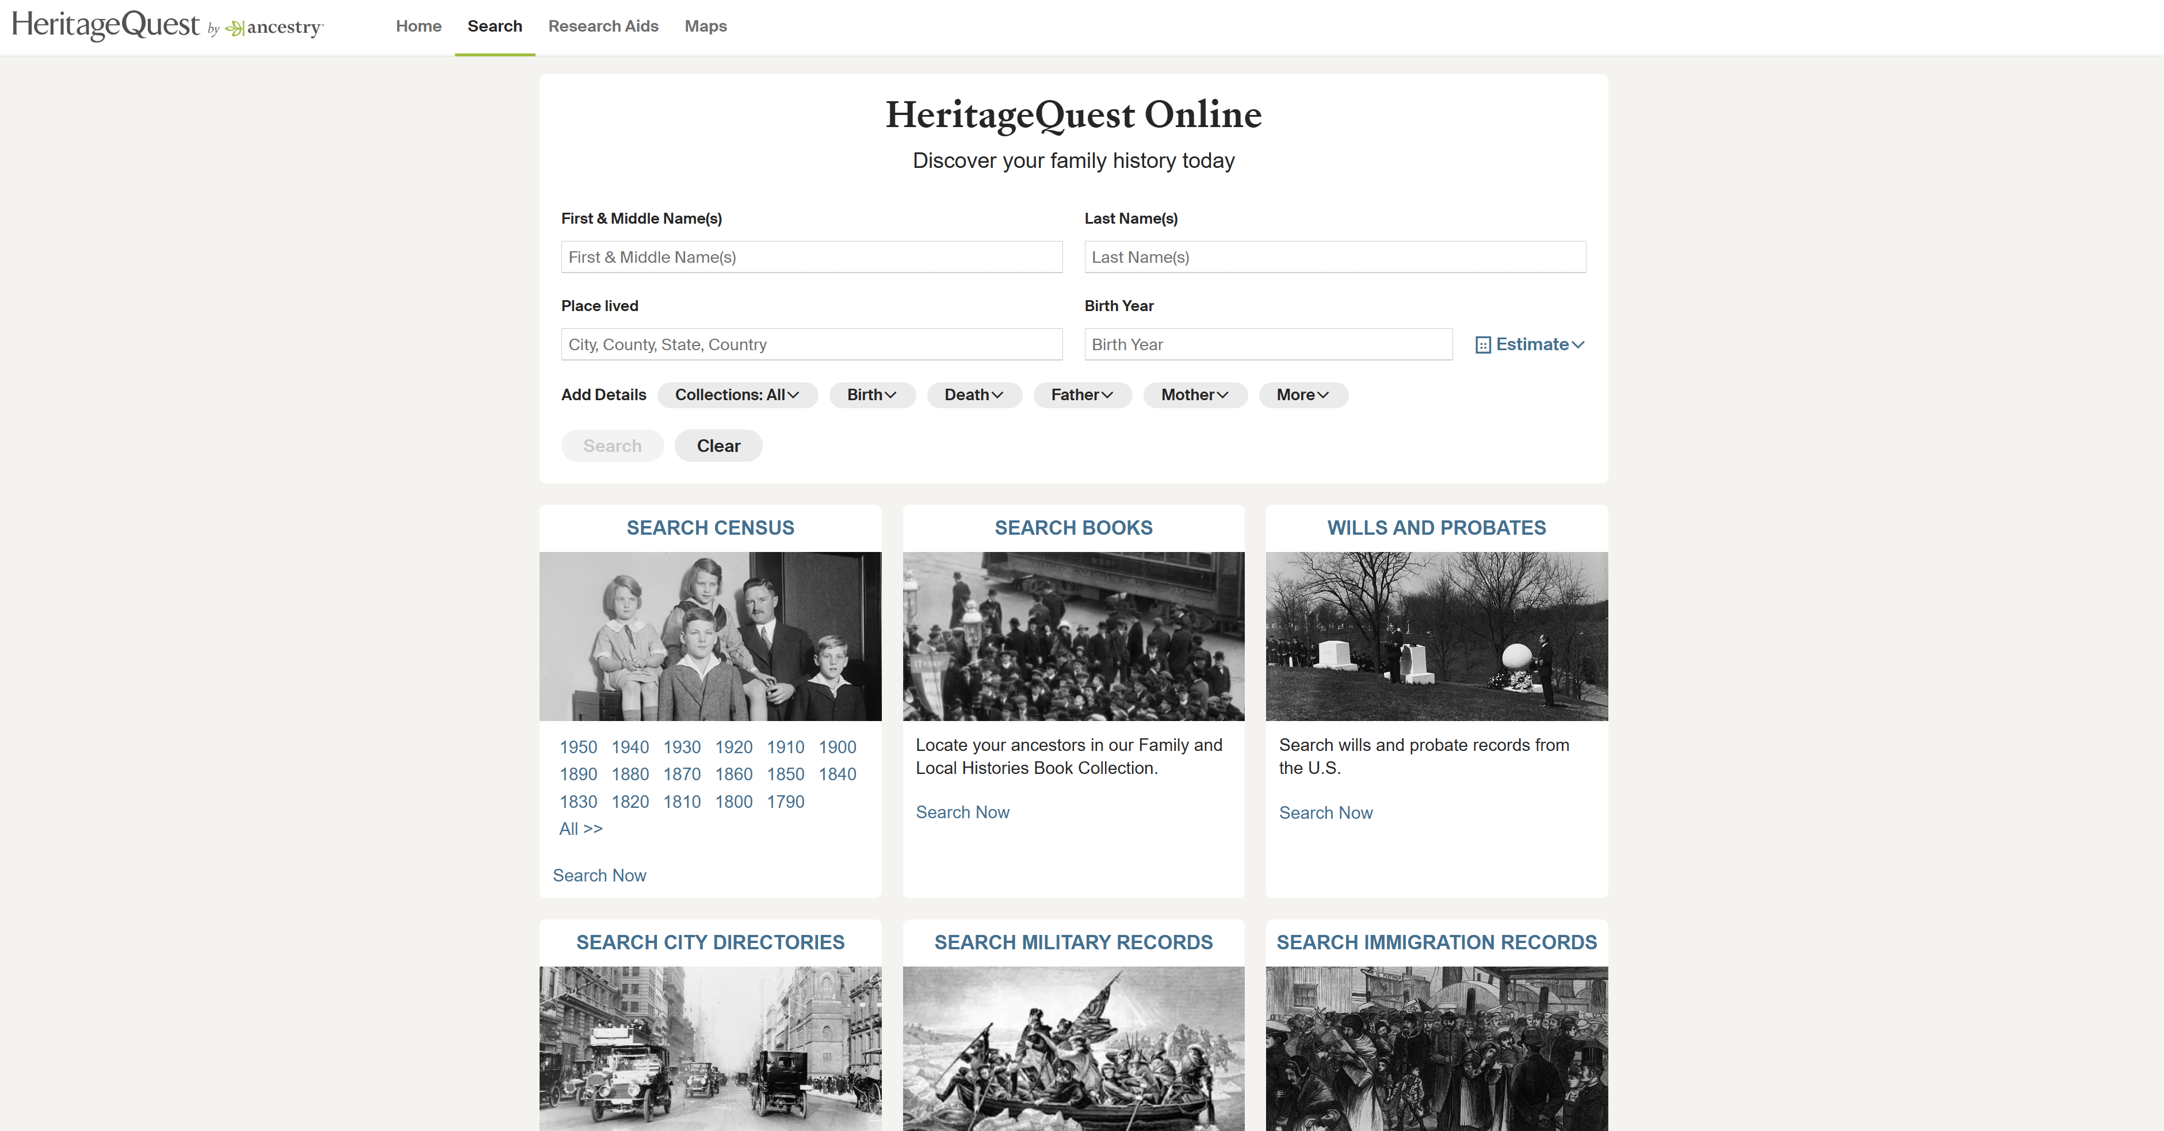
Notes:
HeritageQuest Online, which is powered by Ancestry®, provides a simplified search interface primarily focused on U.S. genealogical records. Its primary search functions are organized into several core data sets:
Laurel County Public Library +1
U.S. Federal Census Search: This is the most popular function, allowing users to search every available federal census from 1790 through 1950. You can search by name, location, and other life events to view original digital images of census pages.
Genealogy & Local History Books Search: Users can perform a full-text search across more than 28,000 digitized family histories, local histories, and city directories. You can search by Person to find names mentioned within the text or by Publication to find specific book titles.
Revolutionary War Records: This specialized search accesses the complete NARA collection of pension and bounty-land warrant application files for over 80,000 officers and enlisted men.
Freedman’s Bank Records (1865–1874): A critical tool for African American research, this allows users to search names of bank applicants, their dependents, and heirs.
U.S. Congressional Serial Set: Users can search for memorials, petitions, and private relief actions made to the U.S. Congress dating back to 1789.
Interactive Census Maps: The "Maps" tab provides a visual search tool to view how U.S. state and county boundaries changed between 1790 and 1920, helping researchers identify where records might be located.
Tennessee Electronic Library +7
HeritageQuest also includes a Research Aids section that provides tips and guides for using these search functions effectively.

Slide 22
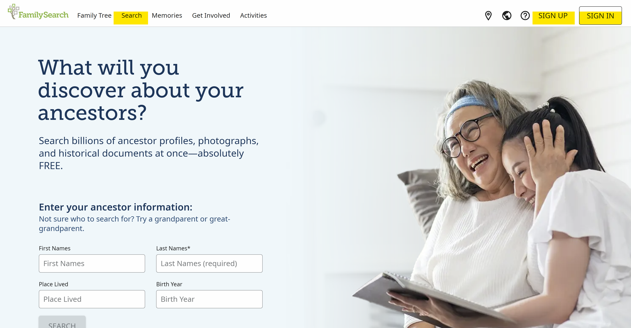
Notes:
Personal account, institutional account
Affiliate library

