Slide 1

From Pages to People:
Creating Meaningful Book
Club Experiences

Slide 2

INTRODUCTIONS

Slide 3

WHY BOOK CLUBS
MATTER?

Slide 4


Why Book Club for Kids
  Reading for pleasure boosts empathy, vocabulary, and confidence
  Book clubs build community and social‑emotional skills
  They support reluctant readers by lowering pressure and raising engagement
  Kids associate books with joy, not homework

Slide 5



BOOK CLUBS FOR YOUTH
MY CURRENT BOOK CLUBS
HAPPY TALES 1st and 2nd grade
ADVENTURE CLUB 3rd - 6th grade
TEEN BOOK CLUB 7th - 12th grade
Because each year the reading can be different with the age groups I have adjusted who attends which group.

Slide 6


PICKING THE BOOK/DISCUSSION QUESTIONS
(All Book Clubs)
  I do try to pick books that are at the reading level
of the youth that are in the group.
    I always order books a month ahead so they can grab a book at the end of a meeting
  I always use whatever resources (such as brightly and child safe for all my book clubs)
  I also read every book before I add it to my list of books.
    I take notes for questions while I read the book and tab interesting quotes.
    I use the author’s websites to learn more about why they wrote the book and sometimes they include discussion questions and activities.
    I do look for other guides and see if there is anything I should add.

Slide 7


Marketing
Word of Mouth
Social Media
School Librarian
Newsletter, Website, Slide Show
Staff Suggests
Each book that is checked out has a bookmark with the day and time of the next book club meeting and copies of books are provided at the meeting prior to the month of the book club.

Slide 8


Activities/Crafts
  I do have candy available for Happy Tales and Young Adult Book Clubs. This always brings in a crowd.
  At the table for the discussion I supply coloring pages, activity pages (puzzles, seek and find, etc) and crayons or colored pencils to give the youth something to do during the discussion phase. Seems to keep them on task.
    I either find already made up puzzles or will make my own based on the books.
    Coloring pages come from any of the free sites on the web.
  Craft and or Activity
    I always have one craft or activity related to the book
    Depending on the month, there is usually an activity or craft that is holiday or season related
      Crafts
        Bookmarks are always a hit, especially if they are related to the book
            Pig (Charlotte’s Web and Mercy Watson)
        Memory Jar (The Vandebeekers)
        Travel Journal (Amelia Six)
        Friendship Bracelets/Pins (Old School)
      Activities
        Things Seen from Above (adventure club)
          We made a spiral walk on the sidewalks
        Song for a Whale (adventure Club)
          Made an outline of a Blue Whale (actual dimensions) in our parking lot
        The Good Girls’ Guide to Murder (young adult)
          Escape Room
        Mr. Potter and Tabby Pour the Tea
          Tea Party

Slide 9


HAPPY TALES
Happy Tales has seen some changes over the last few years.
First and Second Graders (I do invite Kindergarten in March and April to get an idea of what is going on)
  At first I or my teen helpers read the book to the youth and then did our activities. I started this over the summer so I picked a shorter chapter book and we read one chapter a week.
  Weekly meetings were not feasible during the school year so I went to a once a month schedule and still read a book each month before we broke into our crafts.
  There were a few more changes over the last few years, but now I choose an easy chapter book and the youth read that over the course of a month.
      Every book club has a discussion about the book. At this age, we talk a lot about what we like and didn’t like in the book as well as a few more direct questions about things that happened in the group.
          I do have a few that struggle with reading in this age group so I have used very easy chapter books (such as branches)
  Attendance ranges from 5-15 (I usually cap it around 10 during the school year, during the summer I have teen help and can go a little higher)

Slide 10


ADVENTURE CLUB
3rd - 6th grade
Longest running book club that we have.
  Youth have a month to read the book
  Candy, coloring or activity during discussion are available
  Discussion questions are more challenging and require more thought
    I do have one rule
      If you don’t like the book and you gave it a good try, you don’t have to finish it. But, come prepared to tell me why you didn’t like it and a review on a book you did like that you read that month.
    I try to throw easy questions out there for the reluctant talkers to particapate
    Usually around 20 minutes for discussion (although some books get them going and they can talk!
  Attendance has ran from 3-20
    Depending on the ages during that year I have adjusted the maximum up and down (this year I have a lot of younger grades so the limit is around 10 or so)

Slide 11


Young Adult Book Club
  Youth have a month to read the book
  Candy, coloring or activity during discussion are available
Discussion questions are more challenging and require more thought, this club is ran more like an adult book club (except snacks and crafts)
Attendance has ran from 5-15
I do always have the rest of a series (if we had read a series) or read alike books available for checkout after the meeting, as well as next month’s book.

Slide 12


  This book club is for all patrons 18+ and focuses on the romance genre
  We read all different sub-genres of romance which include contemporary, fantasy, historical, and dark romance
  Our meetings take place in the evening that way patrons that work or have busy schedules can have the opportunity to join as well

Slide 13

WHY ROMANCE?
In 2025 romance remained a dominant force in publishing, with 23% of American readers—roughly 32% of women and 12% of men who read—engaging with the genre, making it one of the top genres read.
While romance is one of the most widely read literary genres,
it is often underrepresented in formal literary programming.
This program affirms the value of romance reading and
positions the public library as an inclusive space where
all reading interests are respected and celebrated.

Slide 14


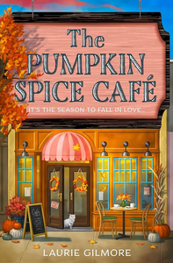


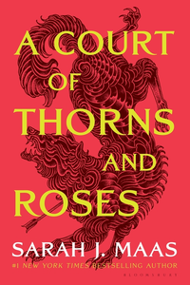
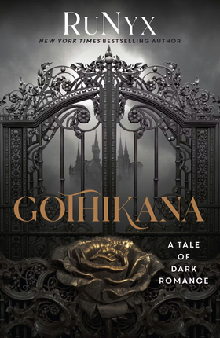
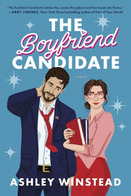

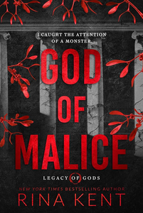


ATTENDANCE IN 2025
ATTENDANCE IN 2026
Contemporary
Feb
Dark Romance
Jan
8
10
Contemporary
Jun
13
Fantasy
Sept
Fantasy tends to bring in the highest numbers due to its virality on social media
Contemporary
Mar
13
10
Fantasy
Jul
Dark Romance
Feb
19
17
Contemporary
Oct
Contemporary
Apr
6
0
Dark Romance
Aug
9
Contemporary
Mar
Fantasy
May
24
16

Slide 15
CHALLENGES TO RUNNING A BOOK CLUB
Hoopla and the rising cost of digital collections
The restrictions on book selection
  the title has to be on Hoopla that way there is no wait time for multiple patrons wanting to check out the same title
  the book they choose cannot be a brand new title so it’s challenging finding options that are new enough to still be popular
  lastly the title has to be available at multiple libraries to attain enough physical copies
Readjusting my program budget and coming up with creative ways to keep costs down

Slide 16
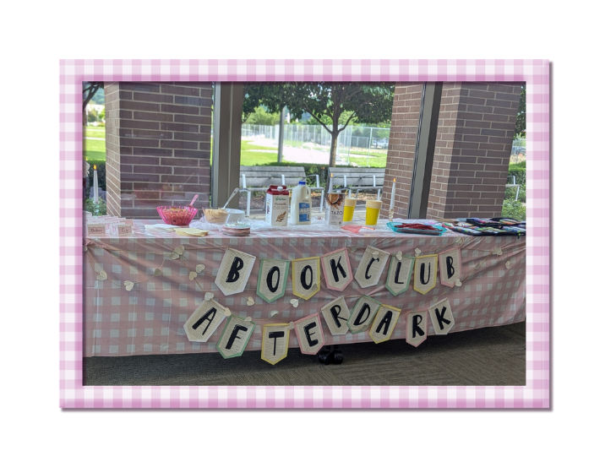
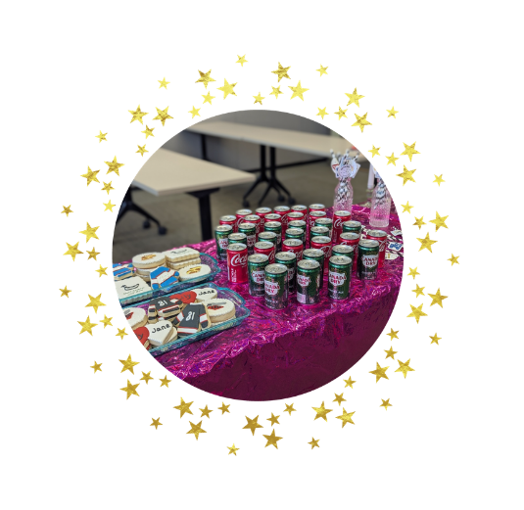
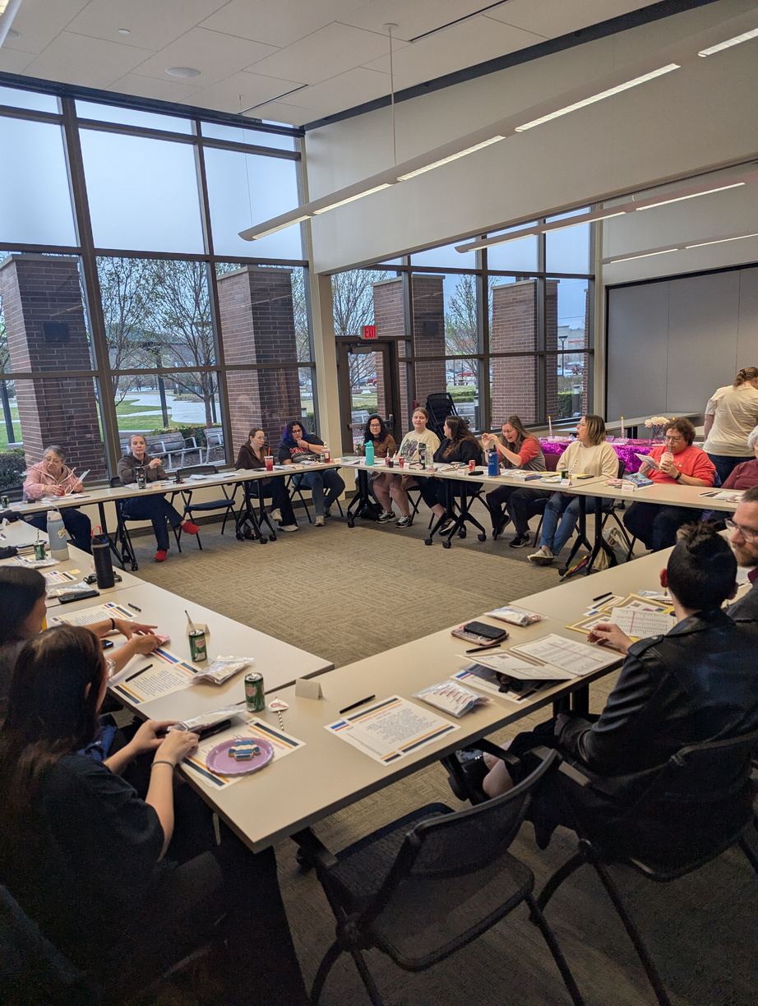
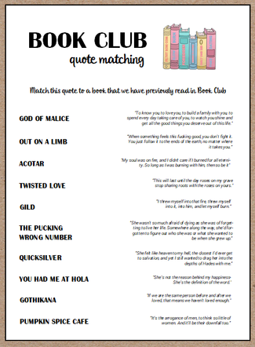
TIPS FOR HOSTING A BOOK CLUB
Choose the right books
  Pick books that will generate discussion and interest among your members
  Use different and creative types of ways for patrons to pick books each month
Set Clear Expectations
  Be clear about what’s expected in terms of preparation and participation
  Make sure everyone feels comfortable expressing their opinions

Slide 17
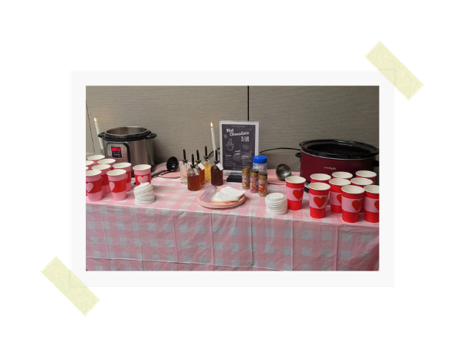
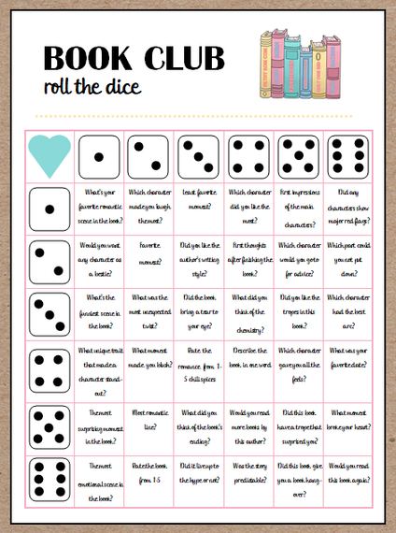
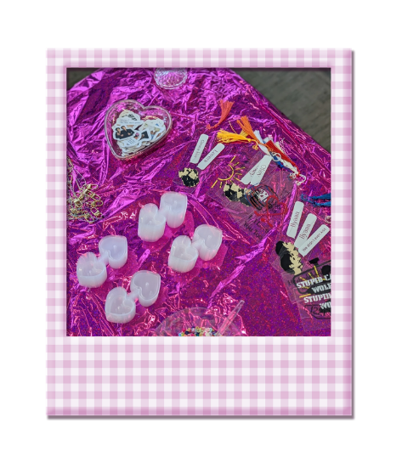
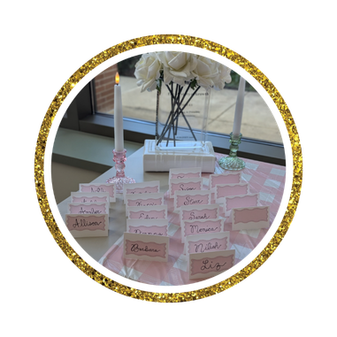
TIPS FOR HOSTING A BOOK CLUB
Create a Friendly Atmosphere
  Encourage open and respectful dialogue. Make sure everyone feels listened to and appreciated
  Games and fun activities really get the meeting started off right and make members feel comfortable
  I like to have a giveaway or small door prize each meeting and offer loyalty punch cards to encourage patrons to return month after month
Keep it Organized
  Set a regular schedule for meetings and stick to it. Use tools like Facebook groups or in house marketing (quarter-sheets + newsletters) to keep everyone informed and engaged

Slide 18
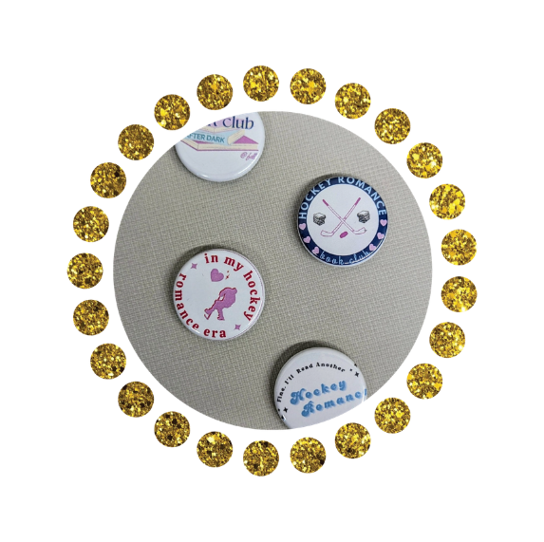
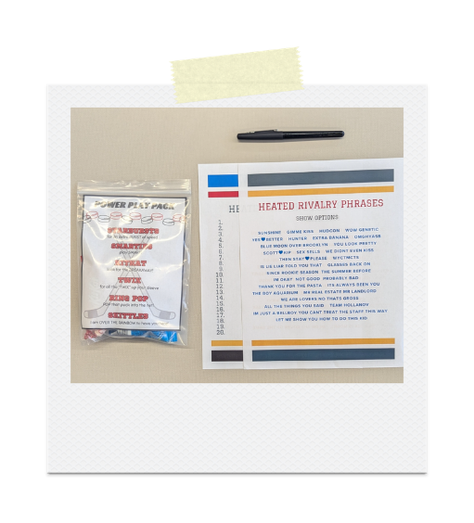
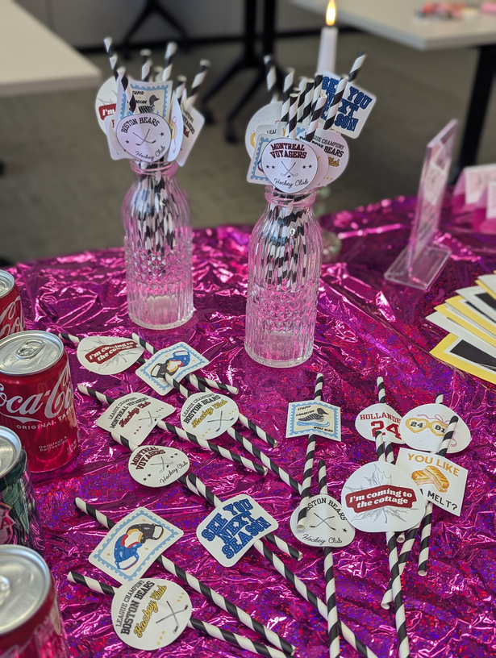

TIPS FOR HOSTING A BOOK CLUB
Stay on Theme
  For me personally I like to have themed snacks/drinks, games and activities, and I play a playlist in the background for atmosphere
  I will also create tailored discussion questions and games that are either specific to the book or sub-genre
Use Free Marketing if You Can
  If I have a display that has romance books on it, I will put a club information quarter sheet in the book for a patron to discover
  When I am hosting another program, I will talk to the patrons about what they’re currently reading and if romance is a genre that they enjoy I will mention the book club
  In circulation I have not only quarter sheets but also contact information inserts with our FB group QR Code that can be given out with the monthly selection at pickup

Slide 19
Contact Us
Jacque
Stengel
Deanna Hohenbery
jstengel@heyworthlibrary.com
deanna@fondulaclibrary.org

