Slide 1
Finding Free or
Inexpensive
Programming
for Your Library

Slide 2
About Prairie Creek Public Library District
We are located in Dwight (pop 4,100).
Our district population is 5,149.
Our library will be 100 years old next year and was founded by Dwight Woman’s Club, which is still in operation and serves the library often.
Currently, our building is housed in a historic building which originally was the Carriage House for the mansion next door.
We have a community room for our programming. Last month, we offered 21 active programs.
Our programming budget is $8,000/yr.

Slide 3
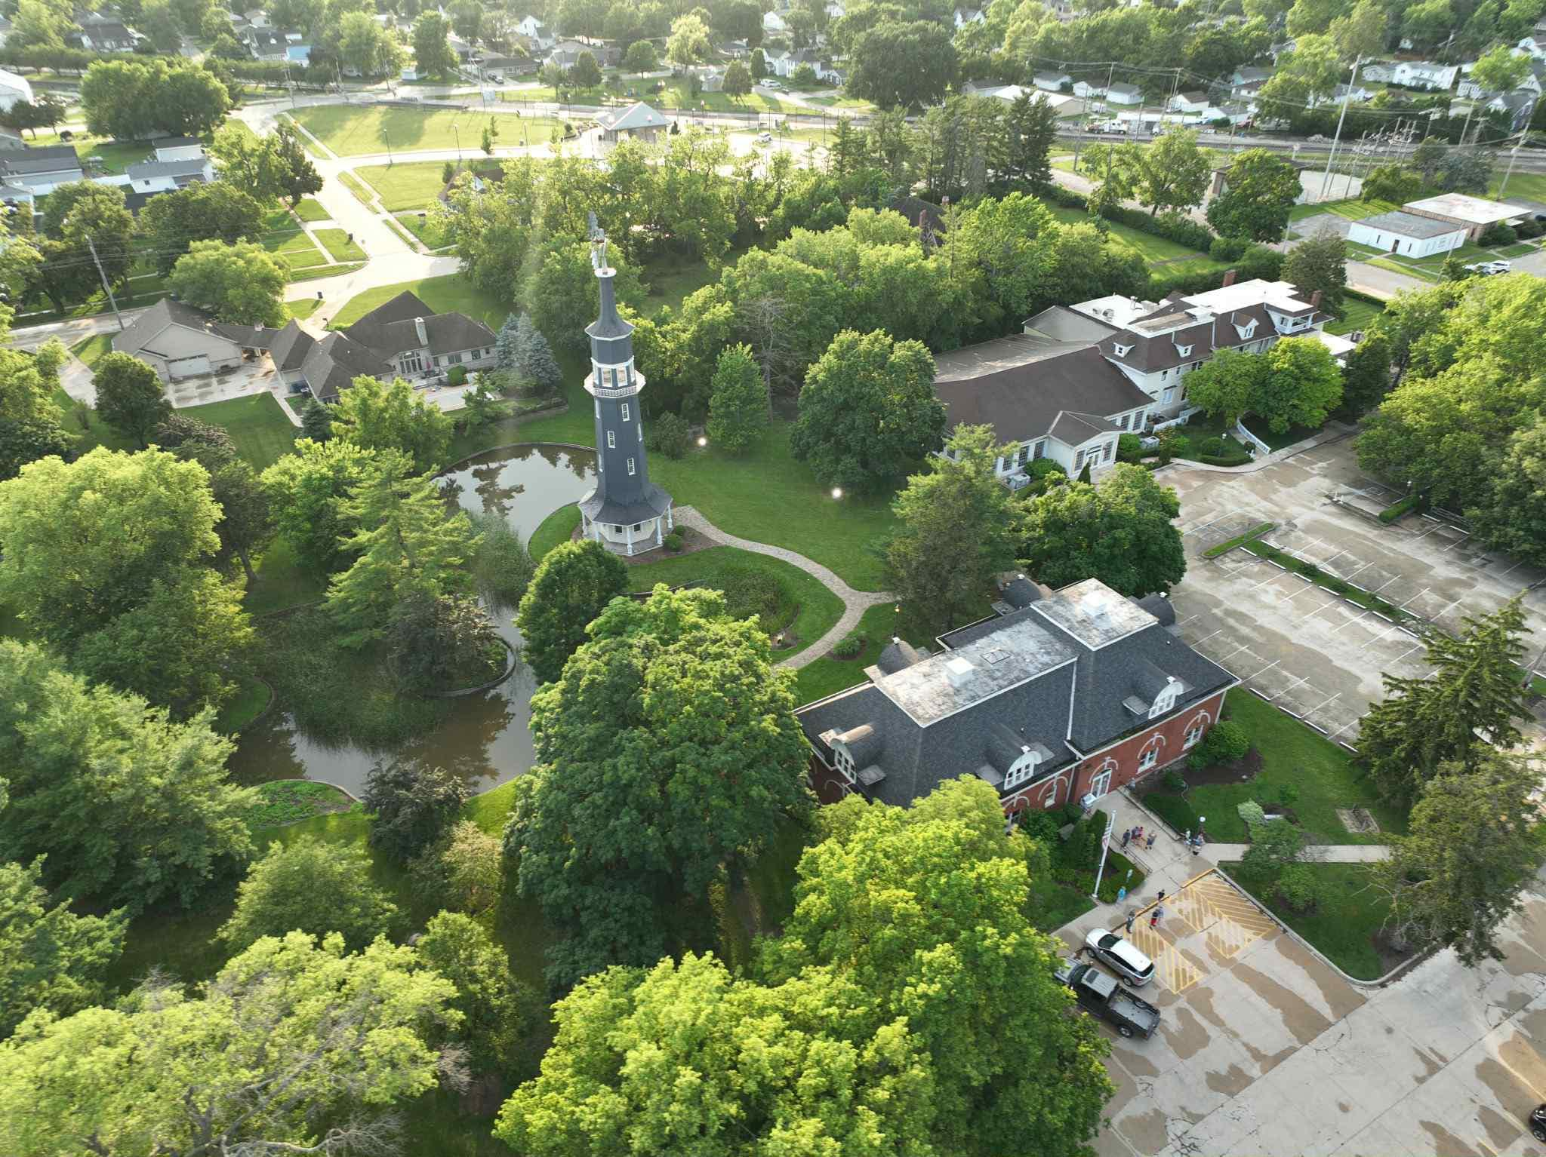
About Prairie Creek
Public Library District

Slide 4
Things to keep in mind:
You must speak to patrons and other members of the public to find hidden talents and opportunities to collaborate.
Always be looking for the win-wins. Is presenting a free program at the library going to benefit the presenter?
Other agencies may be looking for opportunities to get their name out as well. Become their friend!
Find your staff’s hidden talents and use them.
Tie back to your collection when you can.

Slide 5
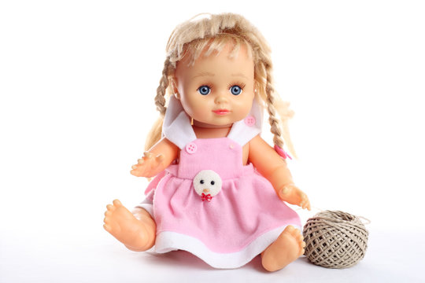
Patrons with Hobbies
Doll Makeovers
Candle Making
Online Sales
Living like it’s the 1930s
American Girl doll displays

Slide 6
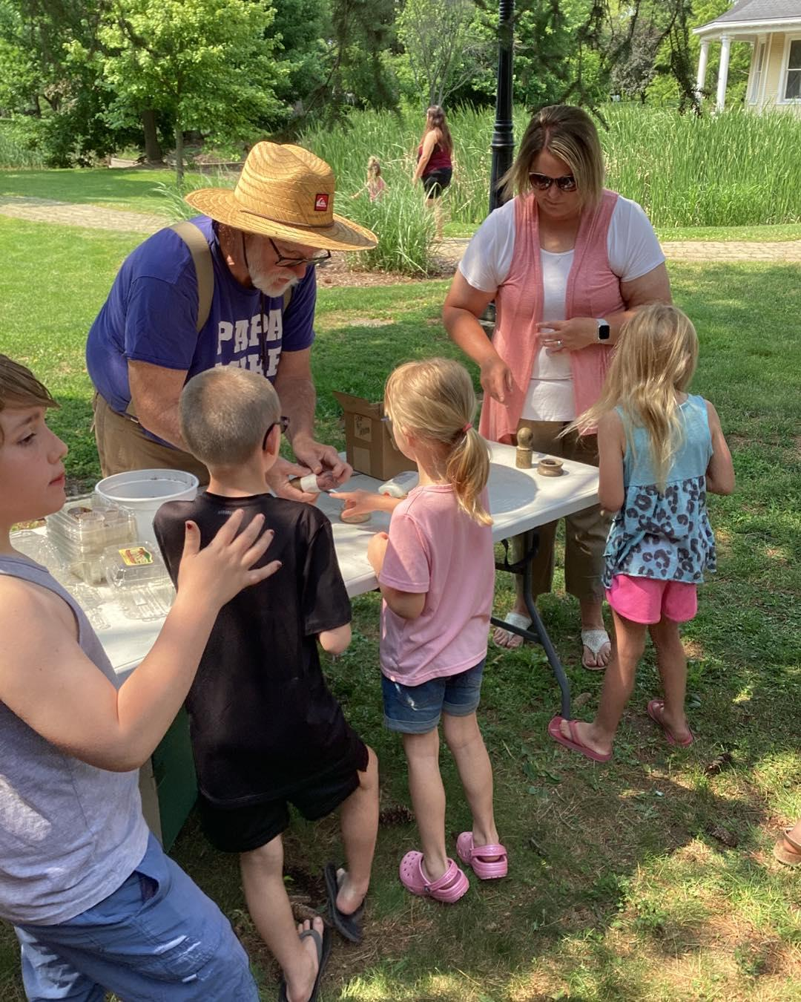
Patrons with Hobbies
Gardening with Papa Mike

Slide 7
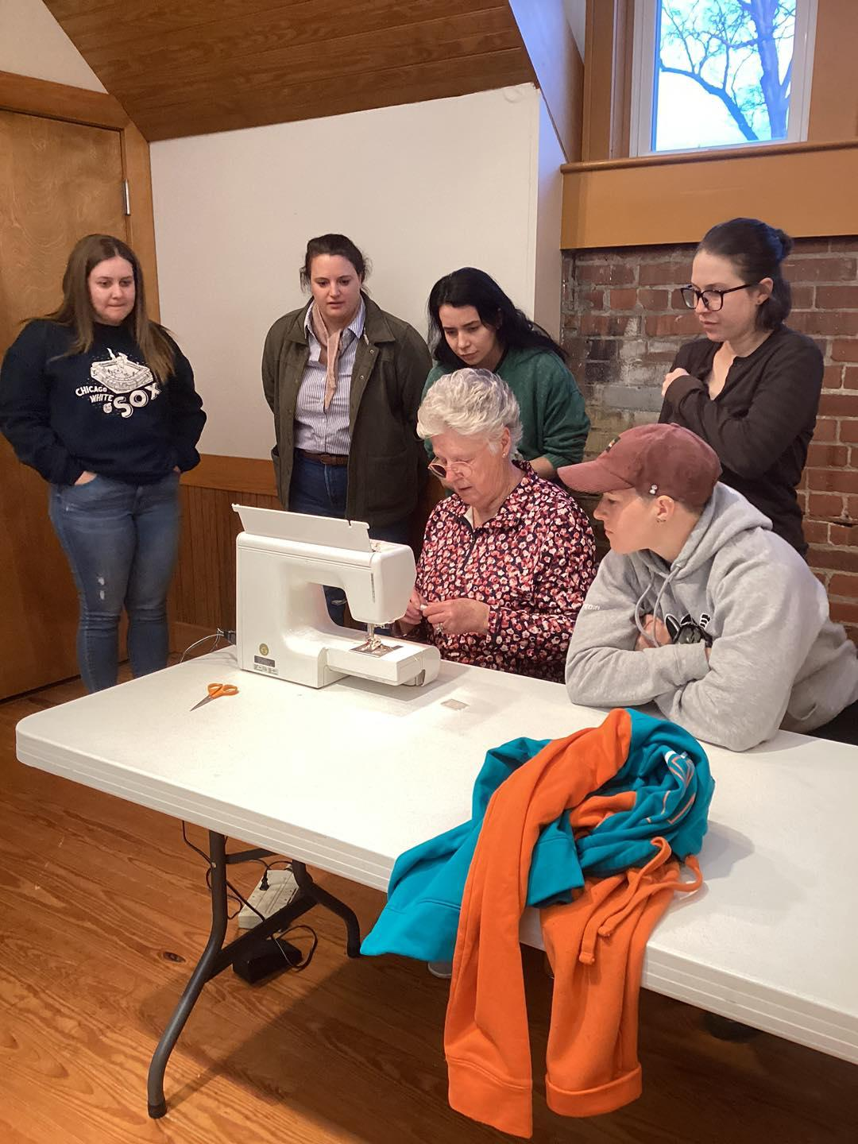
Patrons with Hobbies
Sewing Basics with Iris
Part of our “I Wish I Knew” series

Slide 8

Patrons with Hobbies
Cooking Basics
Part of the “I Wish I Knew” series

Slide 9
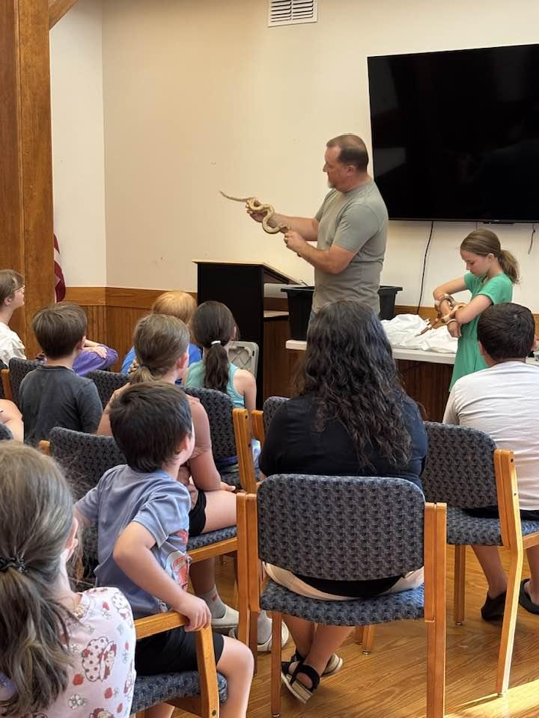
Patrons with Hobbies
Our Snake Friends

Slide 10
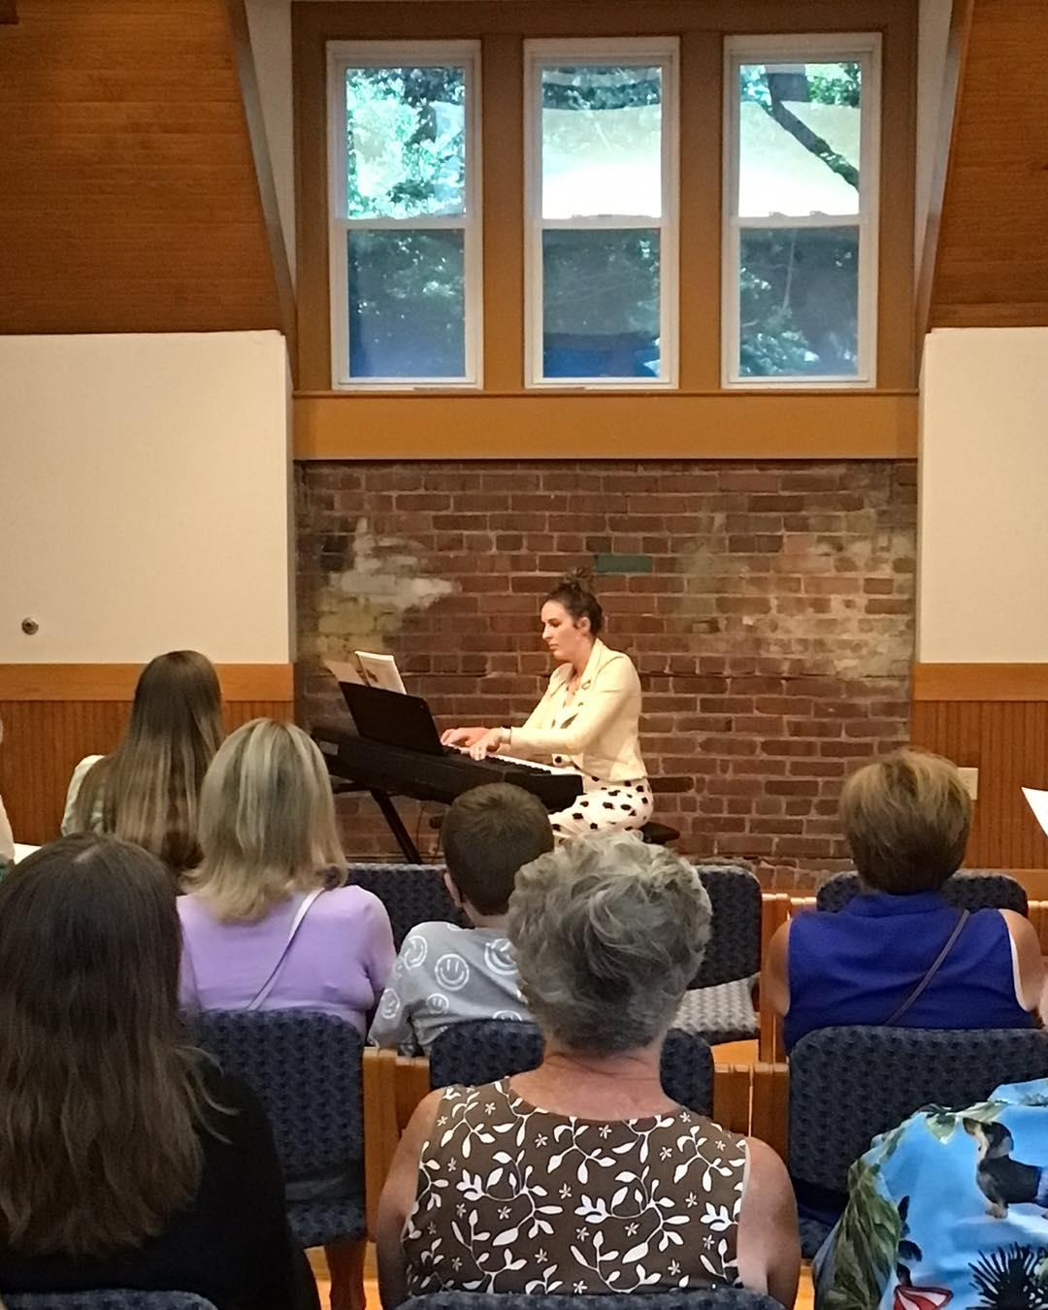
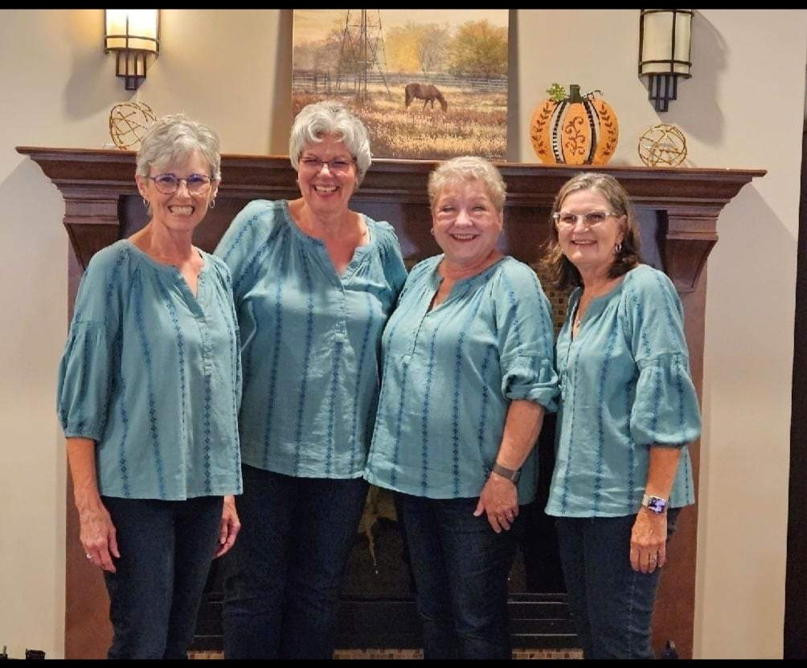
Patrons with Hobbies
Musical Performances

Slide 11
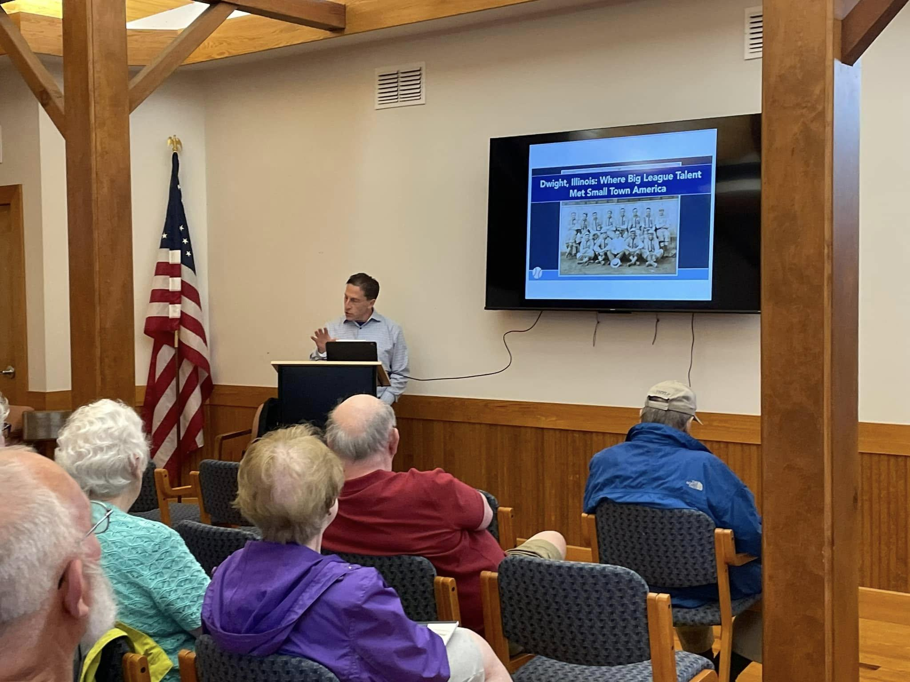
Patrons with Hobbies
Historical Lectures by a board member
Baseball with Bill
Photography
Raising Chickens
Rag Rug Making

Slide 12
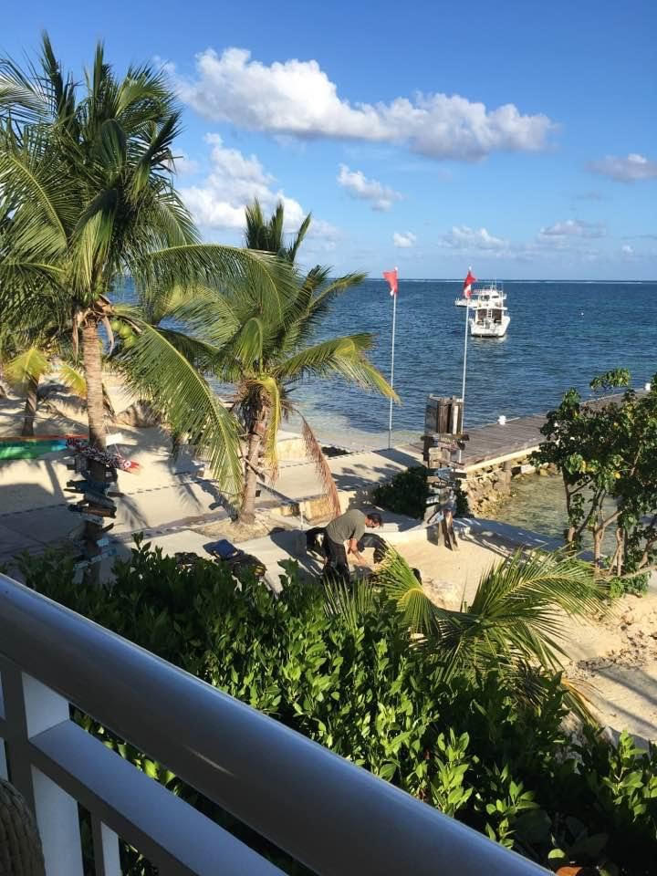
Patrons with Hobbies
Travel Talk Adventures

Slide 13
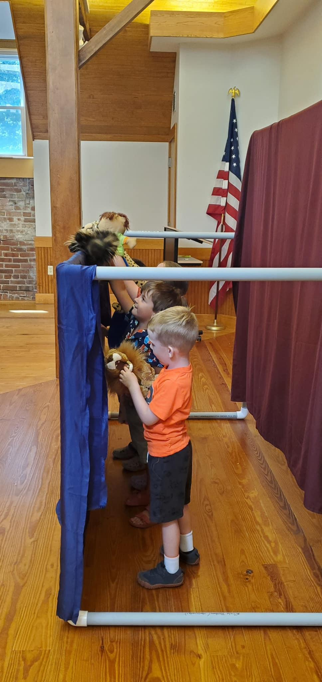
Schools
Drama Club staged a Puppet Theater
Librarian helps with Reading Challenges
Art teacher helped with student art show
P.E. teacher held a dance party.
Don’t forget to explore your community college, even if it isn’t in your town.

Slide 14
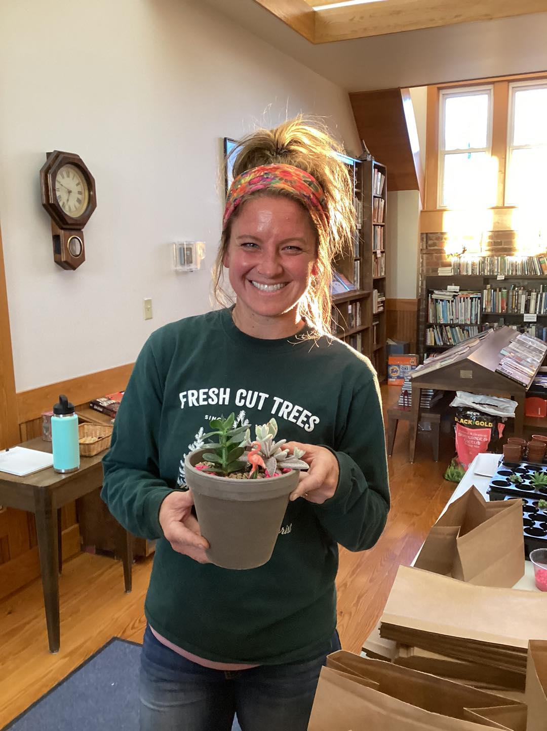
Local Businesses
Casey’s Garden Succulent Planters
Floral Arranging
(Cost recoup)

Slide 15
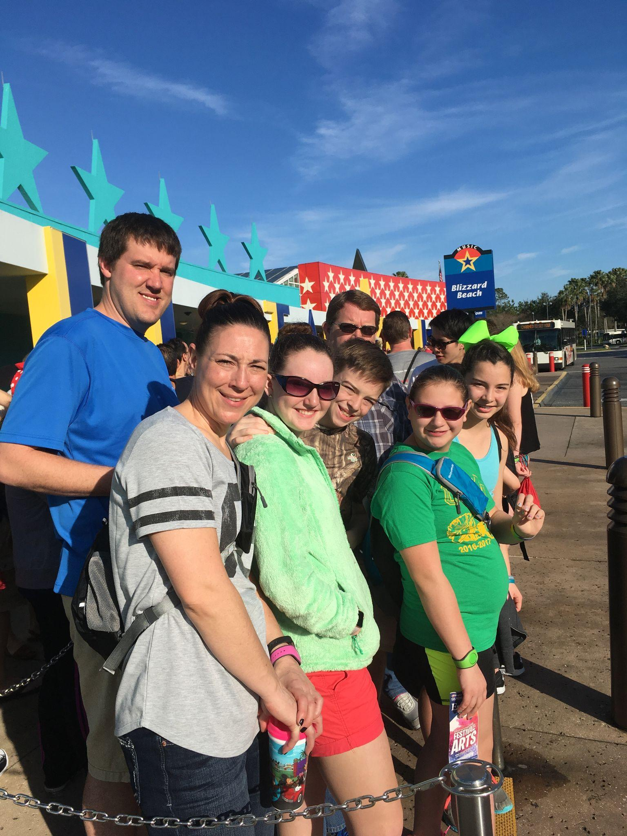
Local Businesses
Disney Vacation Planning

Slide 16
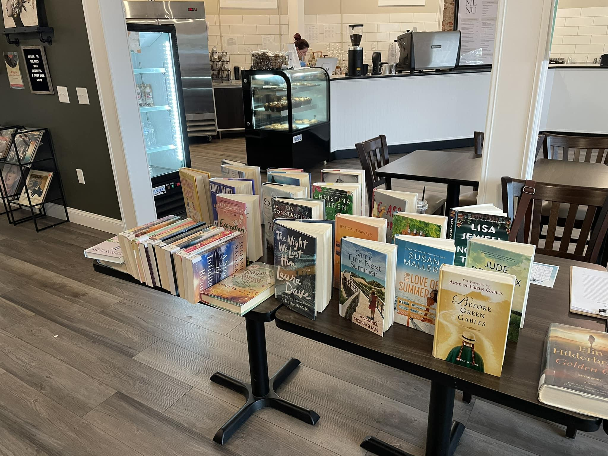
Local Businesses
Perfect Blend Pairings
Coffee Tasting

Slide 17
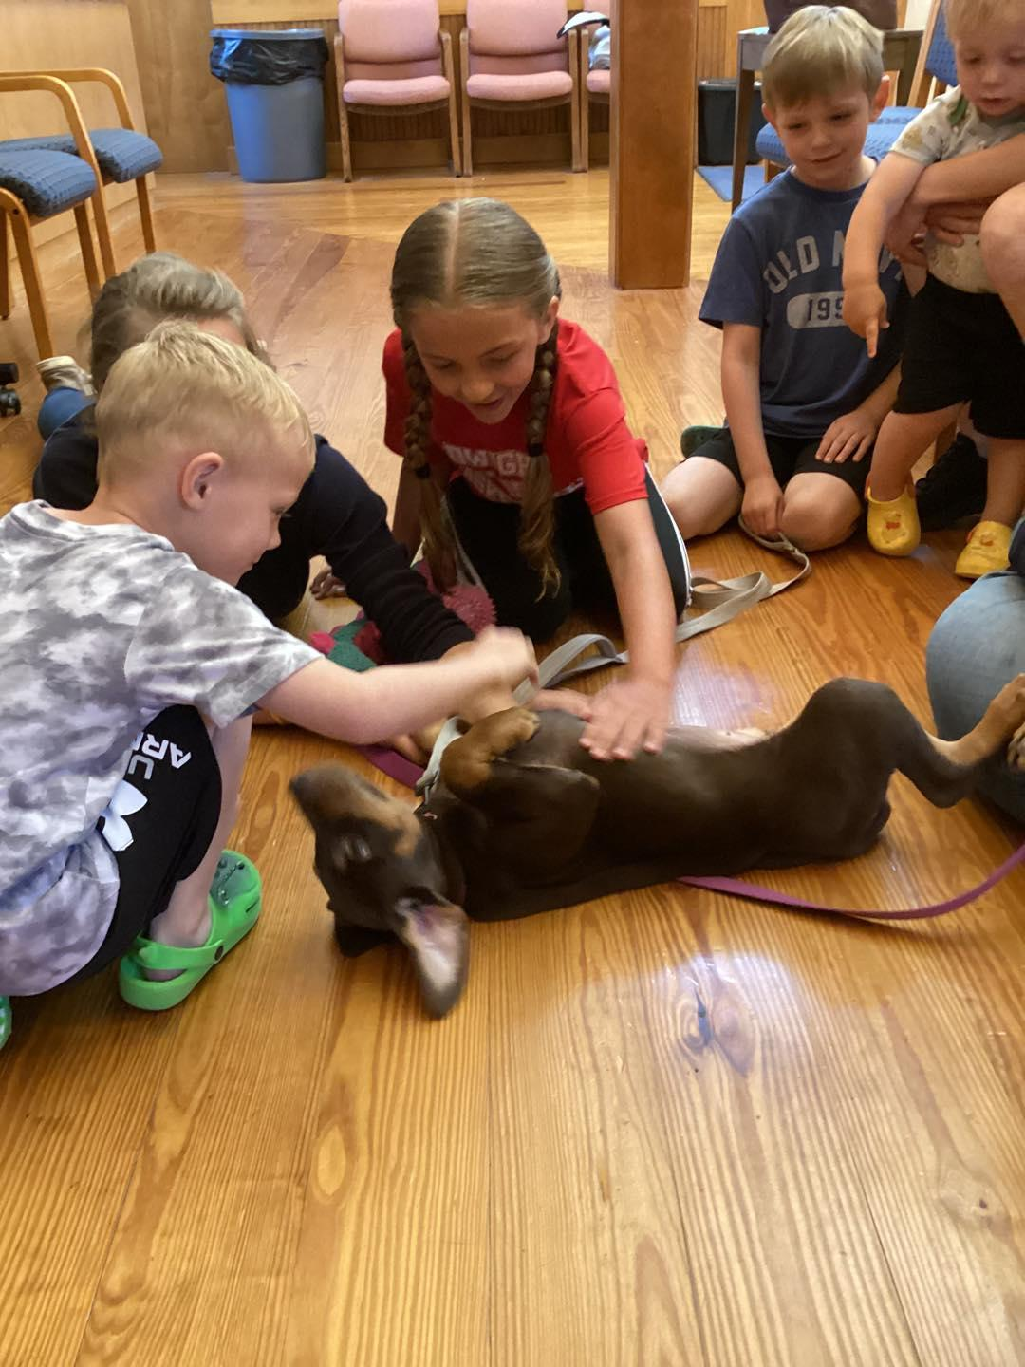
Local Businesses
K-9 Sports
Read to a Dog
Puppy Yoga

Slide 18
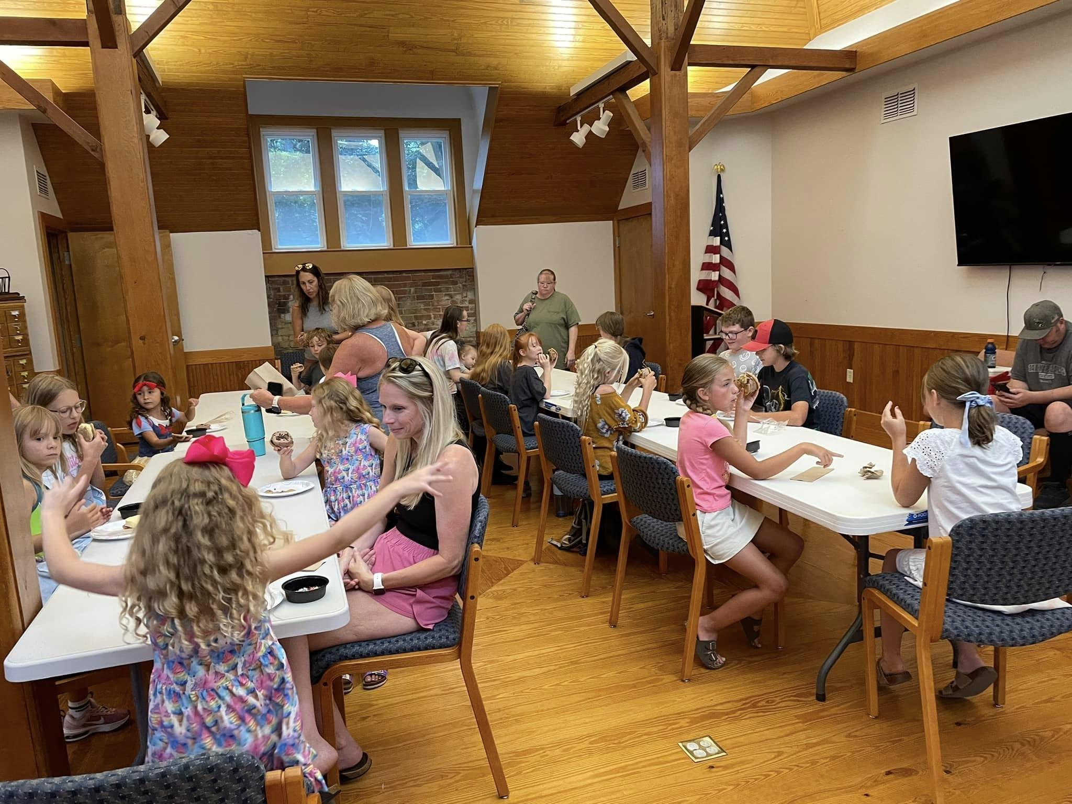
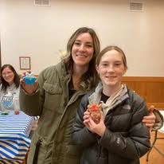
Local Businesses
Cottage Businesses
Kryptonite Soap Making
Tea Tastings
Green Cleaning
Ice Cream Sandwiches

Slide 19
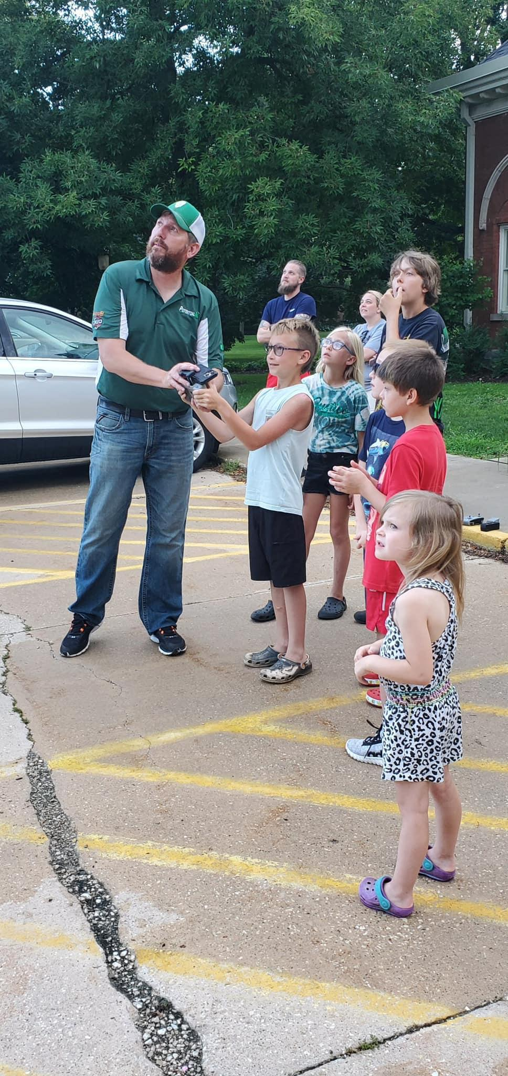
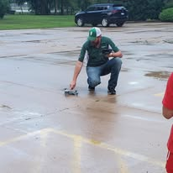
Local Businesses
Drone Demonstration

Slide 20
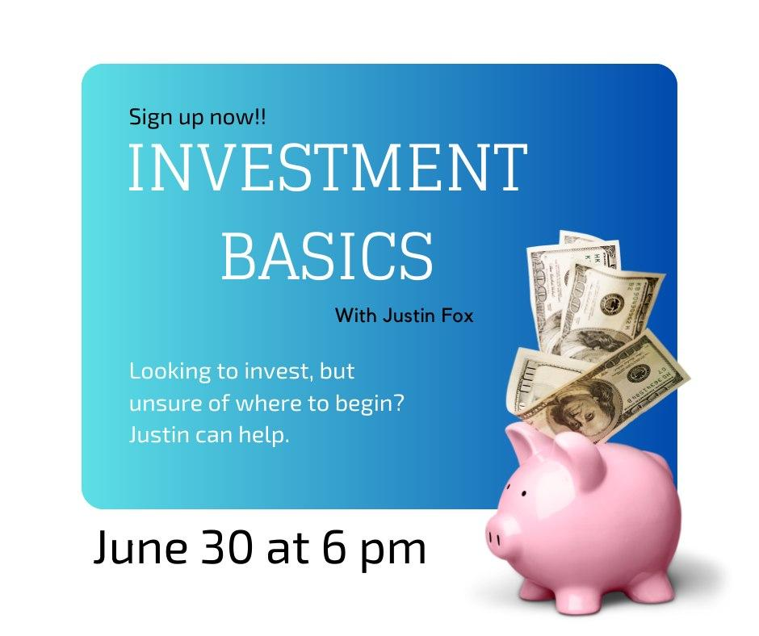
Local Businesses
Investment Basics (I Wish I Knew series)
End of Life Planning
Trash or Treasure program

Slide 21
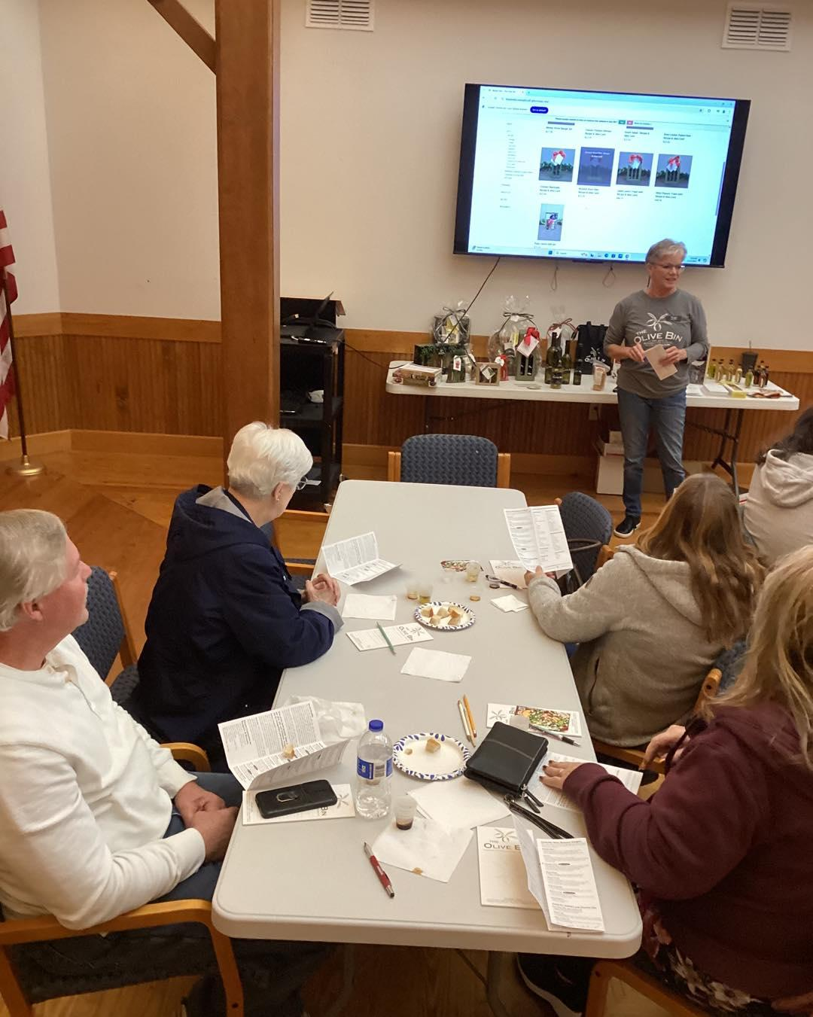
Local Businesses
Consider going outside of your town
Olive Oil Tasting

Slide 22
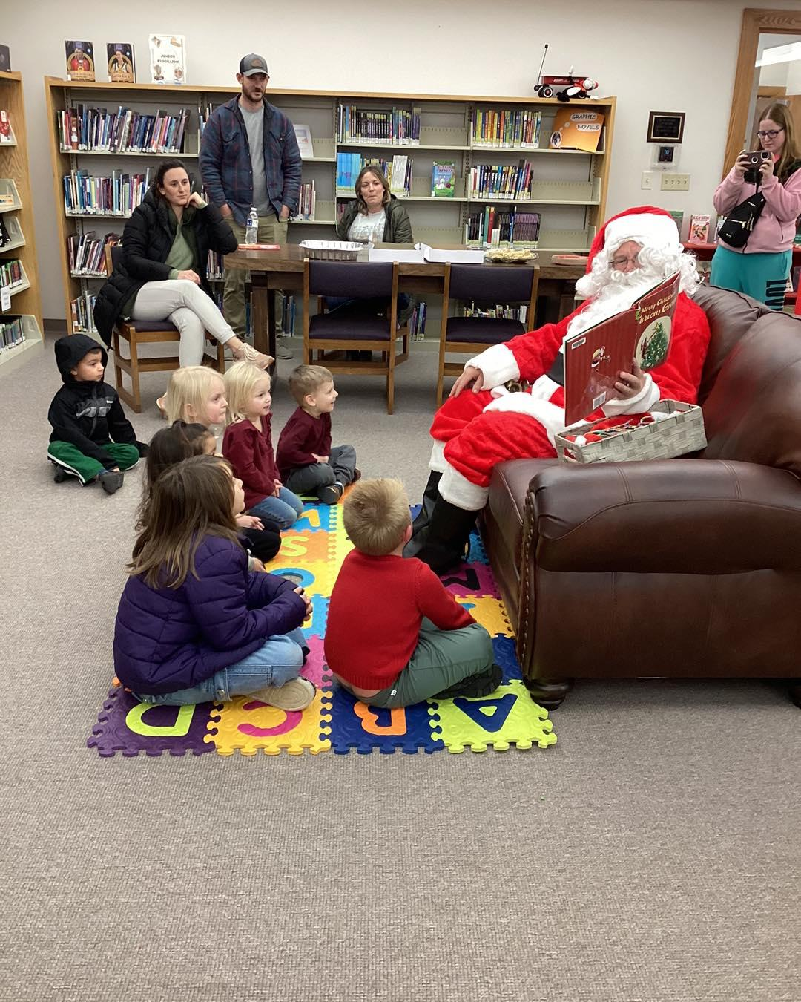
Local Businesses
Pop-Up Story Times
Donuts and checking out police car at the police station
Ice Cream at a restaurant
Matchbox car races at a car dealership
Children’s yoga at the yoga studio
Music and Motion at the piano studio
Story Time with Santa

Slide 23
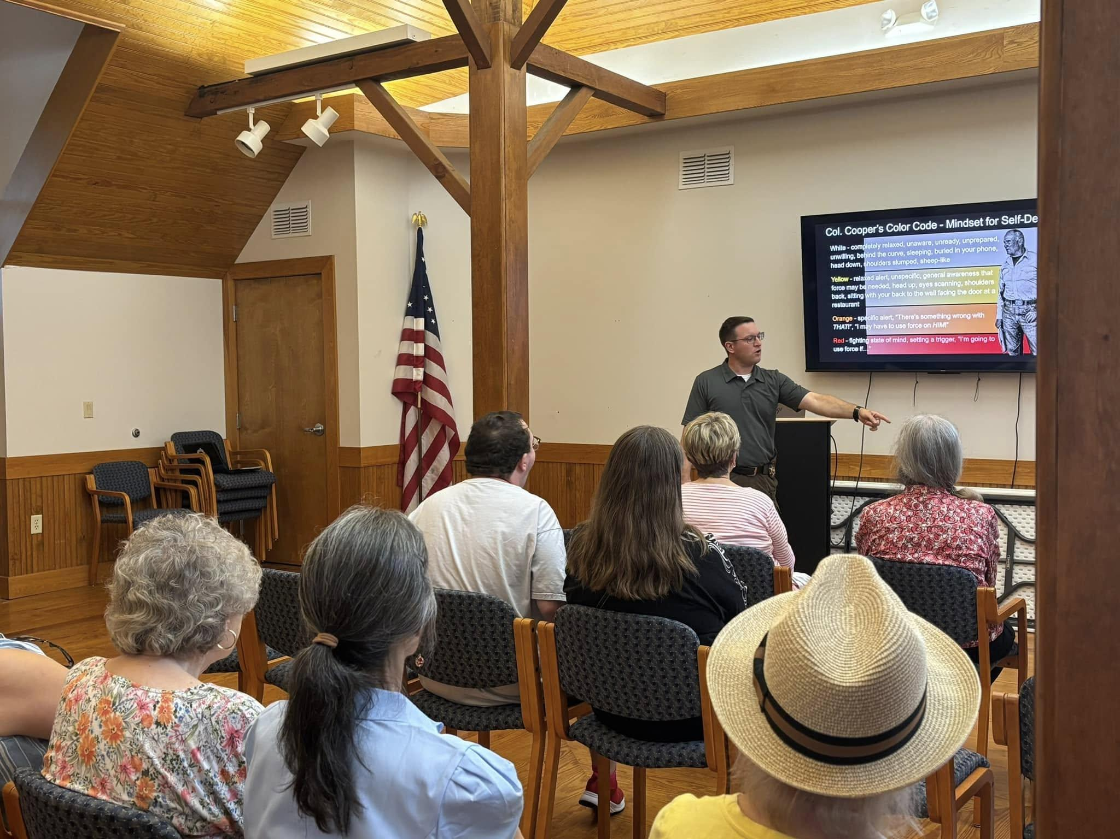
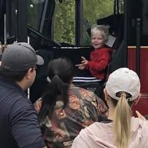
Causes educating the public
Police Department
Personal safety and awareness
Active shooter education for all
Fire Department
Fire Safety for Kids
Touch a Truck

Slide 24
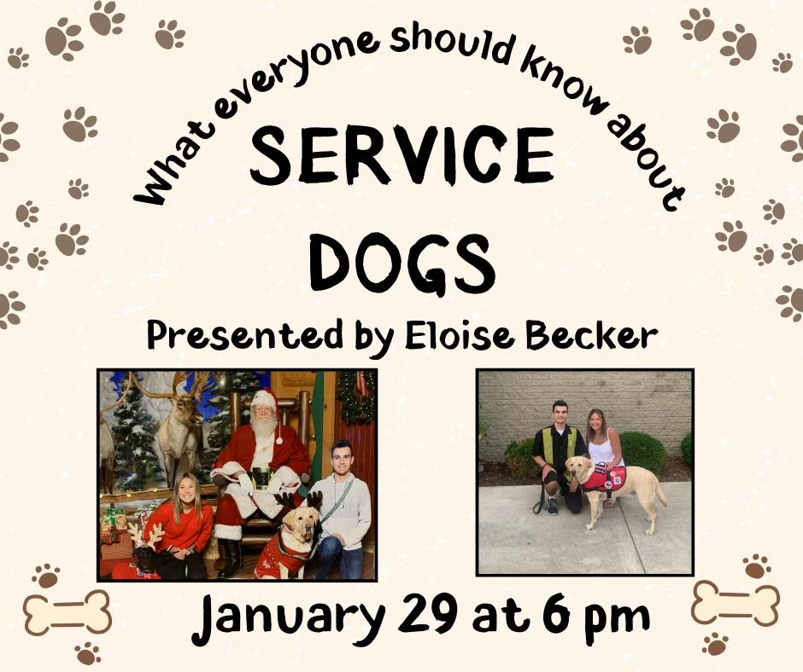
Causes educating the public
Choose a topic you feel people would benefit from education.
Service Animals
Human Trafficking
Technology and AI education for seniors

Slide 25
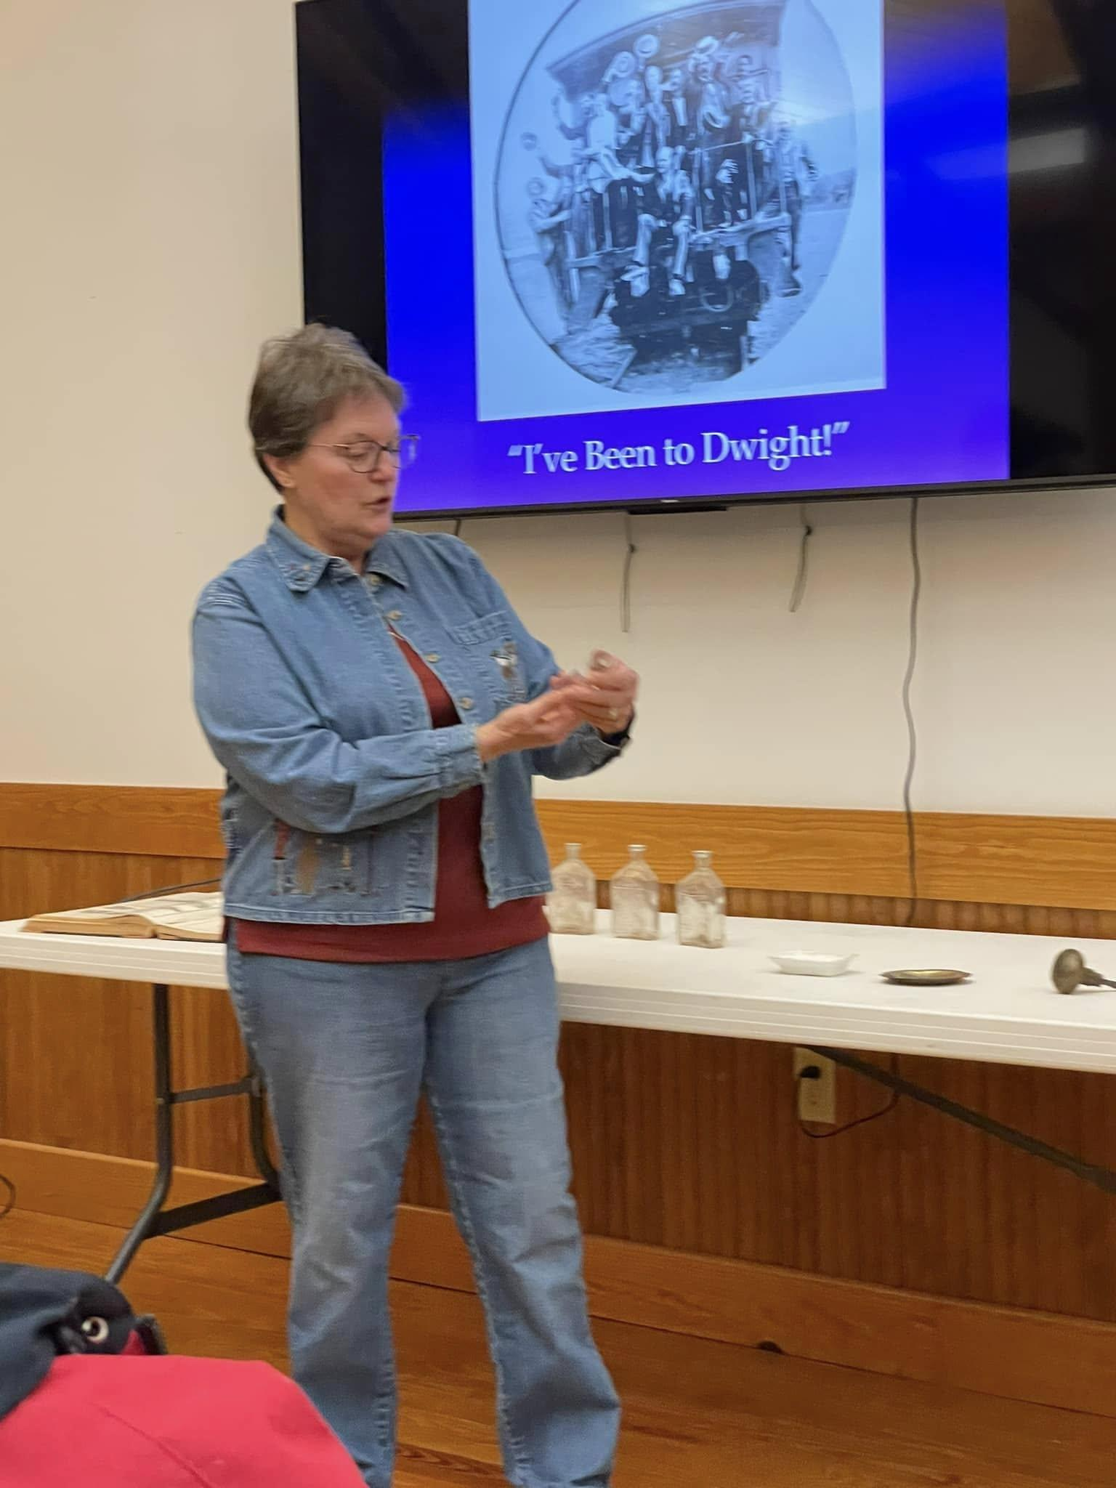
Causes educating the public
Local and area history
Historical Society and Keeley Institute
Dwight Woman’s Club and founding of library
Livingston County Historical Society
  Underground Railroad in our county
  Chatsworth railroad disaster
  Albert Cashier
  Etc.

Slide 26
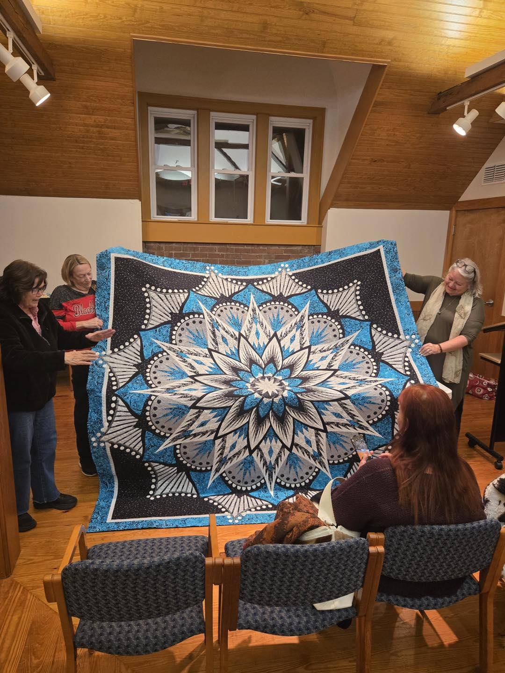
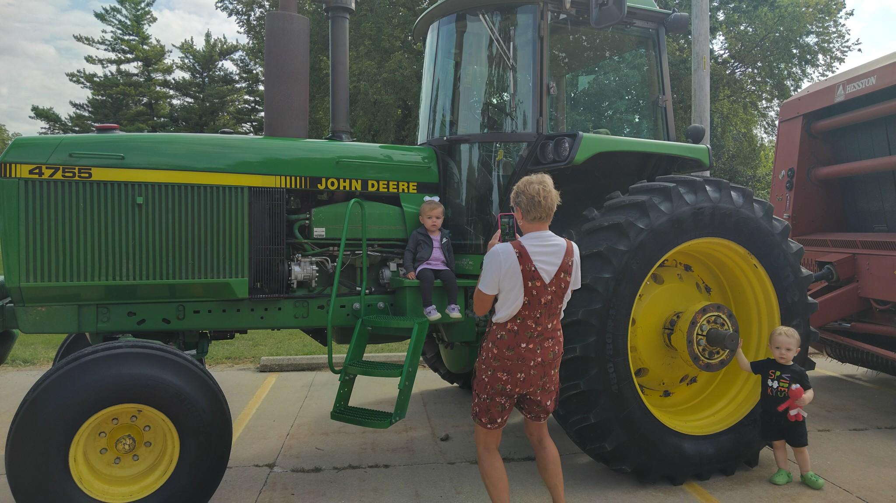
Clubs
Book Clubs
True Crime Club
Cookbook Club
Chess Club
Crochet Club
Lego Club
Senior Social
Quilting Group
Toddler Time

Slide 27
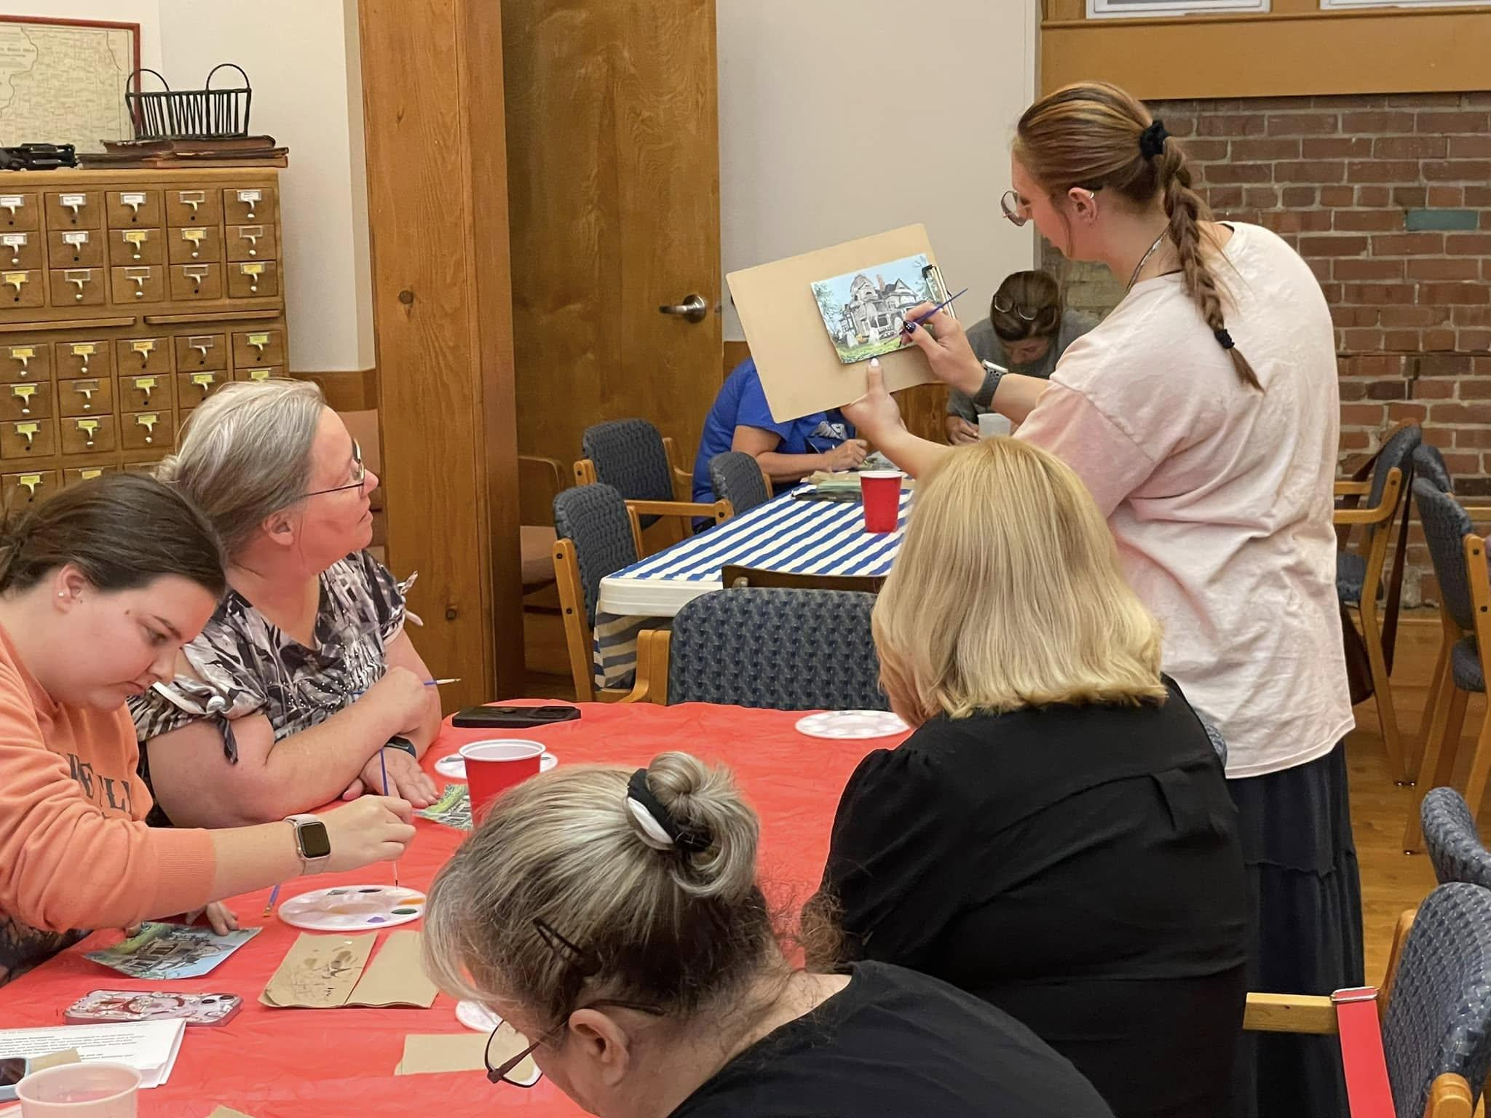
Using the Staff You Have
Craft Nights
Water Colors
Drawing Classes
Costumed Dance Party
Hair Braiding Workshop
Artist Lectures
Lectures on variety of topics
Are You Smarter than a Librarian?

Slide 28
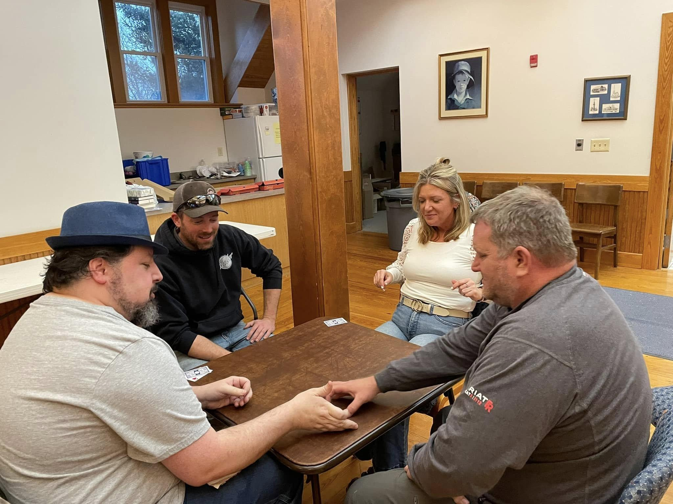
Using the Staff You Have
Director of Table Games
Blackjack Strategies
Euchre
Dominoes
Uno Tournament
Mahjong

Slide 29
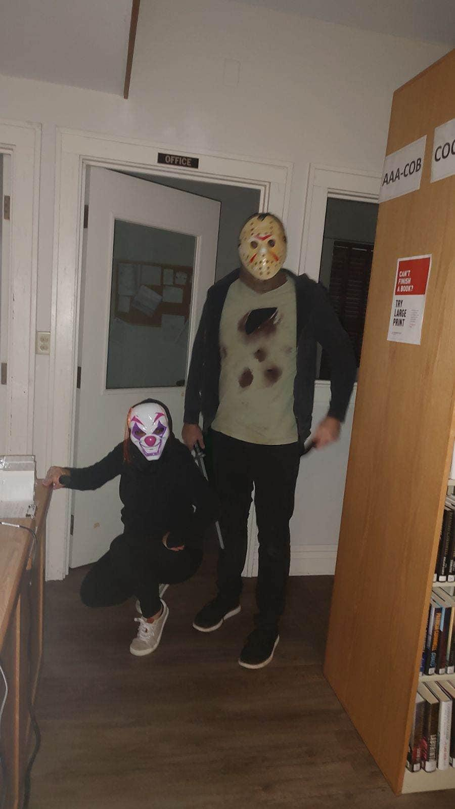
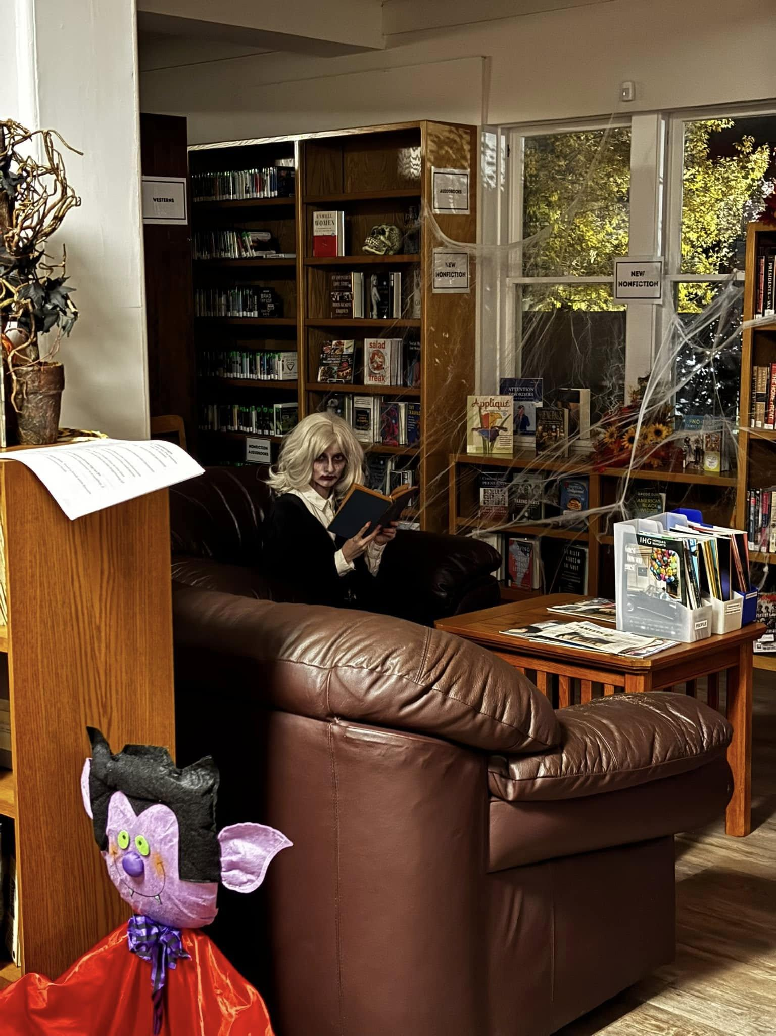
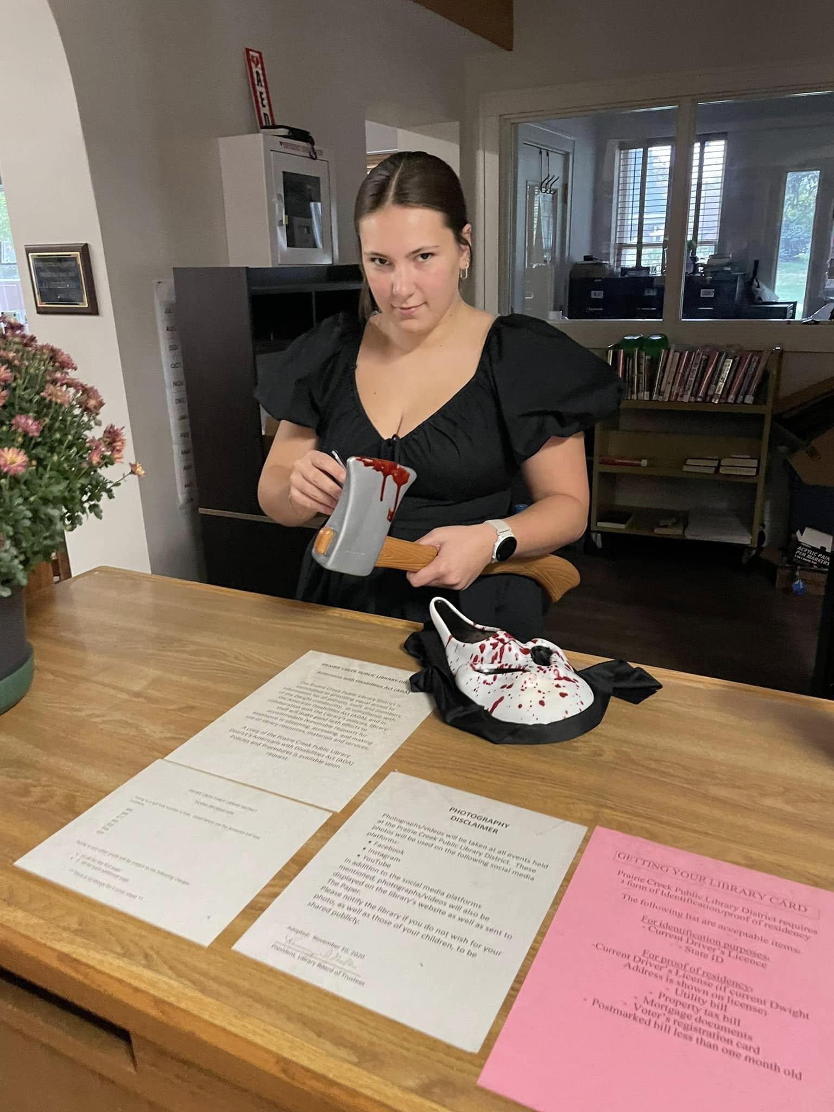
Using the Staff You Have
Haunted Library

Slide 30
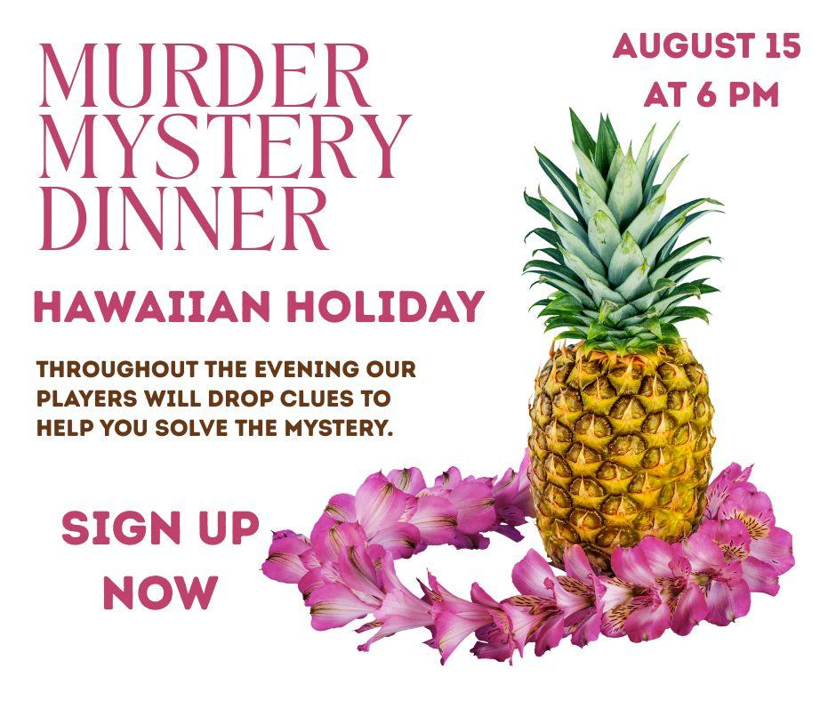
Using the Staff You Have
Mystery Dinners

Slide 31
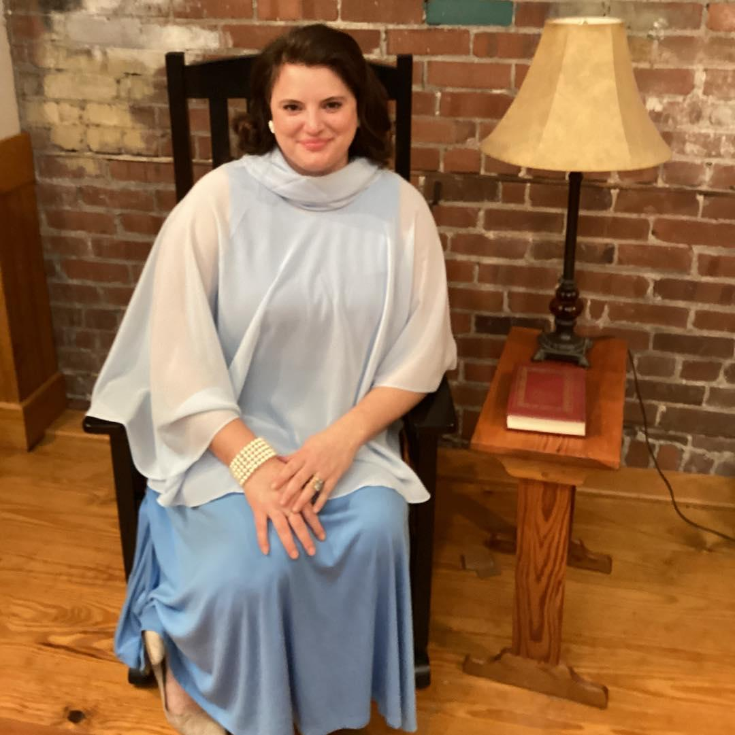
Using the Staff You Have
“Dead People” programs
We Read Dead People
We Laugh with Dead People
First Ladies Dead People
Most Wanted Dead People
We Sing with Dead People

Slide 32
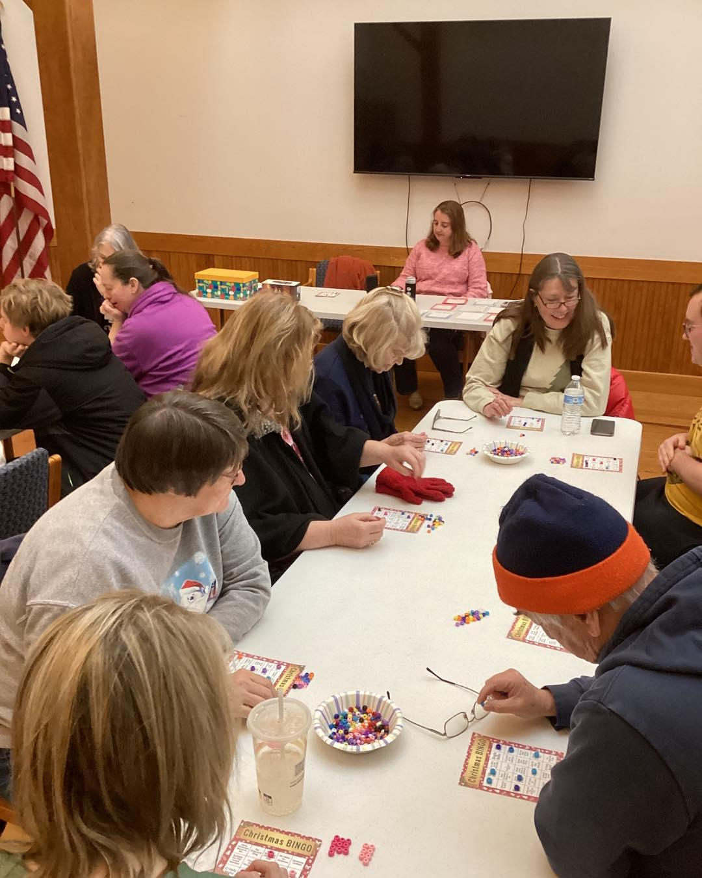
Make It Up (or steal good ideas)
BINGO
Music Bingo
White Elephant Bingo
Kids Bingo
Plant Bingo

Slide 33
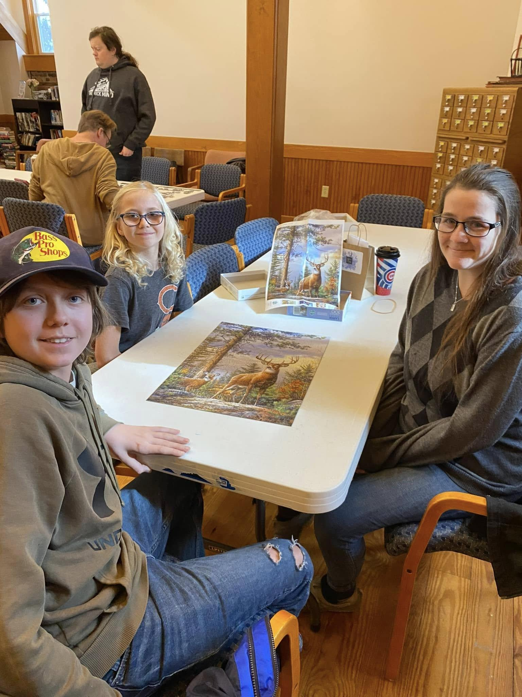
Make It Up (or steal good ideas)
Puzzle Races
Chess Tournament
Family Trivia Night
Game Day

Slide 34
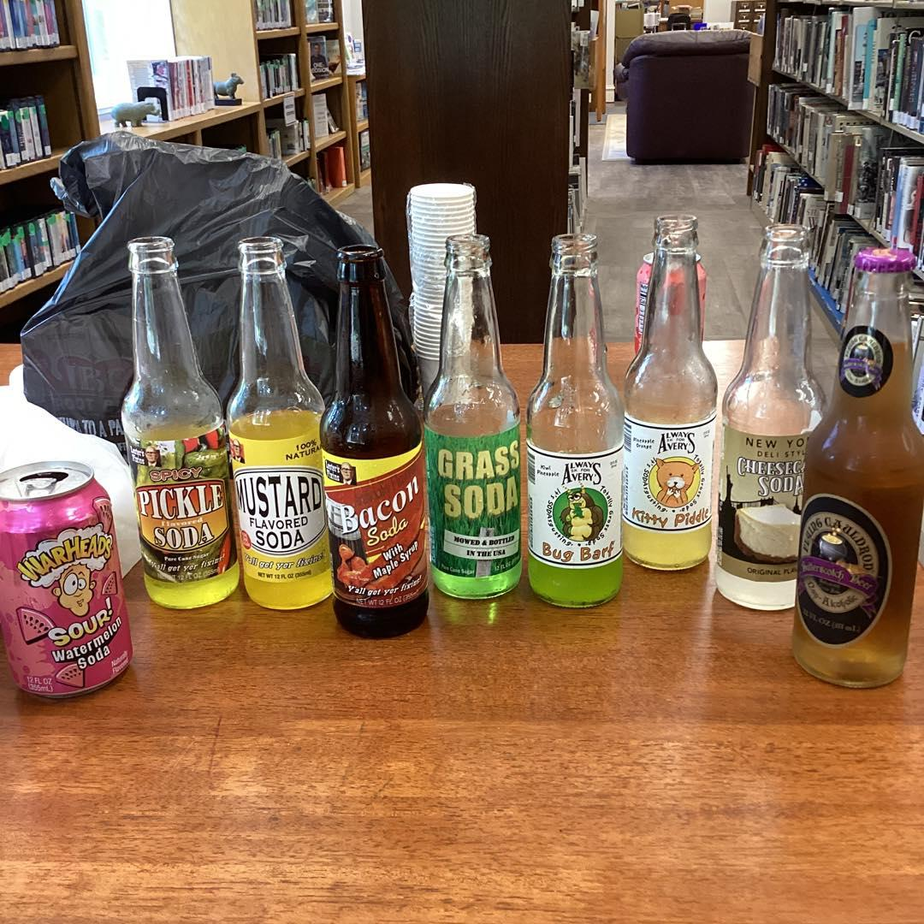
Make It Up (or steal good ideas)
Tastings
Jelly Bean Tasting
Apple Tasting
Soda Pop Tasting

Slide 35
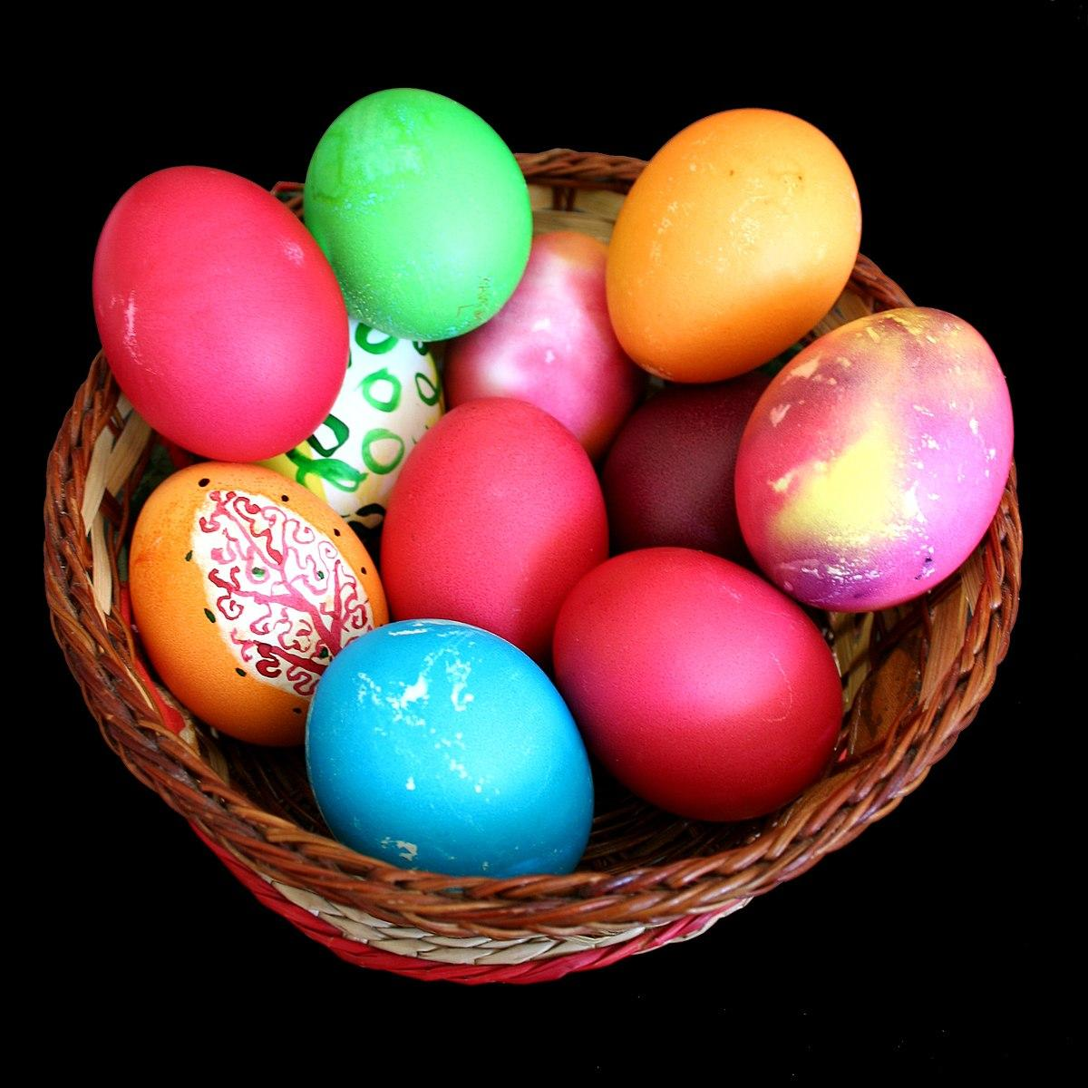
Make It Up (or steal good ideas)
Teen (in the dark) Egg Hunt
Adult Easter Egg Hunt

Slide 36

Make It Up (or steal good ideas)
Ghost Stories
Most popular program
Performed 3 times
Still requested

Slide 37
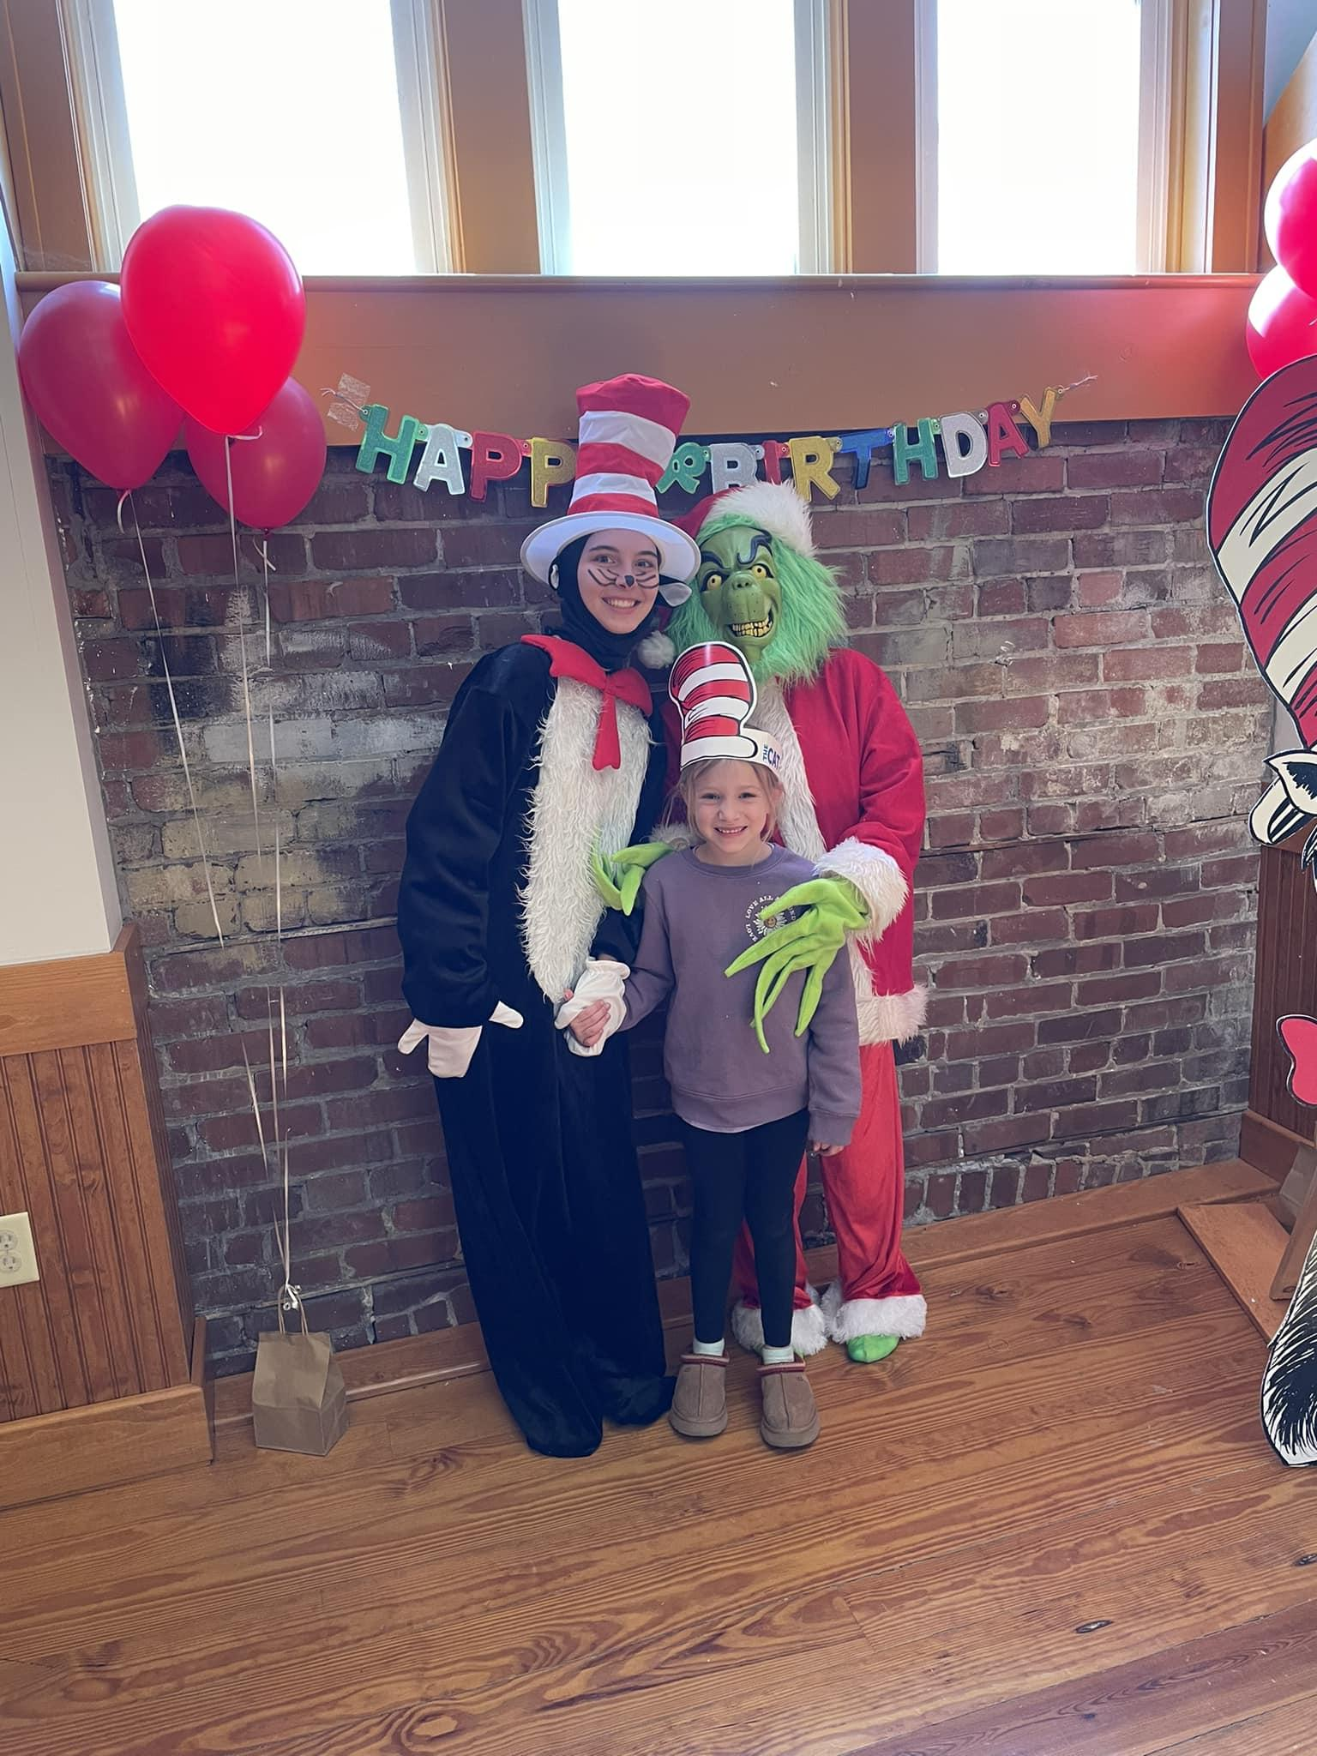
Make It Up (or steal good ideas)
For the Kids
Stuffy Sleepover
Rock Painting
Pete the Cat Pizza Party
Dr. Seuss Birthday Party

Slide 38
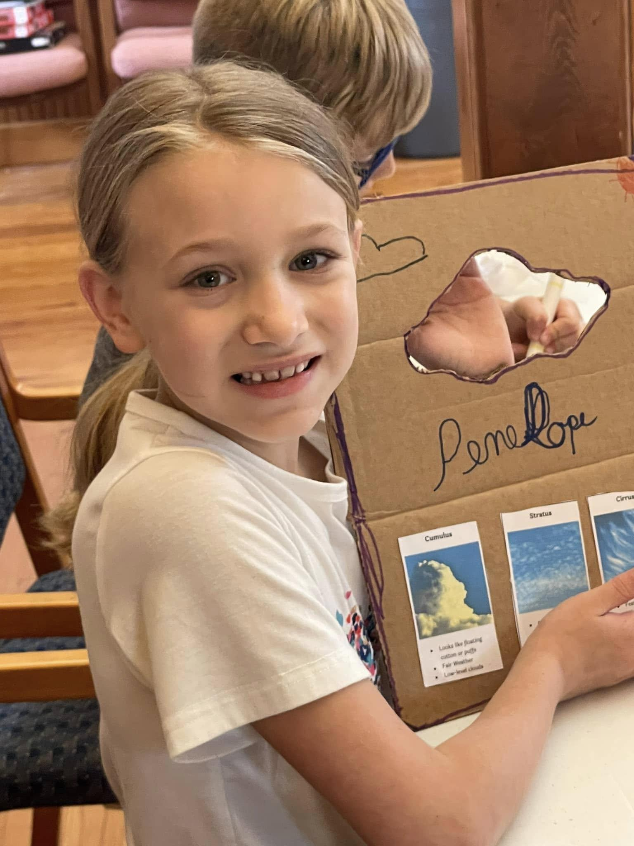
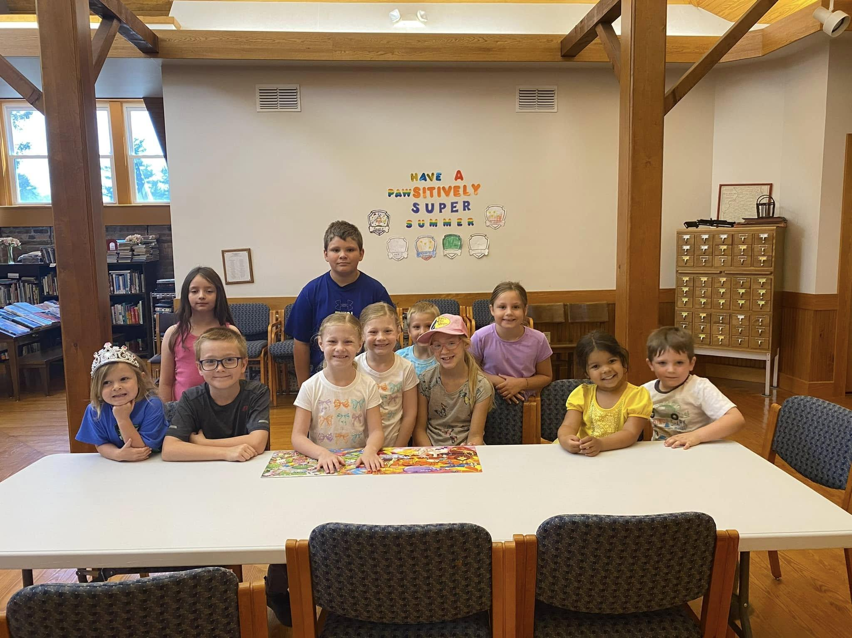
Make It Up (or steal good ideas)
For the Kids
Obstacle Course at the Park
Cloud Scanner and other crafts
Cardboard Carnival
Puzzle Hunt
STEM

Slide 39
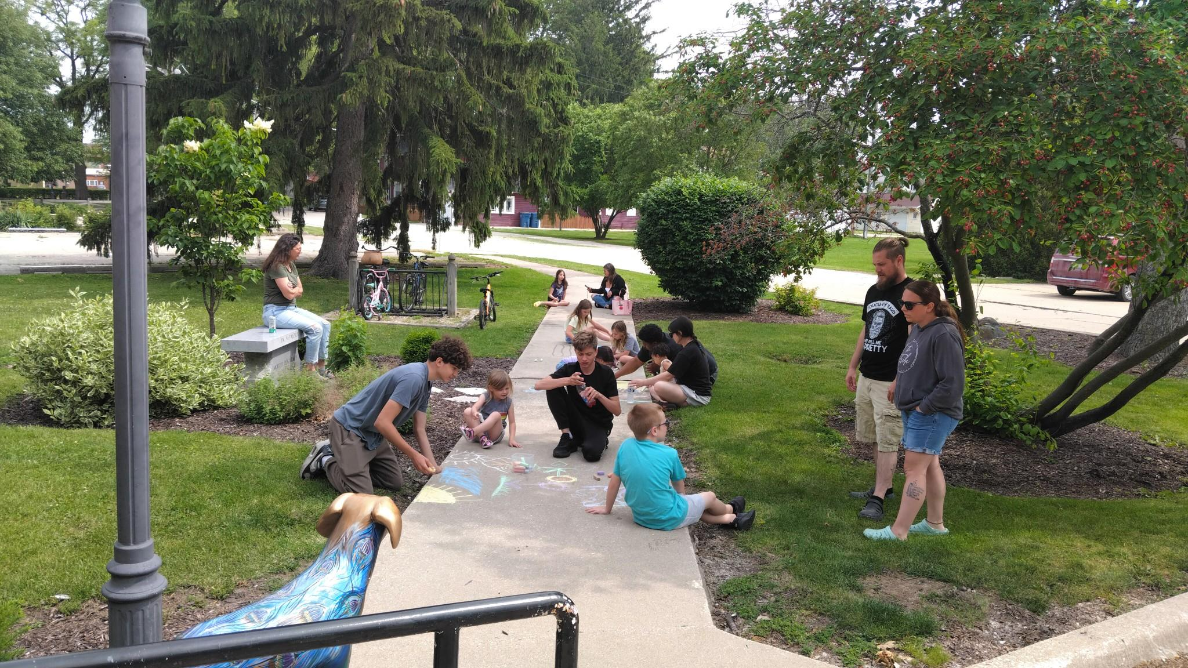
Make It Up (or steal good ideas)
Family Events
Harry Potter Birthday Party
May the Fourth Party (saved)
Chalk the Walk

Slide 40
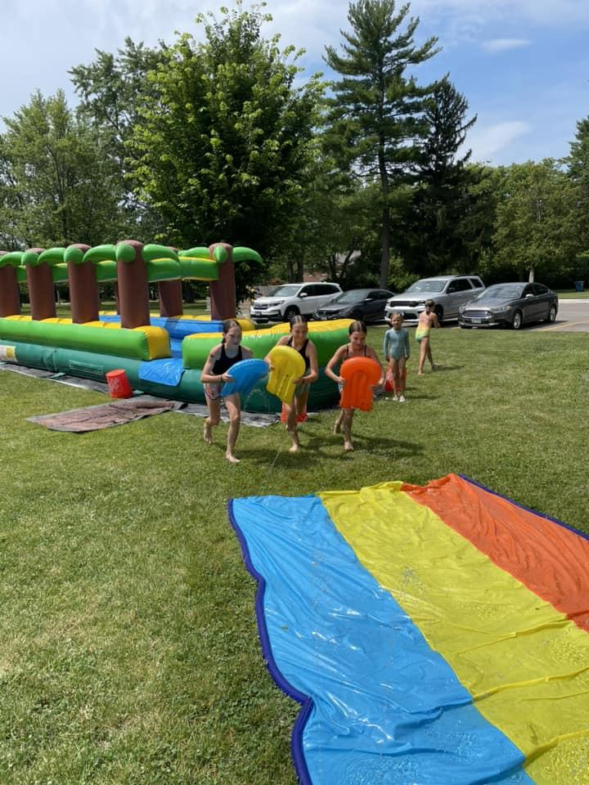
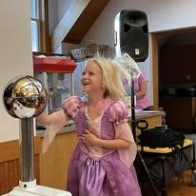
Sponsorships
Major businesses in your community
VFW
Rotary
Lions Club

Slide 41
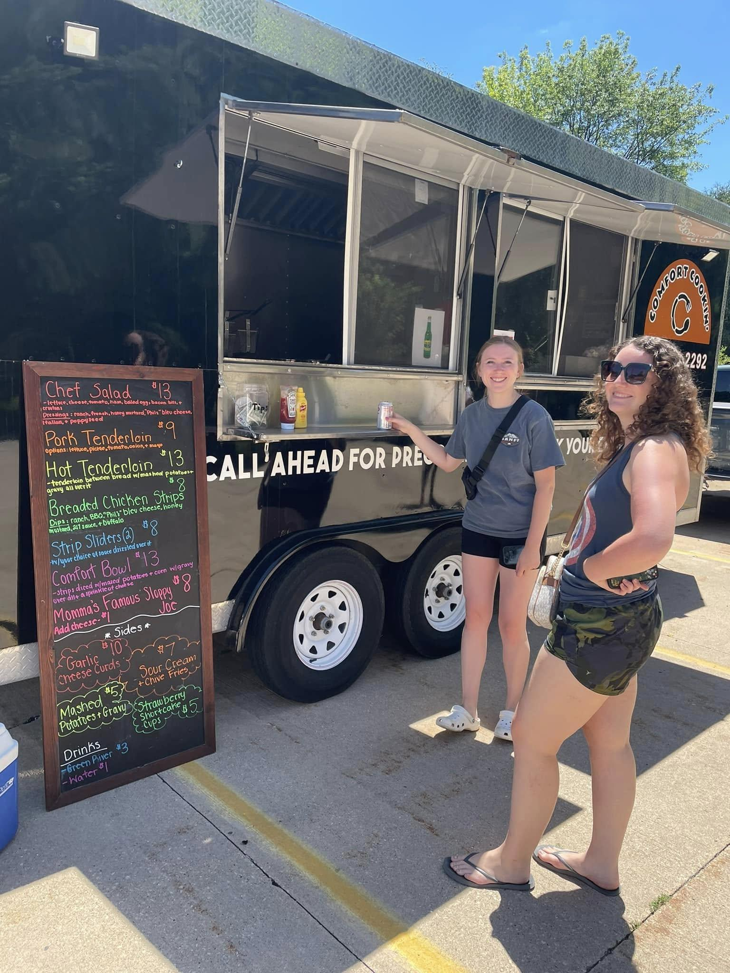
Special Guests
Food Trucks
Bakery
Lemon Shake Ups
Book Mobile Sale
Promotions on their socials.
Helped people find our library!

Slide 42
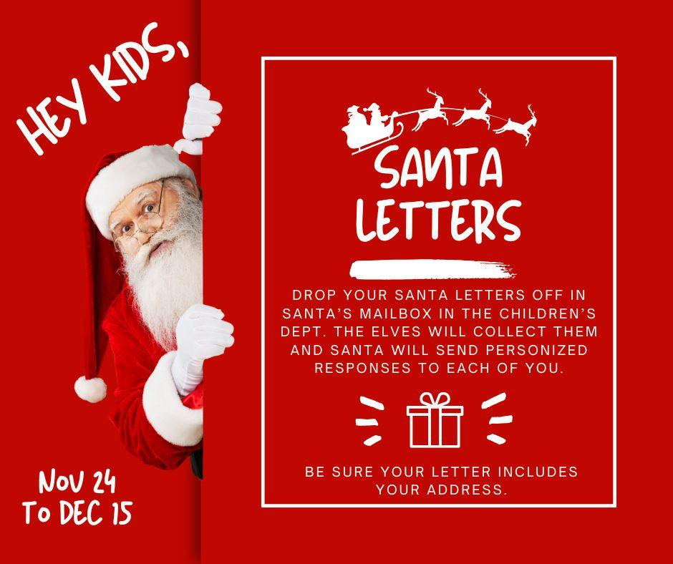
Passive Programs
Take & Make Crafts (Clean out your supply closet)
Puzzle Table
Scavenger Hunts
Santa letters
Matching Games
Plant Cuttings
Spice Club

Slide 43
YouTube Channel
Get more mileage for your programs by recording and posting to a library YouTube channel.
Works great for all those people who say, “I wish I would have known” or “I couldn’t make it that time; will you do it again?”

Slide 44
Promotions
Tie in with other businesses and use their social media to gain followers.
Send news releases not just to your local paper, but surrounding media outlets. Don’t forget PSAs to radio stations.
Partner with teachers. Don’t forget your private schools. Offer to help with extra credit.
Email churches.
Newsletter.
Social Media. Post often to stay up in algorithm.
Flyers inside your library.
Do “advertisements” at other programs.

