Slide 1
AI and the Library World
Dr. Pamela Thomas, Bibliographic Grant Manager
Eric McKinney, CMC Cataloging Trainer
RSA Day, April 8, 2026, 1 p.m.
Notes:
Welcome! Eric and I will be discussing AI and the library world, including ChatGPT and DeepSeek as related to libraries, AI and Circulation, Acquisitions, and Interlibrary Loan, AI and Cataloging, and the ethics of AI. First, we will introduce ourselves, and then we will provide a brief overview of the Cataloging Maintenance Center’s free services. Then, we will dig into AI!
1

Slide 2




All About Pam
Over 30 years of cataloging experience
Over 20 years of teaching experience
Mom to two sons (they are both available!)
Life goal: to become a grandma
Employed at IHLS since March 2015
2015-2018, Metadata Cataloger
2018-present, Bibliographic Grant Manager
Owns a Shiba Inu, Zander
pthomas@illinoisheartland.org
Toddler Pam
Adult Pam
Jackson, 25, and
Nathan, 28
Zander, 7
Notes:
2

Slide 3

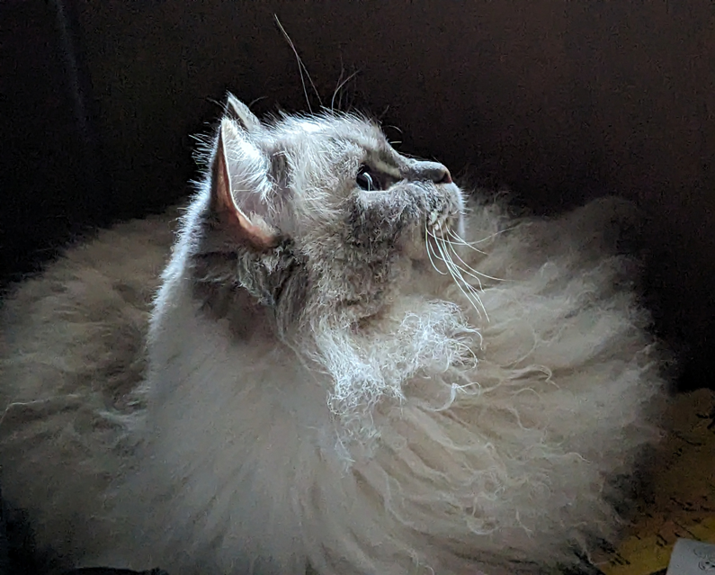
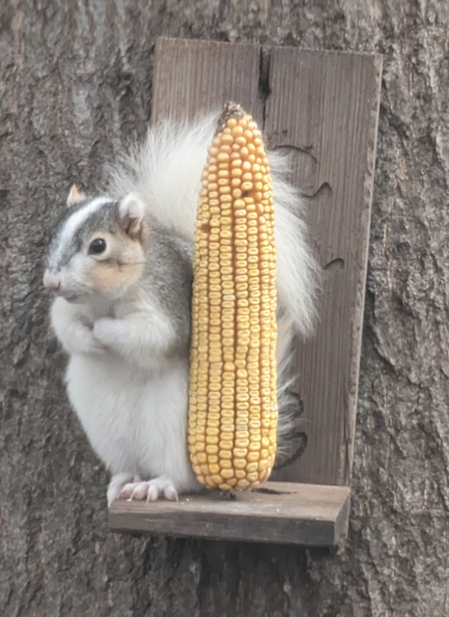
All About Eric
emckinney@illinoisheartland.org
Notes:
Hello everyone! My name is Eric McKinney and I am the Cataloging Trainer at the CMC. I arrived here from an academic library (Go Big Blue!) about 4 and a half years ago, and that is where the bulk of my cataloging experience lies. I am married to a high school librarian, so I guess I come by the work honestly. In our spare time, we enjoy spoiling our pets. That is Tyrion on the left there, my doggie. He turns 12 this summer, and he is, of course, the best good boy. Griffin there in the middle, looking like a supermodel cat. And then we have many, many squirrels running around our backyard, and this one is our favorite. This is Piebald, also known as Pie. And I am pretty sure he considers my wife and I his pets, but that is okay. He has us trained to keep him well-fed. In our spare time, we also enjoy gardening, gaming, and reading, as most library folk do. With that out of the way, here is our agenda for today.
3

Slide 4
Agenda
Brief overview of the CMC’s free services
ChatGPT and DeepSeek as related to libraries
AI and circulation, acquisitions, and interlibrary loan
Ethics of AI
AI and cataloging
Notes:
Pam—CMC overview, ChatGPT and DeepSeek; Eric—AI and Circulation, Acquisitions, and Interlibrary Loan, Ethics of AI, and AI and Cataloging
4

Slide 5
CMC Overview
The Cataloging Maintenance Center (CMC) provides statewide cataloging support for Illinois libraries, including free original and copy cataloging of eligible special collections, consultation on metadata projects, database cleanup for LLSAPs, cataloging training, and more. It is funded by a grant that was awarded by the Illinois State Library, with additional support from the Illinois Heartland Library System (IHLS).
Notes:
Pam
5

Slide 6
CMC’s Free Services
Free cataloging of Illinois authors, history, and genealogy, government documents, microfilm, and special collections
Special collections are defined by your library and might include world language materials, kits, binge boxes, realia, theses, dissertations, library of things, etc.
Free cataloging-related courses in Moodle via the SHARE training portal
Monthly (Aug.-May) Online with the CMC webinars on cataloging-related topics with a Q&A
Online cataloging request form, when you don’t want to send your physical items in for cataloging
Database cleanup—usually for consortia
Creation of authority records (names, titles, and subjects)
Merging duplicate records in OCLC Connexion
Notes:
Pam: These are all the free services the CMC staff provide to Illinois libraries in good standing. Our final Online with the CMC for this fiscal year is Illinoise and some St. Louis Blues: Music, Musicians, and Miscellanea from Illinois and Neighboring Missouri, May 14, 2026, where CMC Cataloger Barb Scoby will discuss bibliographic records created for music CDs, articles, and books written about local musicians, and various items related to Illinois music and musicians. Our final cataloging course for this fiscal year is: Cataloging Basics, April 27–June 7, 2026, which is a six-week crash course in basic cataloging that dives into cataloging using RDA, the Resource Description and Access standards, and using MARC, the MAchine-Readable Cataloging standards. Eric will cover MARC fields 0XX-8XX and fixed-field elements, the most commonly used fields when cataloging library items. If you have any suggestions for future cataloging courses or webinars, please share them with us!
6

Slide 7
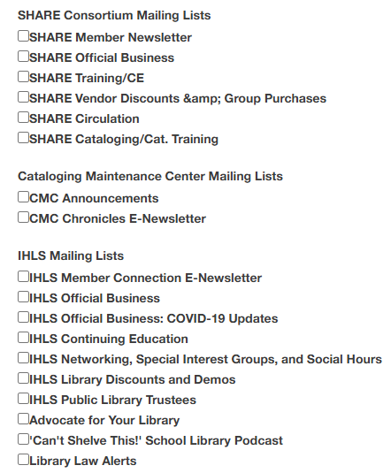
CMC Resources
CMC e-newsletter, CMC Chronicles, https://www.illinoisheartland.org/signup
CMC Online Cataloging Request Form, https://forms.office.com/Pages/ResponsePage.aspx?id=s3c4rTtrLEyHj3jjqNoQdZeZqrEdbHBJnpEDtI3cC3RUOUJZWlMzVE1CODZQNUVMSkxLRzNCU0xTRC4u
CMC web page, https://www.illinoisheartland.org/services/cmc
cmc@illinoisheartland.org
Notes:
Pam: I have included a link to the CMC e-newsletter sign-up, and the choices of things to sign up for are on the right of the slide, with the arrow pointing towards CMC Chronicles E-Newsletter, but if anything else interests you, please sign up for that as well, the CMC Online Cataloging Request Form, the CMC web page, and the group CMC email are on the left of the slide.
7

Slide 8
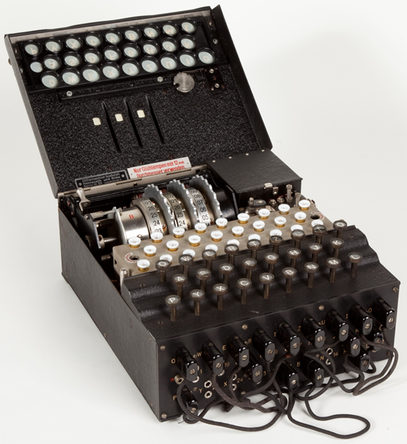

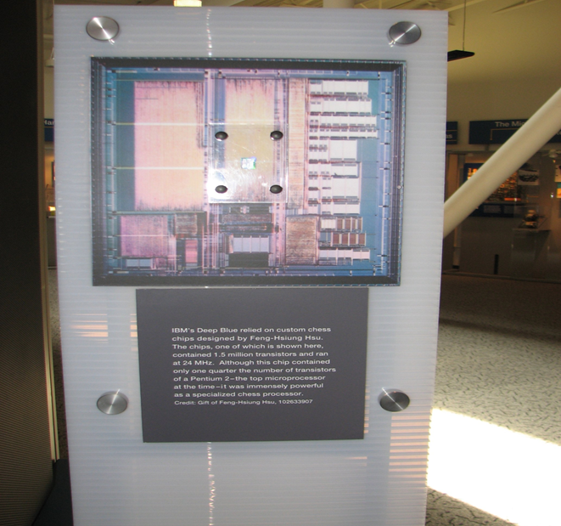
AI: A Brief History
Enigma machine
Checkerboard
Deep Blue Processor
Notes:
Pam: Most experts agree that artificial intelligence as we know it today was born of the work of British scientist Alan Turing. Turing proposed the Imitation Game to better define thinking machines, what we call artificial intelligence. In a nutshell, The Imitation Game imagines a person and a machine in separate rooms. Both are questioned using a computer and a keyboard, and the questioner must determine which the person is and which the machine is based on the responses received. The computer is considered intelligent if it cannot be determined which is which. The term “artificial intelligence” was officially coined in 1956 by Professor John McCarthy, who considered AI to be a science and engineering creating intelligent machines. McCarthy is known as the “Father of Artificial Intelligence” today. The first AI program was created in 1951 by British Computer Scientist Christopher Strachey. It was a checkers program that could play a complete game at a reasonable speed. In 1952, another program called Shopper could memorize items in different shops and remember where to find them. The first AI program in the United States was also a checkers program, written by Arthur Samuel in 1952. The growth of AI took off in the 1960s as government funding became available and computers became cheaper. An AI milestone was reached in 1987 when IBM’s Deep Blue AI (one of 30) defeated chess champion Garry Kasparov. With today’s machines being much faster than those of the 1980s, AI is now used in search engines, facial recognition apps, digital assistants like Siri and Alexa, and numerous other technologies.
8

Slide 9
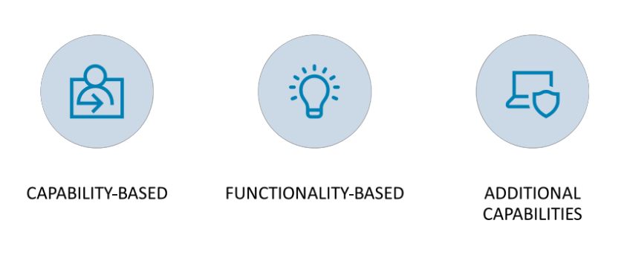
Types of AI
Notes:
Pam: Eric will take a further look at the ethics of AI later in the presentation. But I would like to start by looking at the types of AI in use today. They generally fall into two categories, but do have some additional capabilities. We will start with capability-based AI.
9

Slide 10

Capability-based AI
Notes:
Pam: Artificial General Intelligence (AGI) is also known as general or strong AGI. The goal for AGIs is to have them think, act, and make decisions like humans. Artificial general intelligence is used for robotics, natural language processing, speech recognition, and image recognition without human interference. Artificial Narrow Intelligence (ANI), also known as weak or narrow AI, excels at doing specific tasks. It can learn from the data it collects as it performs its task. Think of the AI chatbots that many libraries are using. Self-driving cars, facial recognition software, and your phone’s digital assistant all make use of ANI.
Super AI, or artificial superintelligence, is currently only theoretical. A Super AI would have the capability to think, reason, learn, and make judgments that far surpass our own.
10

Slide 11
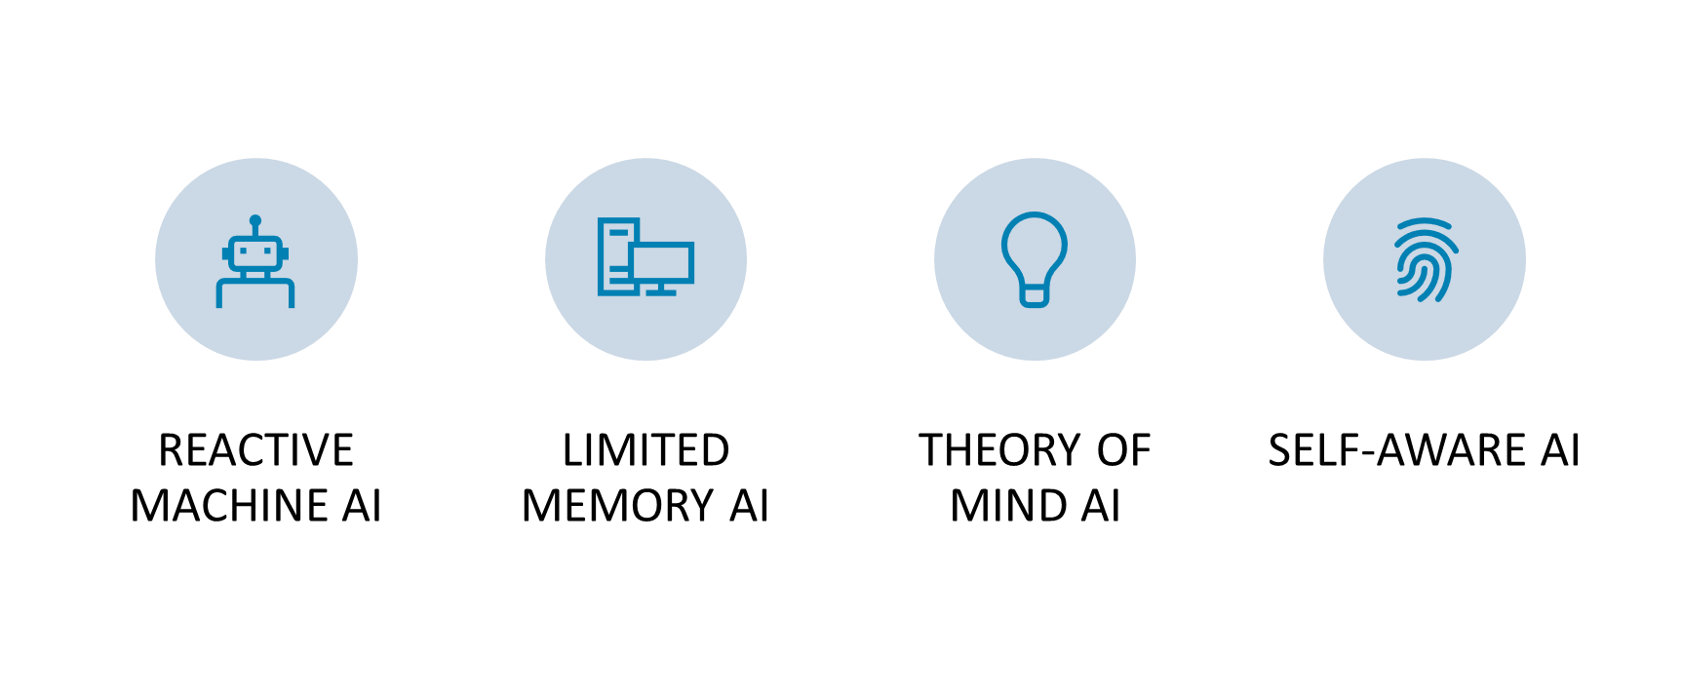
Functionality-based AI
Notes:
Pam: Reactive machines are the most basic AI. They are great at specific tasks but have no memory for recalling previous searches and answers. All answers are based on the information loaded. IBM’s Deep Blue is an example of a functionality-based AI. Limited memory AI does have some memory, so it can make decisions from past experiences with programmers and users. Limited memory AI can be found in most AI programs, like the aforementioned library chatbots, self-driving vehicles, and digital assistants. Theory of Mind AI is also currently only theoretical. If realized, an AI would be able to simulate human relationships by learning to understand human thoughts and emotions. Interaction with such an AI could be highly personalized if it can understand a person’s thoughts or emotions. Self-aware AI is still a way off. In addition to understanding people’s thoughts and emotions, a self-aware AI would understand its own internal conditions. It would have its own separate set of needs and beliefs. It would be a true thinking machine. Almost all AI in use today is ANI with limited memory.
11

Slide 12
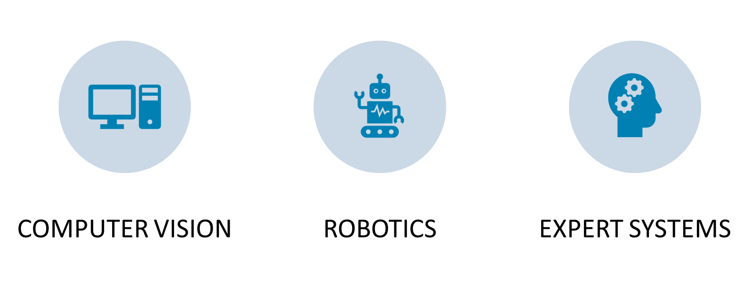
Additional AI Capabilities
Notes:
Pam: Computer vision can be used with narrow AI to teach it to analyze and interpret objects in images and videos. Used in self-driving cars, Roombas, and hopefully self-driving library carts soon!
Robotics: As mentioned, narrow AI excels at performing repetitive tasks. As do robots in factories. Combine the two, and you get AI that assists surgeons during surgery. And Roombas!
Expert Systems: Many businesses spend a lot of time and money trying to predict what might happen and trying to plan for it. Expert systems with narrow AI can examine vast amounts of data to look for trends that might help the business make better decisions.
12

Slide 13
What is ChatGPT?
“ChatGPT is an artificial intelligence language model created by OpenAI that generates human-like text based on a prompt entered by the user. It is programmed to scan a vast range of internet data to answer questions, give feedback, assist in writing, generate ideas, and simulate conversations. It is often used for drafting emails, coding, brainstorming, and creating content. But the program is not foolproof, meaning it can sometimes generate inaccurate information or biased responses”—Kirsten Cox.
Notes:
Pam
13

Slide 14
ChatGPT as Related to Libraries
Libraries are integrating ChatGPT into their patron chat tools to answer basic reference questions and to redirect more complex ones to librarians
Libraries can integrate ChatGPT with databases, catalogs, and research guides to help users find academic sources faster
Enhances engagement by providing personalized recommendations for resources based on user queries and interests
ChatGPT can help with research: brainstorming ideas and topics, identifying key terms, and drafting outlines
Librarians can automate routine tasks such as drafting emails, creating research guides, or suggesting keywords for searches
Notes:
Pam: According to Cox, Libraries worldwide are already integrating ChatGPT into their patron chat tools to answer basic reference questions and to redirect more complex ones to librarians.
Libraries can integrate ChatGPT with databases, catalogs, and research guides to help users find academic sources faster. They can train ChatGPT on specific collections, enabling it to offer guidance tailored to what a library has to offer. This integration also enables ChatGPT to enhance engagement by providing personalized recommendations for resources based on user queries and interests and to assist in advanced research and data analysis by summarizing complex datasets and generating insights from large volumes of text. ChatGPT can help with research. It can be used for brainstorming ideas and topics, identifying key terms, and drafting outlines. Librarians can support students using ChatGPT in all of these ways by conducting workshops on how the tool generates content, including its shortcomings, and offering demonstrations on how to use the tool effectively to refine research questions. Librarians can also teach students how to assess the credibility of the information ChatGPT provides and how to stay within the bounds of academic integrity while using ChatGPT. Librarians can use ChatGPT to automate routine tasks such as drafting emails, creating research guides, or suggesting keywords for searches, freeing them to focus on higher-level responsibilities.
14

Slide 15
ChatGPT Concerns
“ChatGPT is one of many AI platforms that has emerged in the past few years. Its highly advanced capabilities—such as producing high-quality text, engaging in dialogical interactions with users, consistently improving the content quality, and tailoring its outputs to specific language styles—all raise ethical concerns”—Cox, 2025.
Notes:
Pam
15

Slide 16
ChatGPT Concerns
Distinguishing proper attribution of authorship
Inaccurate or unreliable information
Impact on the job market
Privacy and data protection
Environmental impact
ADA compliance
Cox, Kirsten. (2025). What Can ChatGPT Do in the Library? Katina, Librarianship Elevated.
Notes:
Pam: According to Cox (citation is on the bottom of the slide), since ChatGPT produces human-like text, it can be difficult to distinguish proper attribution of authorship. ChatGPT does not always output accurate or reliable information. A 2024 study on using AI for library reference services found that ChatGPT recommended many imposter articles for which it made up fake citations. When asked why it did this, ChatGPT responded that as an AI model, it just tries to provide helpful information but can sometimes make mistakes due to limitations in its current training and the nature of the program. Another concern is ChatGPT’s impact on the job market, especially in relation to computer programming. Privacy and data protection are also critical issues for the library community. ChatGPT processes user input to generate responses, raising questions about how this data is used, stored, and protected. Libraries must consider the implications of exposing patron queries to external AI systems and ensure that data privacy standards are upheld. Environmental impact is a huge concern. Recent studies highlight that AI systems require a large amount of water to operate, both directly and indirectly. This includes water used for cooling data centers and during the manufacture of the necessary equipment. On average, ChatGPT consumes a 500 ml bottle of water for every ten to fifty responses, and this amount is likely to increase as newer versions continue to emerge. Extracting such large volumes of water from rivers and streams can disrupt natural water flows and potentially reduce the availability of water for human consumption and agriculture. ChatGPT also generates large amounts of wastewater that contain a range of pollutants. When not properly treated, it can contaminate local water supplies and degrade aquatic habitats. Generating the energy that powers AI, as well as the production and transportation of hardware for AI systems, also creates concerning amounts of greenhouse gases. ADA compliance is another vital consideration. ChatGPT supports text-to-speech functionality and offers multilingual support, which aids in inclusive education. Its integration with assistive technologies helps users with disabilities access information more effectively. However, continuous evaluation is necessary to ensure these features meet ADA standards and support all types of user needs. Eric is going to cover ethical and legal considerations, so I have only touched lightly on those areas.
16

Slide 17
What is DeepSeek?
“DeepSeek is a new generative AI (artificial intelligence) chatbot, like ChatGPT. DeepSeek doesn’t create images or videos, but both have “reasoning models” which apply logic to their answers, can search the web, and can provide links to their sources. DeepSeek however demands far less computing power and ... tests better on key metrics”—Hall, 2025.
Notes:
Pam
17

Slide 18
What Can DeepSeek Do?
“The integration of DeepSeek AI into libraries is revolutionizing how information is accessed, organized, and utilized, enhancing library services, operations, and user experiences … The AI's ability to detect plagiarism and support academic integrity makes it particularly valuable in educational and research-focused libraries … Its use, however, begs questions about data privacy, algorithmic bias, employment displacement, and the necessity of responsibility and openness”—Suryawanshi, Mane, & Rathood.
Notes:
Pam: The integration of DeepSeek AI into libraries is revolutionizing how information is accessed, organized, and utilized, enhancing library services, operations, and user experiences. DeepSeek AI leverages advanced natural language processing (NLP) and machine learning algorithms to provide intelligent search capabilities, automate cataloging, and offer personalized recommendations, making information retrieval more efficient and accurate. AI-powered chatbots and virtual assistants assist users by answering queries, guiding them through resources, and enhancing user engagement … The AI's ability to detect plagiarism and support academic integrity makes it particularly valuable in educational and research-focused libraries. DeepSeek AI also supports multilingual capabilities, making libraries more inclusive and accessible to diverse user groups. Its use, however, begs questions about data privacy, algorithmic bias, employment displacement, and the necessity of responsibility and openness”—Suryawanshi, Mane, & Rathood.
18

Slide 19
DeepSeek as Related to Libraries
Automating cataloging
Enabling intelligent search capabilities
Offering personalized recommendations based on user preferences
Notes:
Pam: DeepSeek AI, an advanced artificial intelligence system, plays a pivotal role by automating cataloging, enabling intelligent search capabilities, and offering personalized recommendations based on user preferences. Unlike traditional keyword-based searches, DeepSeek AI employs natural language processing (NLP) and machine learning algorithms to understand context, making information retrieval more accurate and efficient. Additionally, AI-powered chatbots and virtual assistants integrated within library systems assist users in finding relevant resources, answering queries, and providing research guidance. The implementation of DeepSeek AI also extends to predictive analytics, which helps libraries manage inventory, anticipate demand, and optimize resource allocation. Furthermore, AI-driven plagiarism detection and automated content summarization enhance academic integrity and facilitate knowledge dissemination (Suryawanshi, Mane, & Rathood, 2025).
19

Slide 20
DeepSeek Concerns
Data privacy
Algorithmic bias
Need for digital literacy among users and librarians
Notes:
Pam: Despite these benefits, the adoption of AI in libraries raises concerns regarding data privacy, algorithmic bias, and the need for digital literacy among users and librarians. Addressing these challenges requires ethical AI deployment, continuous monitoring, and training programs to ensure that AI tools complement human expertise rather than replace it. As libraries evolve into dynamic learning hubs, DeepSeek AI’s role in enhancing accessibility, efficiency, and engagement becomes increasingly crucial. By harnessing AI’s potential, libraries can bridge the gap between traditional knowledge management and the digital age, ultimately fostering a more inclusive and knowledge-driven society. The future of libraries with AI integration promises greater innovation, ensuring that they remain indispensable in the rapidly advancing information landscape (Suryawanshi, Mane, & Rathood, 2025).
20

Slide 21

AI and Circulation, Acquisitions, and Interlibrary Loan
Notes:
Eric
21

Slide 22

Circulation
Notes:
Eric Circulation services in the library include checking in and out items, managing holds, renewing loans, issuing library cards, and handling overdue items.
AI can help automate some of these tasks to enhance circulation service in a couple of ways. For one, there can be a self-checkout and return kiosk for users that will help reduce wait times for patrons. There could also be an automated fine management system, given that some libraries still charge late fees for overdue books and materials. Some libraries already have these in place through their ILS, physical infrastructure, etc., but AI could enhance or streamline these processes. There might also be a way for AI to help remind users about due dates for materials and the arrival of new materials within the library. AI can also help by having a recommendation system for users based on analyzing their borrowing patterns.
22

Slide 23

Acquisitions
Notes:
Eric Acquisition is the process of selecting and acquiring materials for libraries and information centers in all formats, including digital items. AI can be used in libraries to analyze usage patterns and assess collections, guiding future acquisitions. AI can use algorithms to make recommendations for each user, automating order processing for librarians and assisting with the cataloging process.
I found two examples of libraries using AI for the acquisition process. Stanford University Library AI Studio uses AI to help with collection discovery and inventory analysis. The Helsinki Central Library Oodi also uses AI technology for collection discovery. They also use AI technology to make reading suggestions for their users. Large vendors like Ingram already use AI to help with acquisitions (BookFinity).
23

Slide 24

Interlibrary Loan
Notes:
Eric Interlibrary loan allows users to request items and resources from another library that may not be at their own library.
In regard to how AI can assist with this in the library, it can help with automating the processing of interlibrary loan requests between systems, using natural language processing to help interpret user requests accurately, and using chatbots to help provide instant responses to inquiries a user might have in regards to their loan requests. AI might also be able to help with analyzing costs for transactions related to interlibrary loans, thus helping librarians making decisions when it comes to sharing resources.
I was able to find two examples of how AI can be used within the library world. The first example is one that we should all be familiar with, and that is WorldShare with WorldCat. They use AI to automate lending and borrowing through OCLC’s Worldcat to gain access to millions of bibliographic records and resources. Another example is with Texas Tech University and the University of Houston using an interlibrary loan program to share 3D printing objects among a database for their students.
24

Slide 25

Ethics of AI
Notes:
Eric Pam has touched on some of the concerns of specific AI platforms ChatGPT and DeepSeek. I would like to take a step back and look at the ethics and legalities of AI more broadly.
25

Slide 26

Ethical Concerns
• Transparency
• Fairness
• Privacy and data protection
• Accountability
Notes:
Eric Like many new technologies, AI does come with its own set of ethical concerns. Top among them, are:
Transparency – Libraries should be open with patrons about the data used and the decision-making process of the AI. This builds patron trust and makes it easier to identify biases in results.
Fairness – Does the AI serve all patrons impartially? Results should be monitored regularly to evaluate them for discriminatory or biased results with algorithms adjusted accordingly.
Privacy and data protection – Most people value their privacy, both in and out of the library world. Libraries are typically champions of patron privacy, but if their AI leaks a patron’s private information, the damage is done. Accountability – Libraries should establish clear guidelines and protocols for the use of AI and make them available to patrons both in print and online.
26

Slide 27


Additional Ethical Concerns
Energy use
Water use
Notes:
Eric Another concern that has been much-discussed recently is the amount of energy AI requires. But it is certainly an ethical concern. AI requires so much that companies like Meta and Microsoft have plans to build their own nuclear reactors to meet future needs. MIT Technology Review notes that the latest studies indicated data centers in the U.S. accounted for almost 4.5% of energy usage in the United States. While not all of that went to AI applications, the Lawrence Berkeley National Laboratory research indicates more than half of the electricity going to data centers will be used for AI by 2028. At that point, AI could account for almost 25% of all households' energy use in the United States. Water use is also a concern. Computers generate a lot of heat. Water is used to keep the servers from overheating. Then there are the secondary uses. The daily water use of the building and the water used in the transportation of physical goods to and from the data center. Recently, the Dewitt County Board met to consider if data centers would be allowed in the county. They decided that because the current charter says nothing about them, they cannot be allowed in the county. However, they decided a discussion should be held to discuss whether something should be added. Whether we like it or not, AI and its repercussions are coming.
27

Slide 28
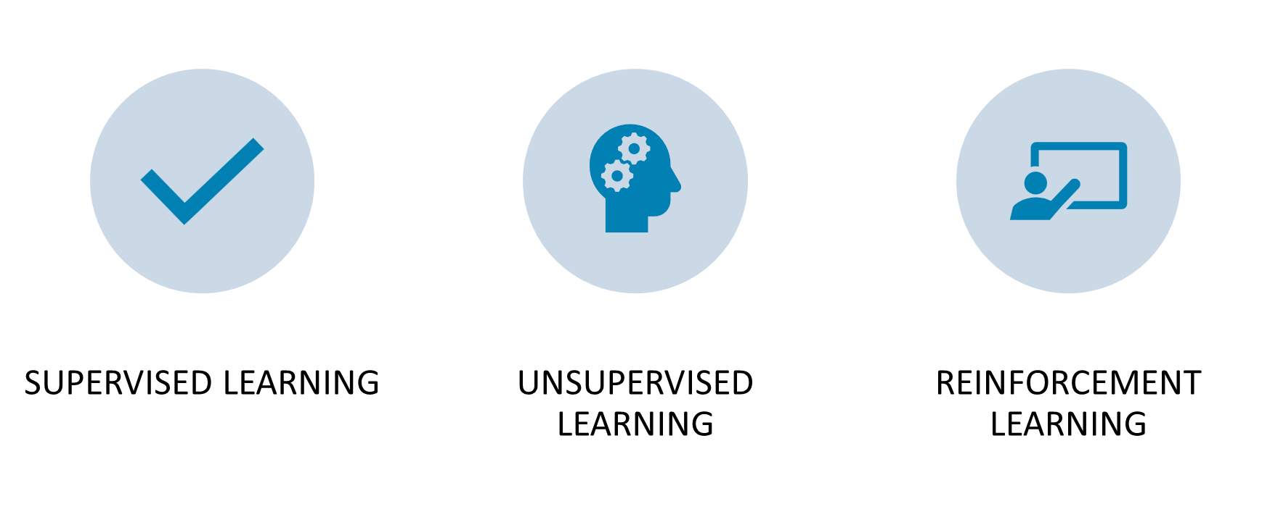
How To Train Your AI
Notes:
Eric AI training is one of the biggest controversies of the technology. Some crawl the internet like a search engine, sucking up ALL information, copyrighted or not. Thousands of authors have sued AI companies for having their copyrighted work essentially pirated by the AI. End users can use that material to create and profit from their own art, stories, etc., based on the copyrighted work. Fortunately, it is not necessary for libraries to take this route. Supervised learning models in AI rely on well-defined data. These AI can use historical data and user input for prediction tasks like spam detection and forecasting market changes and consumers behavior. This would be the best model for libraries.
Unsupervised learning models in AI excel at sorting and filtering through large amounts of unstructured data to find the best results.
Reinforcement learning models is sort of a mash-up of supervised and unsupervised. These models can work with structured or unstructured data and make decisions based on future impact. Many automation tasks benefit from reinforcement learning.
28

Slide 29

AI and Cataloging
ChatGPT 5.4 DeepSeek V3.2 Gemini 3.1 (Live demo)
Notes:
Eric For the past several years I have tested the ability of various AI to create a full MARC/RDA bibliographic record. The results get more and more accurate each year. For the test, I created a fake-book and ran the details through various AI. This year, I used ChatGPT 5.4 and DeepSeek. To finish up, I will put the query used into Google's Gemini 3.1 and see what comes out. Next, I will look at the query used and then we will look at the results.
29

Slide 30
Query used
I need a MARC/RDA bibliographic record for a book described as:
In 2014, Belleville, Illinois celebrated their 200th anniversary. The city created and published a book with historical content as well as narratives and photographs of the city’s celebration.
The book contains text, black and white and color maps and photographs. Text contributors include Bob Johnson, Patty Brown, Sheila Walleski, and John Turner.
Photographer contributors include Barry’s Unique Photography, Phyllis Harrison, and One-Shot Photography.
The book is 12.2 inches, was published in 2015, and is bound back-to-back and upside-down with 115 pages in one half and 130 pages in the other half.
The title, Belleville, celebrating 200 years, 1814-2014, only appears on the front cover. The book has an ISBN, 9784321495782.
Chapters in the table of contents: History, Businesses, Churches, Schools, Services, Walnut Hill Cemetery, St. Clair County Genealogical Society, Belleville Public Library, Rotary Park.
Please fill out the fixed-field elements and the variable fields. You might not need to fill in all fields. Add indicators, delimiters, subfields, as needed. Also use the appropriate punctuation in each field.
Notes:
Eric You can see that I started with what I wanted to achieve. Next, I fed in the details (parameters). As a quick synopsis of the book, it is a celebration of Belleville, Illinois’ 200th anniversary. Created and published by the city, the book contains black and white pictures and maps. You can see the text and photography contributors listed. To further test the AI, the binding is a bit unusual, and the dimensions are expressed in inches rather than centimeters. It is noted the title is only found on the cover and the book has an ISBN. The chapter titles are listed. I end the query with the instruction to the AI to present the correct fields, subfields, and punctuation.
30

Slide 31
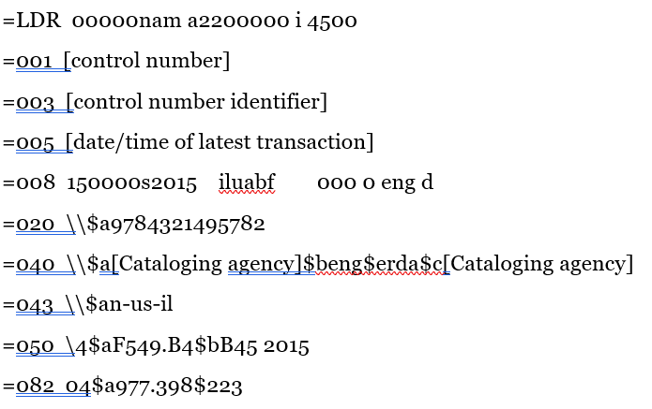
ChatGPT 5.4
Notes:
Eric
31

Slide 32
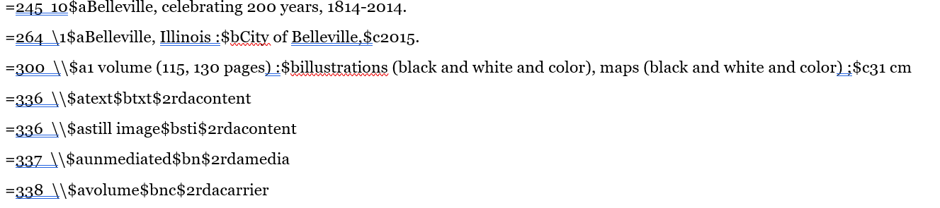
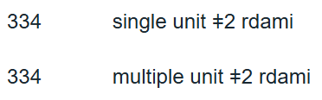
ChatGPT 5.4 (cont.)
Notes:
Eric
32

Slide 33
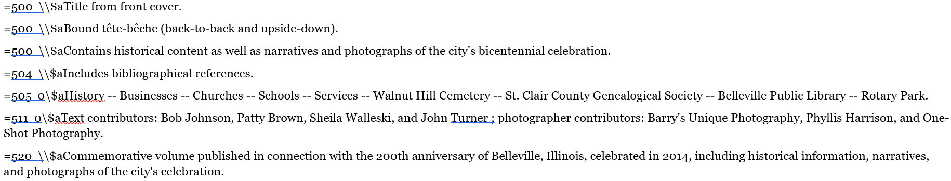
ChatGPT 5.4 (cont.)
Notes:
Eric
33

Slide 34
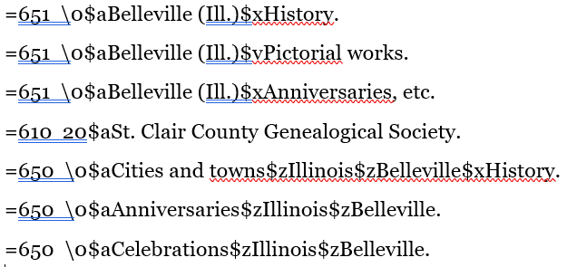
ChatGPT 5.4 (cont.)
Notes:
Eric
34

Slide 35

ChatGPT 5.4 (cont.)
Notes:
Eric
35

Slide 36
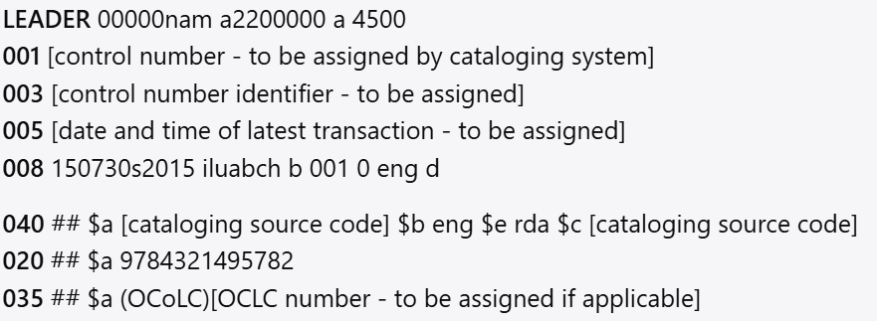
DeepSeek V3.2
Notes:
36

Slide 37

DeepSeek V3.2 (cont.)
Notes:
37

Slide 38

DeepSeek V3.2 (cont.)
Notes:
Notes on Key Fields:
LDR/008: Coded for a printed language material (a) published in 2015 (s2015). Place of publication is Illinois (ilu). Illustrative content codes: a=maps, b=illustrations, c=portraits. Form of item is a printed volume (h).
245: The title is taken from the only source, the cover ($a). A statement of responsibility ($c) lists the primary contributors (text writers).
264: The publisher is inferred to be the City of Belleville, as the city "created and published" the book. The location is placed in brackets as it is not explicitly stated on the item but is certain.
300: Dimensions are converted from 12.2 inches to the nearest whole centimeter (31 cm). The unique pagination ("115, 130 pages") reflects the tête-bêche (back-to-back) format. Illustrative details are specified.
500 Notes: Crucial notes for the cataloger and user: source of title, publication occasion, and the distinctive binding.
336-338: RDA content/media/carrier type terms.
505: Formatted table of contents.
700/710: Separate entries are created for all named textual contributors (with relator term $e contributor) and photographic contributors (with relator terms $e photographer or $e contributor for corporate entities). The city is added as an issuing body.
Fixed Fields (not displayed in block above but implied by 008):
Desc: a (AACR2-compatible RDA record)
DtSt: s (Single known date)
Dates: 2015,
Ctry: ilu
Lang: eng
Form: (None specified, i.e., not a manuscript, braille, etc.)
MRec: (Not a microform reproduction)
Srce: d (Not a government publication)
Ills: abch (Maps, Illustrations, Portraits, Coats of arms)
Audn: (Target audience not specified)
Cont: (Form of contents not specified beyond the 505)
GPub: (Not a government publication)
Conf: 0 (Not a conference publication)
Fest: 0 (Not a festschrift)
Indx: 0 (No index)
LitF: 0 (Not fiction)
Biog: (Biographical data not specified)
This record provides a full bibliographic description that meets RDA standards and accurately captures the unique physical characteristics of the item.
38

Slide 39
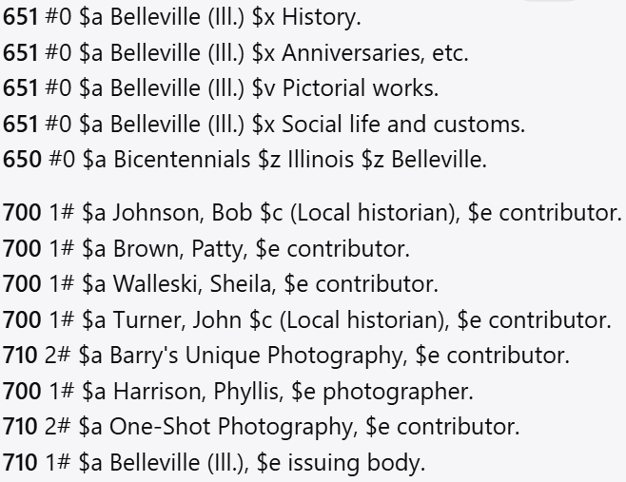
DeepSeek V3.2 (cont.)
Notes:
39

Slide 40
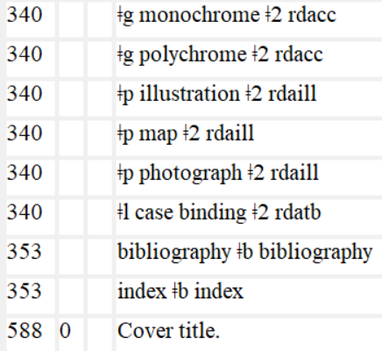
340
Notes:
Here is what both omitted.
40

Slide 41

Gemini 3.1 -- Live Demo
Notes:
Eric
41

Slide 42
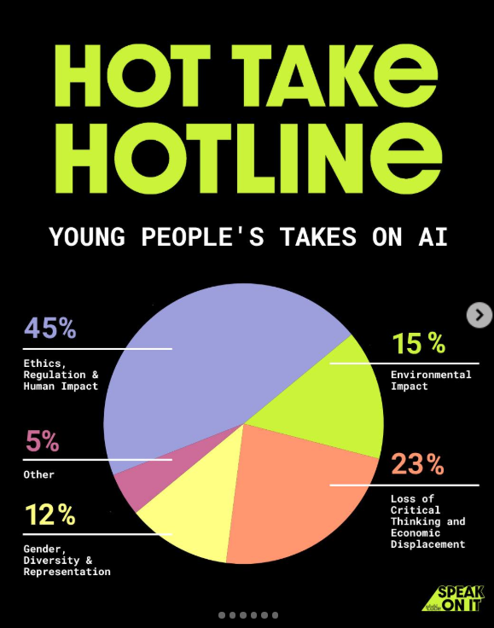
Girls Who Code AI Survey
Notes:
Pam: “One thing is clear: youth want AI that’s human-centered, ethical, sustainable, and inclusive … Our community imagines a future where technology: ✨ Serves humanity, not profit. 🎨 Amplifies creativity, not replaces it. 🌍 Reflects diversity, not bias. 💚 Respects the planet, not exploits it.” (1) Instagram
42

Slide 43
Resources
Cox, Kirsten. (2025). What Can ChatGPT Do in the Library? Katina, Librarianship Elevated.
Girls Who Code AI Survey (2025)
Hall, Ysabella (2025). An Introduction to DeepSeek AI. UEA Library Blog.
Suryawanshi, Sachin & Mane, Smita & Rathood, Pooja. (2025). DeepSeek AI in Libraries. International Journal of Applied Ethics. 11. 1-7.
Xiao, T., Nerini, F.F., Matthews, H.D. et al. Environmental impact and net-zero pathways for sustainable artificial intelligence servers in the USA. Nat Sustain 8, 1541–1553 (2025). https://doi.org/10.1038/s41893-025-01681-y
Notes:
43

Slide 44
Resources
Pinheiro Privette, A. (2024, October 11). AI’s Challenging Waters. Illinois.edu. https://cee.illinois.edu/news/AIs-Challenging-Waters
Meyer, Macy. (2026). AI Data Centers: What to Know About Their Water and Energy Use. CNET. https://www.cnet.com/tech/services-and-software/ai-data-center-what-to-know/
Notes:
44

Slide 45

Questions?
Notes:
45

