Slide 1
Cataloging Best Practices
Dr. Pamela Thomas, Bibliographic Grant Manager, IHLS/CMC
RSA Day, April 10, 2025, 9:30-10:30 a.m.
Notes:
Are you new to cataloging? Do you find all the rules confusing? I will discuss best practices in cataloging to help you focus on the information you need to include in a bibliographic record.

Slide 2
Agenda
Description
Importance of High-quality Cataloging for Library Users
FISO (Find, Identify, Select, Obtain)
Understanding Current Best Practices in Cataloging
Examples
Classification
Subject Headings
Matching Records
Staying Informed

Slide 3
Descriptive Cataloging
“Descriptive cataloging involves applying a standardized set of rules, currently RDA: Resource Description and Access, to record the title, authorship, and publication data for a work, describe the physical extent of the work, add bibliographic notes as necessary, and add access points for persons or entities associated with the creation of the work”—ALA Resource Guides.

Slide 4
Bibliographic Description
Author
Title
Publication data
Physical description
Notes
Access points
Notes:
This is the important information that needs to be included in each bibliographic record. I will be sharing examples of a book, video, sound recording, serial/continuing resource, and realia highlighting this content.

Slide 5
Importance of high-quality cataloging for library users
Find: Find resources that match a search
Identify: Distinguish between different sources
Select: Choose the resource that best meets the user’s needs
Obtain: Request the resource from the library
Notes:
Let’s talk about the importance of high-quality cataloging for library users. Your patrons need to Find, Identify, Select, and Obtain (FISO) the items they are looking for. I am going to talk about each of these individually in the next few slides.

Slide 6
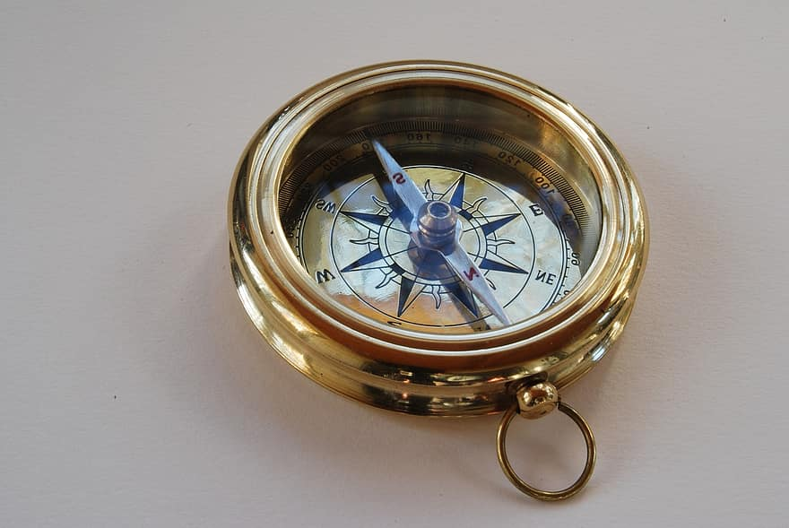
Find
Find: Find resources that match a search
Notes:
When you have a clean database, your users/patrons will be able to find resources that match a search. As we know, people usually only view the first page or two of the results page. Ensuring that the best matches are on the first page or two is vital. What is your patron looking for? How can you help them find that item?

Slide 7
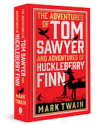
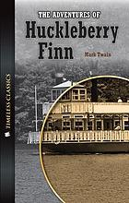





Identify
Identify: Distinguish between different sources
2024 edition
2013 edition
2014 edition
Notes:
Is your patron looking for a book in English, a journal in Polish, a DVD, or a graphic novel? Having a catalog with filtering and correctly coding the fixed fields in a MARC record will allow your patrons to find exactly what they are looking for. Your patron is looking for the 2024 edition of The adventures of Tom Sawyer and Huckleberry Finn by Mark Twain. The correct edition is on the left. During their search, they also found a 2013 edition (middle image), and a 2014 board book adaptation (image on the right) in your database.

Slide 8

Select
Select: Choose the resource that best meets the user’s needs
This Photo by Unknown Author is licensed under CC BY-SA
Notes:
Your patron has selected the 2024 edition of The Adventures of Tom Sawyer and Huckleberry Finn. They need to be able to find it quickly and easily not only from the library database but also from the shelf. Having to sort through pages of search results and various library shelves can be frustrating.

Slide 9

Obtain
Obtain: Request the resource from the library
Notes:
Your patron has successfully found the 2024 edition of The Adventures of Tom Sawyer and Huckleberry Finn in the database and on the shelf, and they are ready to check it out from the library. Being able to tell which copies are available makes the process simple and easy.

Slide 10
Understanding Current Best Practices in Cataloging
Descriptive Cataloging
Classification
Subject Headings
Staying Informed
Notes:
Having an understanding of the current best practices in cataloging can ensure that your bibliographic records are cataloged consistently and accurately. I will be discussing descriptive cataloging, classification, and subject headings in conjunction with specific titles and various formats. Finally, I will discuss how you can stay informed with current best practices. The following bibliographic record examples are from OCLC Connexion and do not display $a.

Slide 11
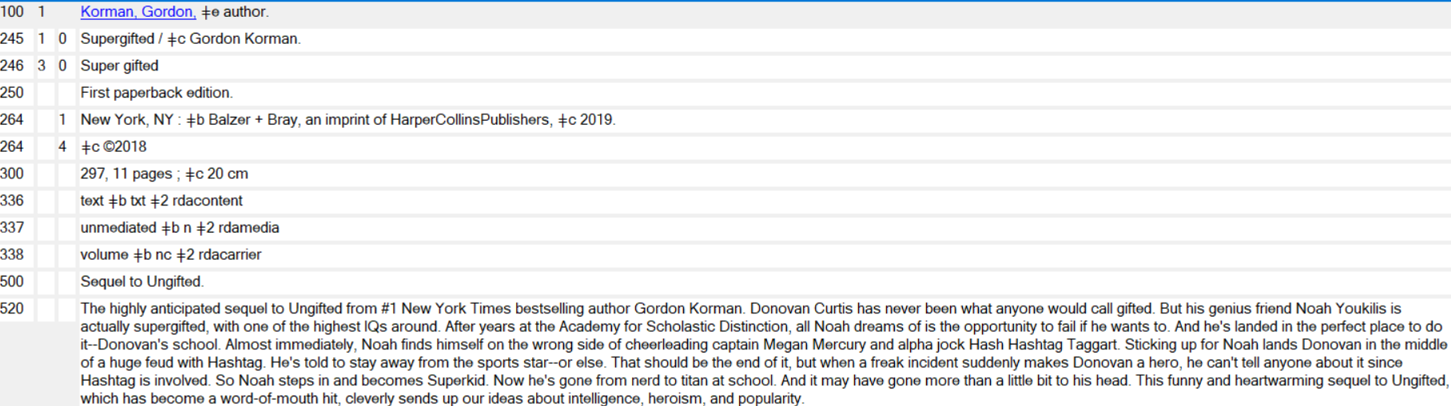
Book Description
Notes:
For this book, Supergifted, we have the author, Gordon Korman, in the 100 field. The title is in the 245 field. The variant title, Super gifted as two words, is in the 246 30 field. Publication data is in both of the 264 fields. The physical description is in the 300 field. The 334 field, Mode of Issuance, which is fairly new, has single unit—right now, there are only two options for this field: single unit and multiple unit. The 336-338 fields are standard for a book. There are two notes, the first 500 informs us that this is a sequel to Ungifted, and the Summary, Etc., note, the 520 field, gives a fairly lengthy summary. This note could be tweaked a little to be more concise. The guidance from OCLC’s Bibliographic Formats and Standards (BFAS): “The level of detail in a summary may vary depending on the audience for a particular item. When no distinction between levels of detail in a summary note is required, subfield ǂa contains all the text. When a distinction is appropriate, subfield ǂa contains a brief statement and subfield ǂb contains additional information.” There are not any 7XX fields for this title. I will discuss the subject headings in a few minutes.

Slide 12
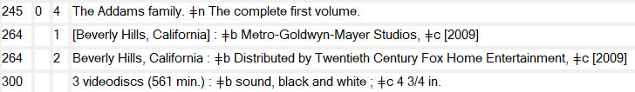
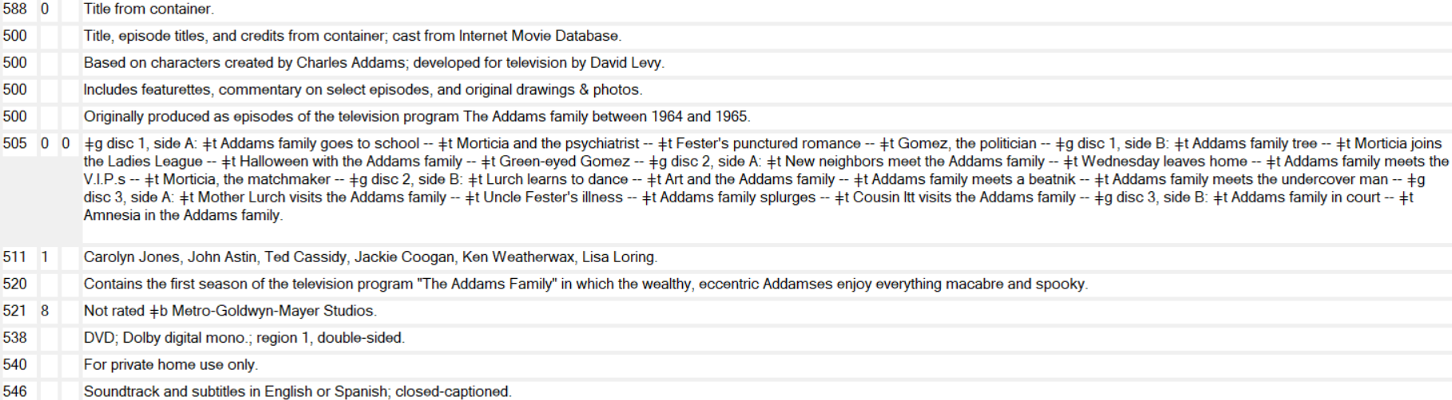
Video Description
Notes:
As you can see, there is no author or creator for this video, The Addams family. Typically, videos do not have an author or creator, unless they fill all the roles of responsibility (acting, directing, producing, etc.), which rarely happens. So, we have the title as well as publication information (in both of the 264 fields). Notice that the second 264 field has distributor information (second indicator is 2). The 300, or Physical Description field, informs us that there are 3 videodiscs with 561 minutes, that there is sound, the video is in black and white, and the size of the discs is 4 ¾ in. I did not include all the 3XX fields for the sake of space and readability on the slide. There are numerous 5XX fields, with really great information. The 588 0_, Source of Description Note—Source of Description, has Title from container. There are four general notes, 500 fields. The first one provides information about the title and episode titles. The second 500 gives a characters based on note. The third 500 discusses additional content. The final 500 tells us that the episodes were originally produced as a television program and when. The 505 00, Formatted Contents Note—Contents—Enhanced, lists the titles of the episodes and which disc they are on. The 511 1_, Participant or Performer Note—Cast, lists the main actors. The 520, Summary, Etc., note, gives a brief summary. The 521 8_, Target Audience Note—No display constant generated, gives the rating, Not rated, and the publishing company. The 538, System Details Note, gives technology information, DVD, Dolby digital mono, region 1, double-sided. The 540, Terms Governing Use and Reproduction Note, tells us that this DVD is for private home use only. The final 5XX field, 546, Language Note, lets us know that the soundtrack and subtitles are in English or Spanish and that it is closed-captioned. Let’s move to the next slide to see the access points.

Slide 13
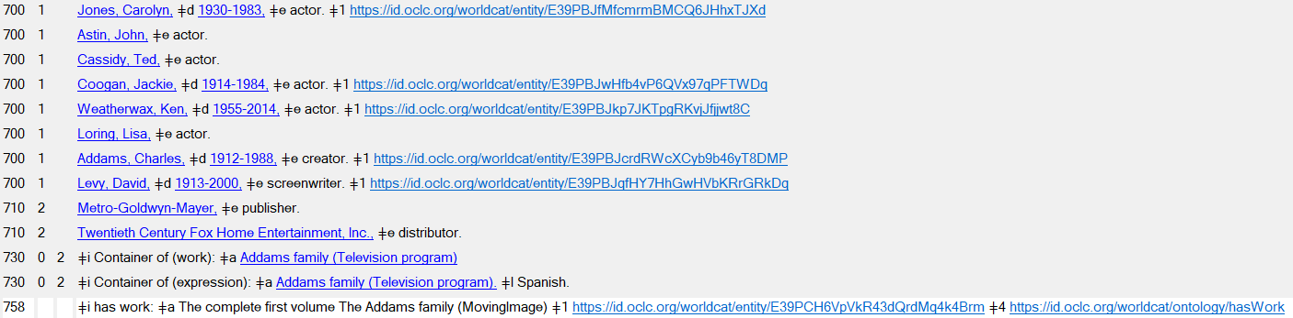
Video Description, C’td.
Notes:
If you have cataloged any media, you know that there are always numerous access points. For this video, there are actors, a creator, and screenwriter, all in a 700 1_ field, Added Entry—Personal Name, and the publisher, distributor in the 710 2_ fields, Added Entry—Corporate Name—Direct Order, two analytical titles in the 730 02 fields, and a 758, the Resource Identifier field, which has a link to WorldCat. I will discuss the subject headings in a few minutes.

Slide 14
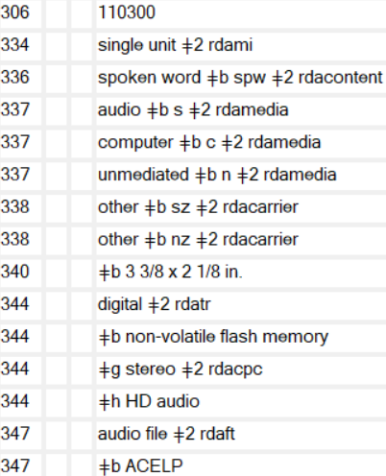
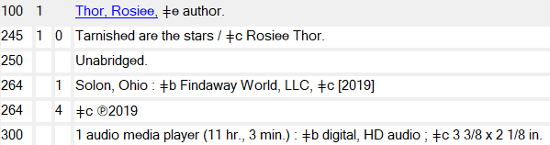
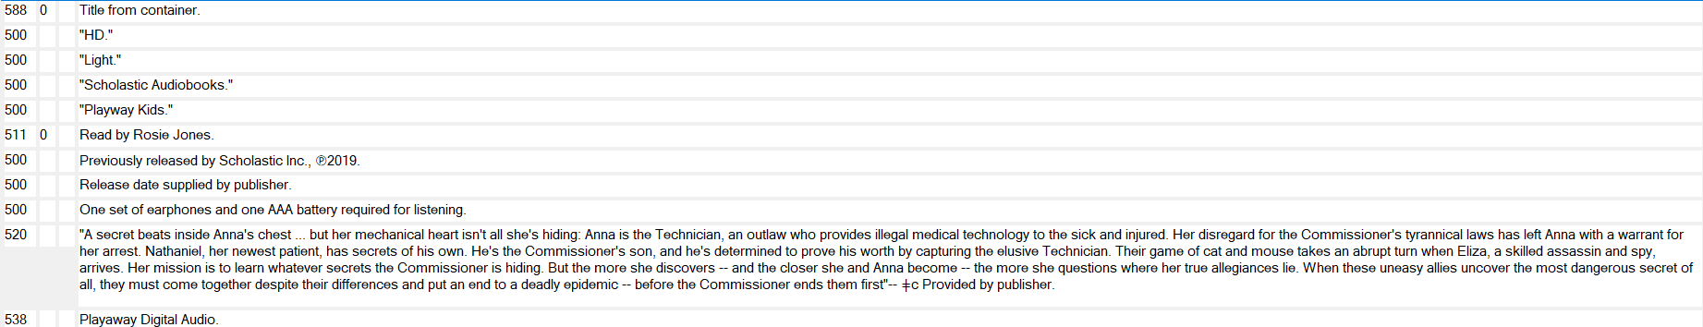
Sound Recording Description
Notes:
For our sound recording, we have Rosiee Thor as the author in the 100 field. Tarnished are the stars is the title in the 245 field. We have two 264 fields. The first one has the place of publication, Solon, Ohio, the publisher, Findaway World, LLC, and 2019 as the implied publication date. The second 264 has the copyright date of 2019. The 300 field, or Physical Description, has 1 audio media player (11 hr., 3 min.) in $a for the extent, digital, HD audio in $b for other physical details, and in $c are the dimensions, 3 3/8 x 2 1/8 in. The rest of the 3XX fields are on the right of the slide. Finally, we have all kinds of notes! As you can see, this is a Playaway. The cataloger used the title from the container (the 588 0_ field). There are four quoted notes. Typically, if a note has quotations, the source of the quotation should be provided. The 511, Participant or Performer Note, tells us that this book is read by Rosie Jones. There are three more General Notes, 500 fields, with the previously released by Scholastic, the release date was supplied by the publisher, and there is one set of earphones and one AAA battery which are required for listening. The 520 or Summary, Etc., note gives a quoted note with the information that it was provided by publisher. Finally, a 538, System Details Note, tells us that this is a Playaway Digital Audio.

Slide 15
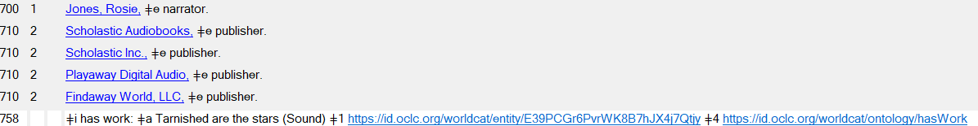
Sound Recording, C’td.
Notes:
Here are the access points for Tarnished are the stars. The 700 field, Added Entry—Personal Names, is for the narrator, Rosie Jones. The four 710 fields, Added Entry—Corporate Name, are for the four publishers. The 758 field, Resource Identifier, has a link to the entity record in $1, Real World Object URI, and in $4, Relationship, or the RDF Schema (Resource Description Framework). I will discuss the subject headings in a few minutes.

Slide 16
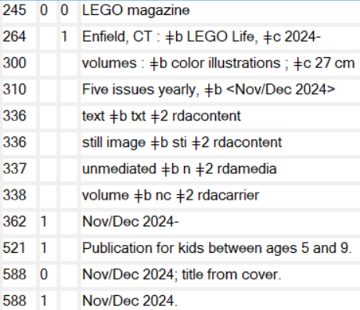

Serial/Continuing Resource Description
Notes:
For our serial/continuing resource record, we have LEGO magazine, which we can find in the 245 field. There is no author and typically serial/continuing resource records will not have an author. In the 300 field, volumes is in $a along with color illustrations in $b and the height of the magazine, 27 cm in $c. There is a 521 1_ field, Target Audience Note—Interest Age Level, Publication for kids between ages 5 and 9. The 588 0_ field, Source of Description Note—Source of Description, Nov/Dec 2024; title from cover. The 588 1_ field, Source of Description Note, Latest issue consulted, informs us that the description is based on the Nov/Dec 2024 issue. For access points, we have a 780 00, Preceding Entry—Display Note—Continues, Lego life magazine and then the OCLC number in $w. The 856 41, Electronic Location and Access—HTTP—Version of Resource, with the url to Lego magazine. The 856 42, Electronic Location and Access, HTTP, Related Resource, has the url to LEGO Club in $u, Uniform Resource Identifier and the Related internet site in $z, Public note. I will discuss the subject headings in a few minutes.

Slide 17

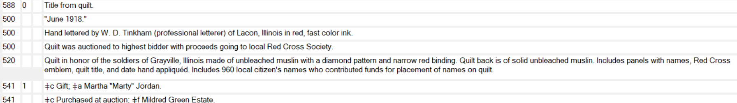

Realia Description
Notes:
The Red Cross 1918 roll of honor quilt is an example of a visual material realia object. The title is in the 245 field. There is no author. In the 264 field, there is $a [Place of production not identified] $b [producer not identified], $c 1918. In the 300 field, 1 quilt is in $a, Extent, muslin, color is in $b, Other physical details, and 202 x 238 cm is in $c, Dimensions. There are various notes, starting with the 588 field, Source of Description Note, indicating that the cataloger found the title from the quilt. The first 500, General Note, has “June 1918,” which we can assume appears on the quilt. The second 500 informs us that the quilt was hand lettered by W. D. Tinkham of Lacon, IL, in red, fast color ink. The third 500 tells us that the quilt was auctioned to the highest bidder with proceeds going to the local Red Cross Society. The 520 or Summary, Etc., note gives us information about the quilt. The 541 fields, Immediate Source of Acquisition Note, has Gift in $c, Method of Acquisition, and Martha “Marty” Jordan in $a, Source of Acquisition, while the second 541 has Purchase at auction in $c and Mildred Green Estate in $f, Owner. There are two 700 fields, Added Entry—Personal Name, for the letterer, W. D. Tinkham, and for the donor/contributor, Martha Jordan. The 710 field, Added Entry—Corporate Name, is for the Grayville Ladies (Grayville, Ill.), who were the creators of the quilt.

Slide 18

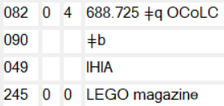


Classification
Notes:
The classification number should match the first subject heading in a bibliographic record. The number should be as specific as possible. Using the Red Cross 1918 roll of honor quilt (on the left), 746.46 is the Dewey Decimal Classification for patchwork and quilting. LEGO magazine (on the right) is our second example, and the DDC number is 688.725, which is for educational toys. The first subject heading, LEGO toys $v Periodicals, is a good match for this classification number.

Slide 19
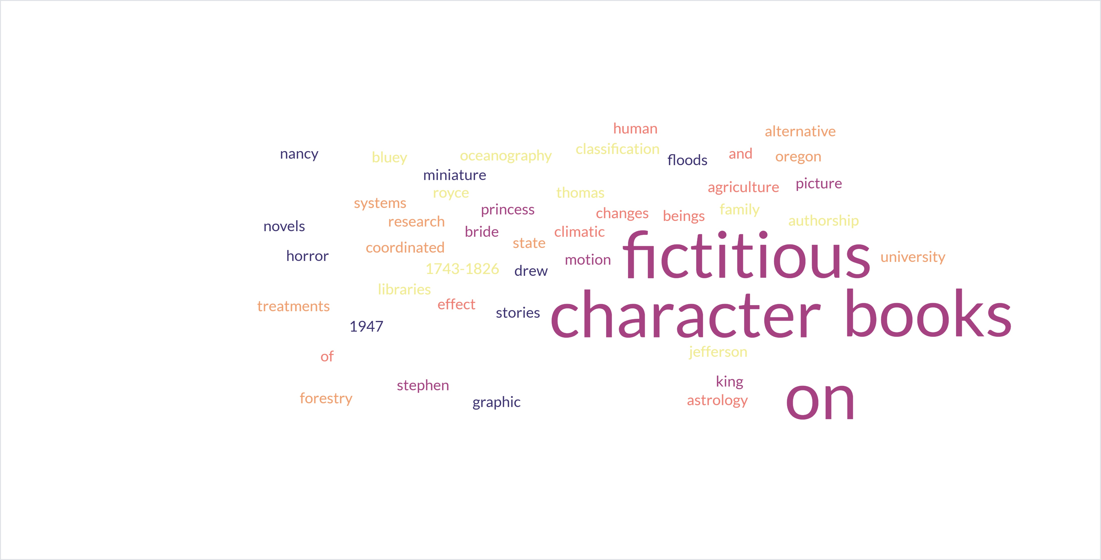
Subject Headings
Notes:
Subject analysis can be complicated. You need to determine what subject headings or topics match the item that you are cataloging. If your library uses Library of Congress subject headings (LCSH), then you need to become familiar with how LCSH are formatted. LCSH does not always use the most obvious terms, so don’t get frustrated if you don’t find an exact match for your first or second search. Useful resources are the Library of Congress online catalog, Library of Congress Subject Headings Manual, Classification Web Plus, and OCLC. LC’s online catalog and LC’s subject headings manual are free for anyone to use, but Classification Web and OCLC are subscription services. The 20% rule is still applicable, which recommends assigning headings only for topics that comprise at least 20% of the work. You can’t always rely on the words in the title to find the best subject headings for your item. Read the information on the jacket, the back of the book, table of contents, index, or you can look at outside sources, too—Amazon, the publisher’s website, etc. Sometimes, it can be more difficult deciding when to stop looking for subject headings and determining that you have enough for your bibliographic record. However, remember the 20% rule, where 20% of the contents of the work must pertain to the subject heading.

Slide 20

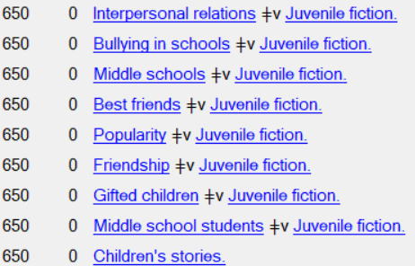

Subject Headings, C’td.
The Addams Family
Supergifted
The highly anticipated sequel to Ungifted from #1 New York Times bestselling author Gordon Korman. Donovan Curtis has never been what anyone would call gifted. But his genius friend Noah Youkilis is actually supergifted, with one of the highest IQs around. After years at the Academy for Scholastic Distinction, all Noah dreams of is the opportunity to fail if he wants to. And he's landed in the perfect place to do it--Donovan's school. Almost immediately, Noah finds himself on the wrong side of cheerleading captain Megan Mercury and alpha jock Hash Hashtag Taggart. Sticking up for Noah lands Donovan in the middle of a huge feud with Hashtag. He's told to stay away from the sports star--or else. That should be the end of it, but when a freak incident suddenly makes Donovan a hero, he can't tell anyone about it since Hashtag is involved. So Noah steps in and becomes Superkid. Now he's gone from nerd to titan at school. And it may have gone more than a little bit to his head. This funny and heartwarming sequel to Ungifted, which has become a word-of-mouth hit, cleverly sends up our ideas about intelligence, heroism, and popularity.
Contains the first season of the television program "The Addams Family" in which the wealthy, eccentric Addamses enjoy everything macabre and spooky.
Notes:
On the left is Supergifted with the summary note and subject headings. On the right is The Addams Family with the summary note and subject headings. After reading the summary, would you edit either summery note (add or delete information)? Would you add or remove any subject headings from either of these records?

Slide 21
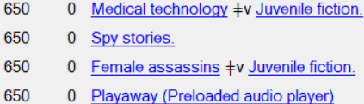

Subject Headings, C’td.
Tarnished are the stars
Lego magazine
"A secret beats inside Anna's chest ... but her mechanical heart isn't all she's hiding: Anna is the Technician, an outlaw who provides illegal medical technology to the sick and injured. Her disregard for the Commissioner's tyrannical laws has left Anna with a warrant for her arrest. Nathaniel, her newest patient, has secrets of his own. He's the Commissioner's son, and he's determined to prove his worth by capturing the elusive Technician. Their game of cat and mouse takes an abrupt turn when Eliza, a skilled assassin and spy, arrives. Her mission is to learn whatever secrets the Commissioner is hiding. But the more she discovers -- and the closer she and Anna become -- the more she questions where her true allegiances lie. When these uneasy allies uncover the most dangerous secret of all, they must come together despite their differences and put an end to a deadly epidemic -- before the Commissioner ends them first"-- ǂc Provided by publisher.
Notes:
I have provided the Summary, Etc., note for Tarnished are the stars as well as the subject headings. Reading over the summary, are there any subject headings that you think should be added? Would you edit the summary note—add or remove information? Lego magazine does not have a summary note, but I have included the subject headings. Would you like to suggest a summary note for Lego magazine? This is the description of the magazine that I found on the Lego magazine website. What information from this description could be used in a summary note?

Slide 22

Subject Headings, C’td.
Quilt in honor of the soldiers of Grayville, Illinois made of unbleached muslin with a diamond pattern and narrow red binding. Quilt back is of solid unbleached muslin. Includes panels with names, Red Cross emblem, quilt title, and date hand appliquéd. Includes 960 local citizen's names who contributed funds for placement of names on quilt.
Notes:
I have included the Summary, Etc., note, the 520 field, at the top of the slide, followed by the subject headings for the Red Cross 1918 roll of honor quilt. Reading the summary note, are there any other subject headings that you think should have been included? Would you rewrite the summary statement (add or delete any information)?

Slide 23
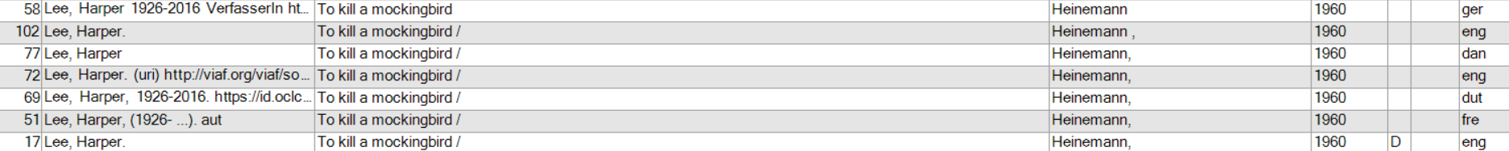
Matching Records
Notes:
Your library received a 1960 edition of To kill a mockingbird published by Heinemann in English. The book is in great condition, so you are going to add it to your collection. On the slide are the records you can choose from—remember, you can always create an original record, if there isn’t a good match.

Slide 24
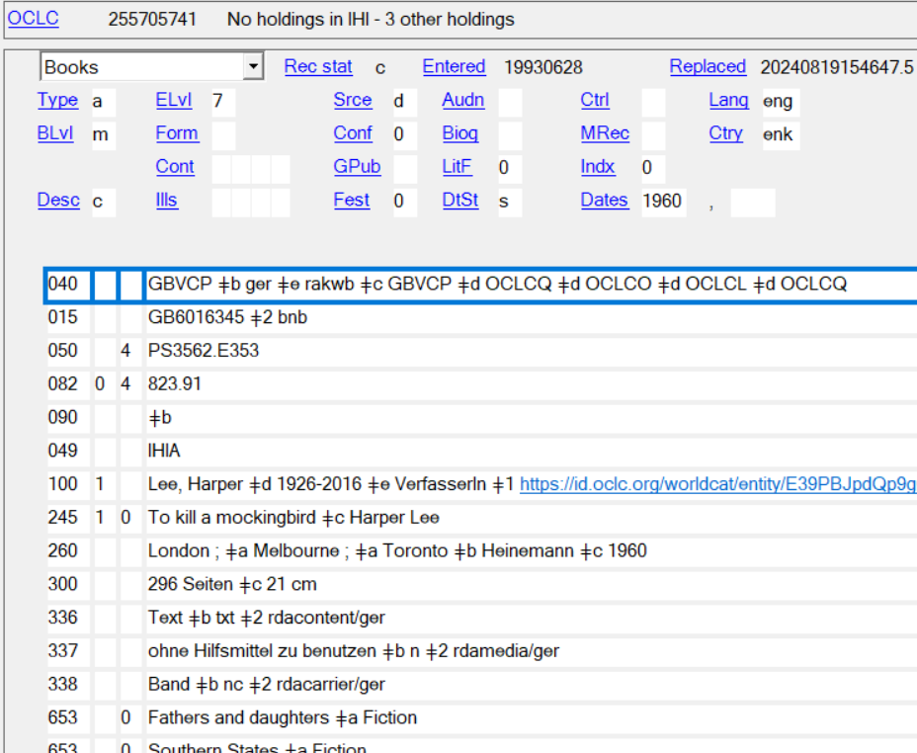
Matching To Kill a Mockingbird
Notes:
Record #1 is in German and the 040 $b, 300, and 336-338 fields tell us that. Does this record match the donated copy?

Slide 25
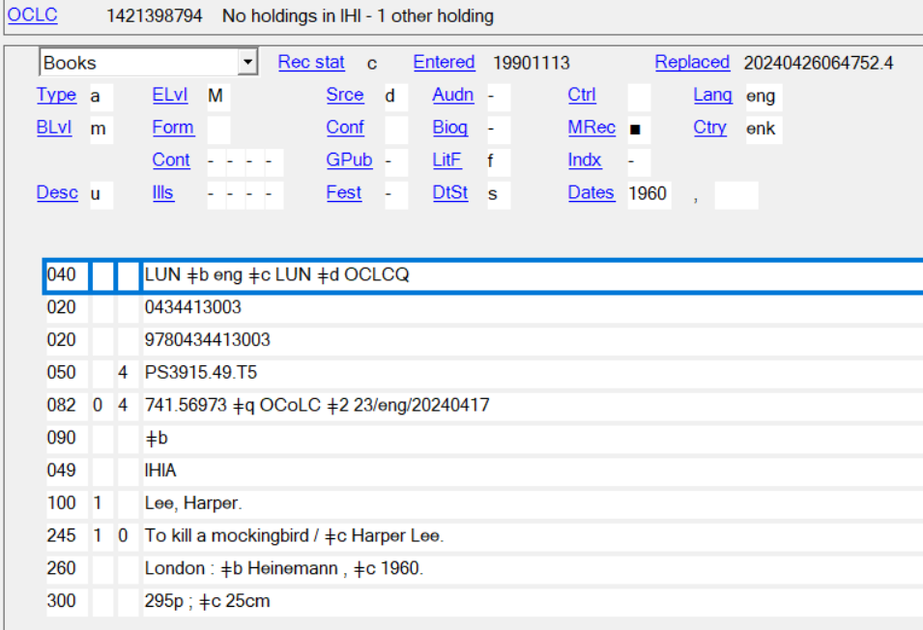
Matching To Kill a Mockingbird
Notes:
Record #2 is in English, was batchloaded (ELvl is M—which does not always mean that it’s a bad record), and Desc, Descriptive Cataloging Form, is coded as u which is unknown. This is an AACR2 record and not an RDA record (no $e rda in the 040 field, no $e author in the 100 field), a 260 and not a 264 field, no 336-338 fields, and there are no subject headings. This is the entire record. Is this a good match to our donation?

Slide 26
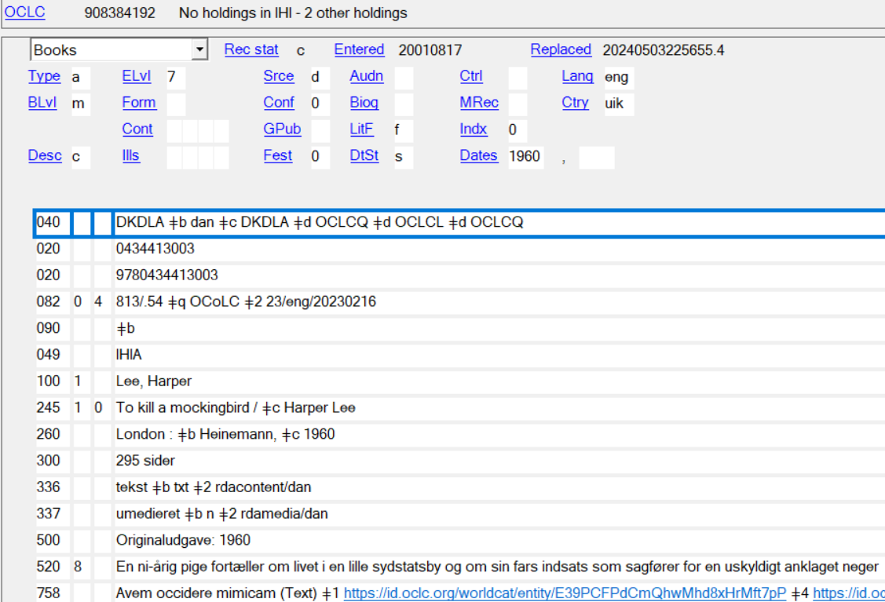

Matching To Kill a Mockingbird
Notes:
This is Record #3. Desc, Descriptive Cataloging Form, is coded as c for ISBD punctuation omitted. ELvl is coded 7 for minimal level. Ctry is coded uik for United Kingdom Misc. Islands. In 040 $b, there is dan for Danish. There is no $e rda in the 040 field, so this has not been cataloged using RDA guidelines. This record does not have $e author in the 100 field. There is a 260 and not a 264. The 300 has sider instead of pages. The 336-338 fields are in Danish and so are the 500, 520, and 758 fields and possibly the 029 fields. This is a hybrid record (both AACR2 and RDA elements). Is this a good match for our donated copy?

Slide 27
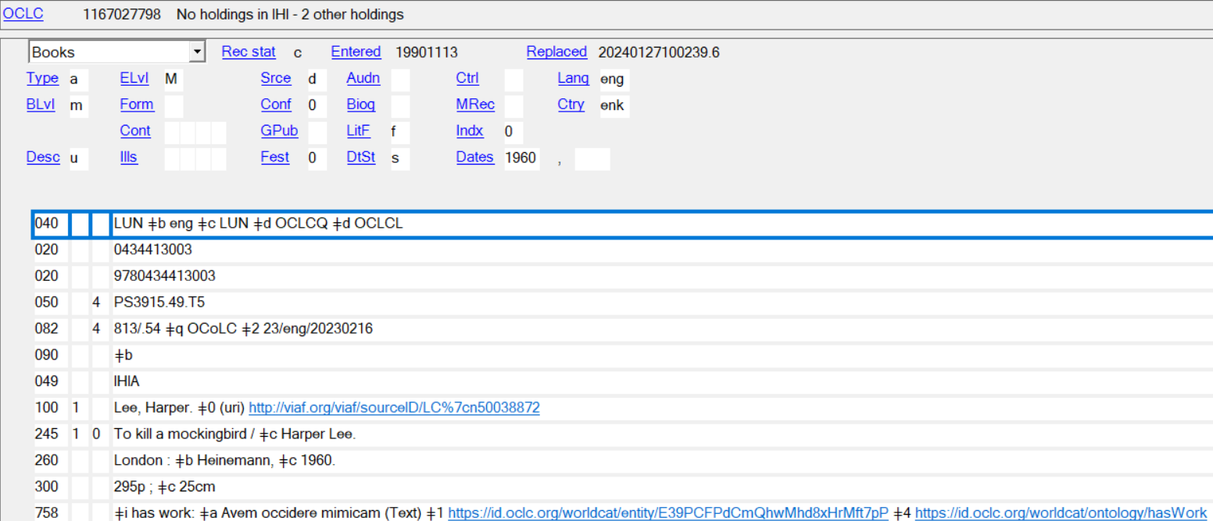
Matching To Kill a Mockingbird
Notes:
Record #4 was batchloaded, ELvl is M. Desc, Descriptive Cataloging Form, has u for unknown. There is no $e rda in the 040 field, so this has not been cataloged using RDA guidelines, but is an AACR2 record. There is no $e (relator term) in the 100 field. There is a 260 and not a 264 field. The 300 needs some work—a space needs to be inserted between 295 and p and between 25 and cm and pages should be spelled out. There are no 336-338 fields or subject headings. Is this a good match for our donated copy?

Slide 28
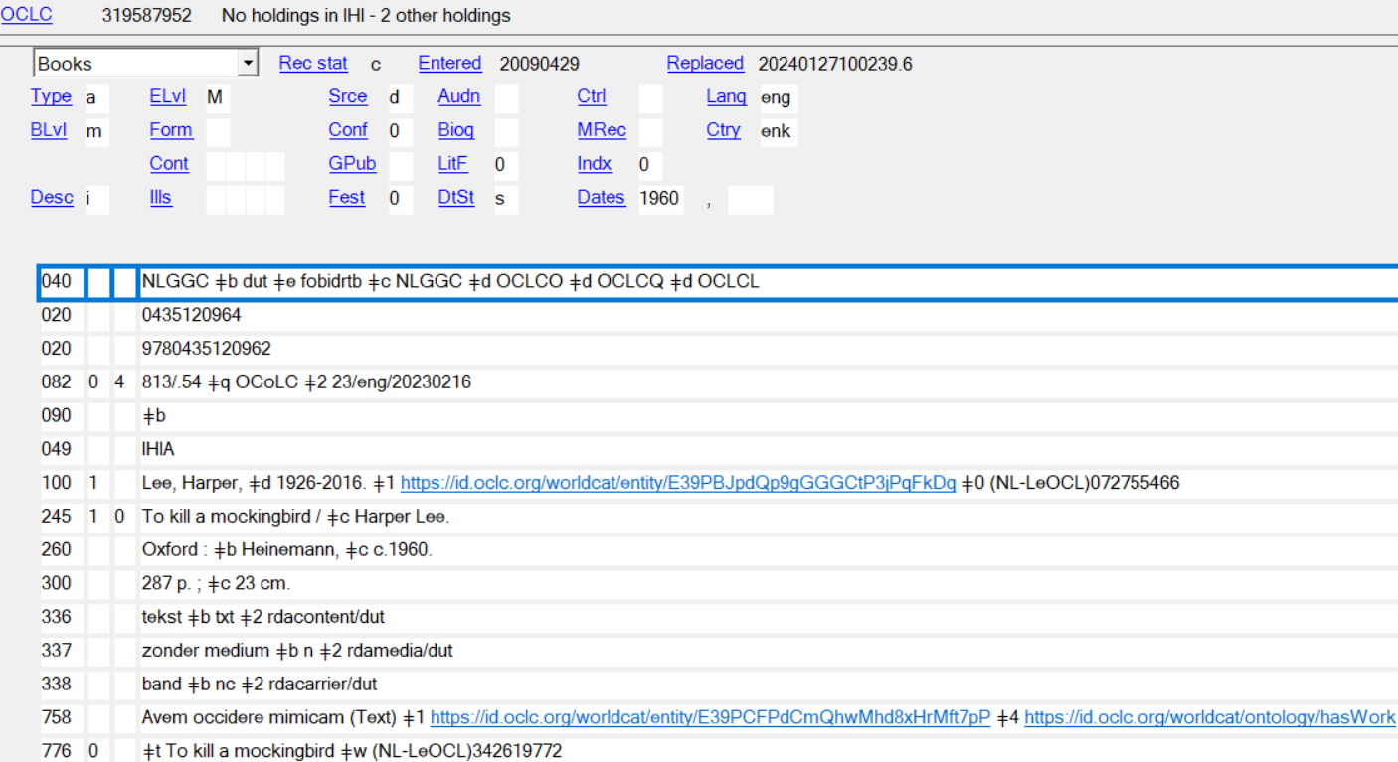

Matching To Kill a Mockingbird
Notes:
Record #5 is in Dutch (040 $b, 336-338, and 758 fields) indicate that. Is this a good match for our donated copy?

Slide 29
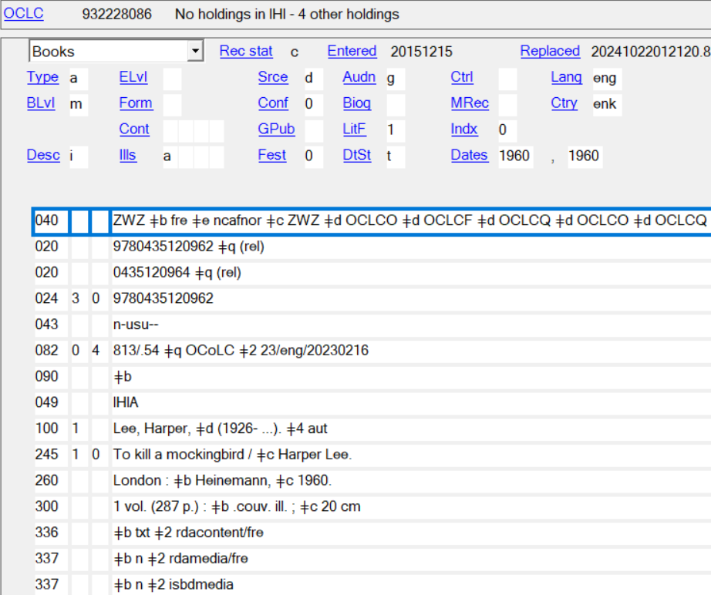
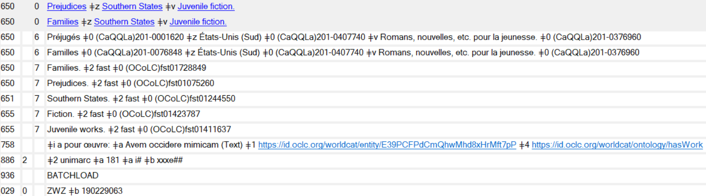
Matching To Kill a Mockingbird
Notes:
Record #6 is in French—the 040 $b, 300 $b, 336-337, and the 758 fields indicate this. Is this a good match for our donated copy?

Slide 30
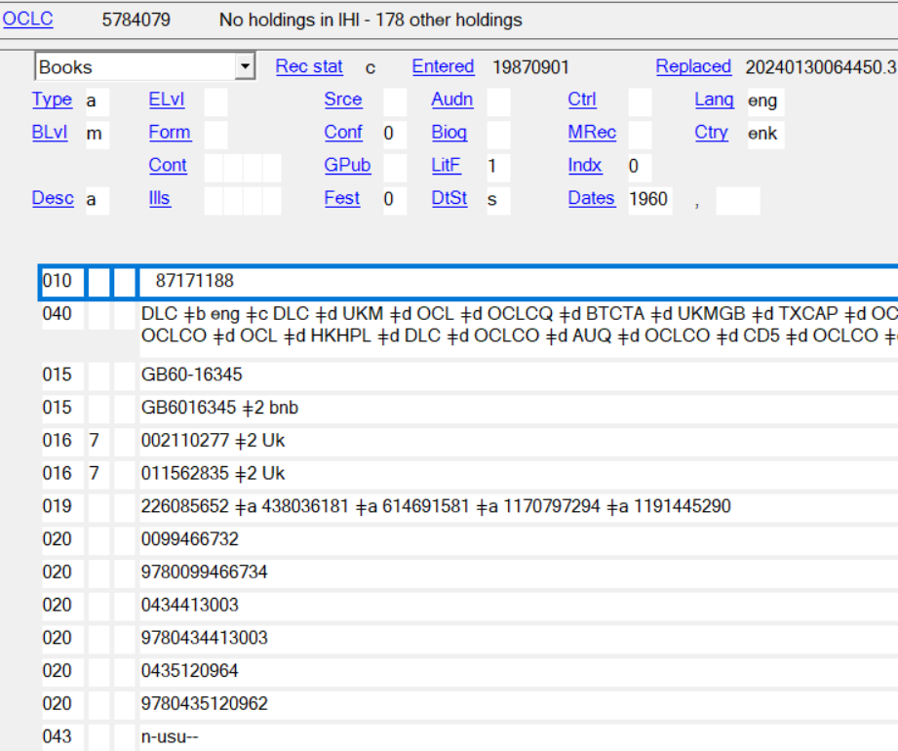
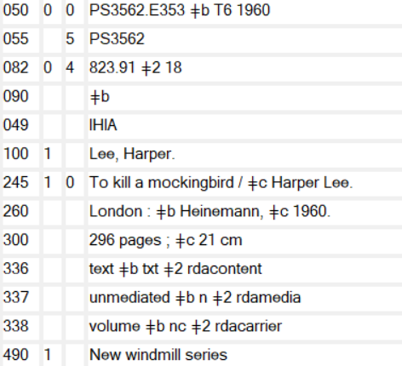
Matching To Kill a Mockingbird
Notes:
This is Record #7. The complete 040 is not included, but for display purposes only. Desc, Descriptive Cataloging Form, is coded as a for AACR2 rules, there is no $e rda in the 040, there is no $e in the 100 field, and there is a 260, rather than a 264 field. However, there are 336-338 fields, so this is a hybrid record (a mix of AACR2 and RDA). This has been cataloged by DLC (040 $a, $c, etc.). Is this a good match for our donated copy? Yes. It will need to be upgraded to RDA guidelines, though. Since there is a 490 field, then a period should be added after cm in the 300 $c. Let’s look at the rest of the variable fields.

Slide 31
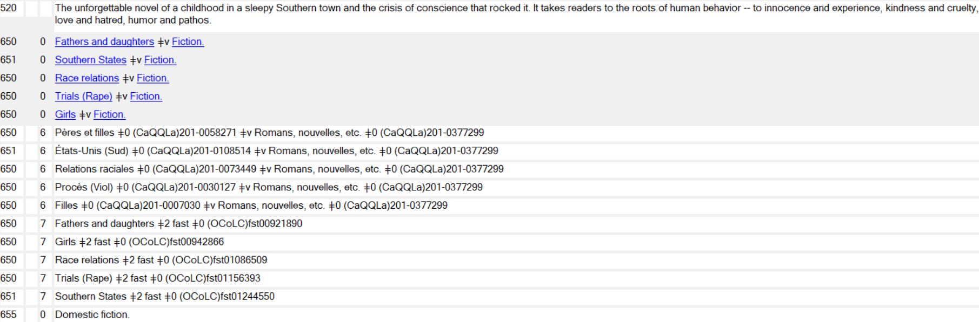
Matching To Kill a Mockingbird
Notes:
Here are the 5XX and 6XX fields for Record #7.

Slide 32
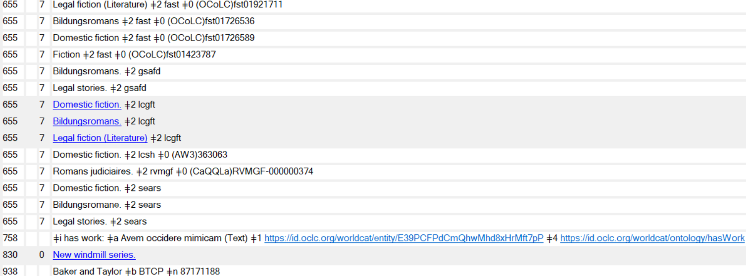
Matching To Kill a Mockingbird
Notes:
This is the end of Record #7—I have not included the numerous 029 fields.

Slide 33
Staying Informed
MARC Field Changes can be found at the following links:
MARC 21 Format for Bibliographic Data: Table of Contents (Network Development and MARC Standards Office, Library of Congress) (loc.gov)
WorldCat Validation release notes and known issues - OCLC Support
Technical Bulletins - OCLC Support
OCLC. Bibliographic Formats and Standards (BFAS)
OLAC. Resources
You can receive updates via email by subscribing to:
One or more of the following OCLC Product and Services Updates for Cataloging & Metadata, Dewey Services, WorldCat, Linked Data, etc.
Library of Congress Discussion lists
OCLC-Cataloging Listserv
Virtual AskQC Office Hours
Notes:
There are many ways to stay informed on changes to MARC records, subject headings, and cataloging in general. Here are just a few of them.

Slide 34
Resources
ALA. Resource Guides.
Classification Web Plus.
Lego magazine.
Library of Congress authorities database.
Library of Congress online catalog.
Library of Congress Subject Headings Manual.
MLA (Music Library Association) Best Practices.
OCLC. Bibliographic Formats and Standards.
OLAC (2020). Best Practices for Cataloging Objects Using RDA and MARC 21.
OLAC (2023). OLAC Best Practices for Cataloging DVD-Video and Blu-Ray Discs, Objects, Streaming Media, and Video Games Using the Original RDA Toolkit and MARC 21.

Slide 35

This Photo by Unknown Author is licensed under CC BY-SA

